Slide 1
OPTIMIZING EDUCATION BENEFITS A Great Opportunity to Proactively Help Our Taxpayers
Bill Hawkins
January 6, 2022

Slide 2
3 THINGS TO REMEMBER
There is a lot to cover in this presentation, but there are 3 primary things you need to know about education optimization:
You usually have the power to choose where best to use educational expenses to create the most tax savings for your client.
The American Opportunity Credit is the benefit to choose any time it is available.
Be extra cautious before allowing a postsecondary student to claim herself.
If you remember these 3 things, you will be doing the right thing for our clients when it comes to maximizing the available tax benefits for education.
While these 3 points generally answer the question for the vast majority of our clients, for the “complicated” minority, I will give you the information and tools you will need to help them out as well, but understand things get much more complicated.

Slide 3
OPTIMIZING EDUCATION BENEFITS
An area of great confusion & great opportunity.
Take the time to learn it or make sure a more experienced volunteer at your site helps with optimizing education benefits or else we are making taxpayers pay tax they don’t owe.
This discussion does not detail the requirements for the various education benefits but instead focuses on optimizing those benefits. The requirements for the various education benefits are explained in detail in Pub. 4012, Tab J.
Be sure you understand what benefits your taxpayer can qualify for before beginning this exercise. If the taxpayer qualifies for the AOC, you will always pick the AOC.
It is incredibly helpful if you are doing the returns of the student and the parents at the same time if the parents are claiming the student.

Slide 4
EDUCATION TAX BENEFITS
The following tax benefits are potentially available with respect to educational expenses:
The American Opportunity Credit (AOC)
The Lifetime Learning Credit (LLC)
Preventing a scholarship from being taxable to the student
Preventing the imposition of tax on a distribution from a Section 529 Plan (or Coverdell Education Savings Account).
The December 2020 Stimulus Bill repealed the Tuition and Fees deduction for years after 2020.
Note that other potential benefits exist (such as Employer-provided Educational Assistance) but this discussion is limited to the benefits listed above.

Slide 5
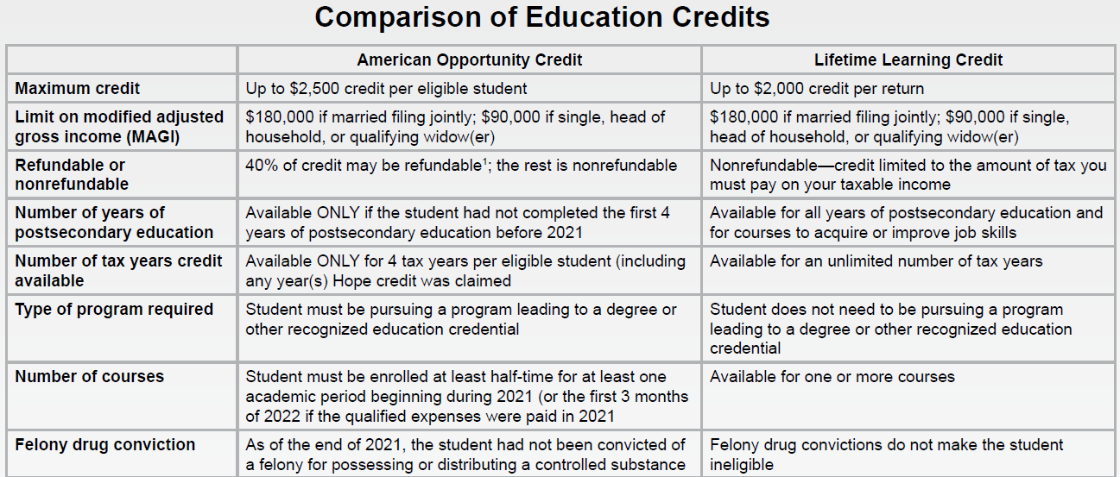
EDUCATION CREDITS

Slide 6
WHO GETS THE BENEFIT?
The AOC and LLC are both taken by the taxpayer who is “claiming” the student.
For example, if the parents claim the student on their return, the parents get the education credit tax benefit.
If the student is not claimed by anyone else, she gets the benefit.
Unlike the test for whether the student can be claimed as a dependent which focuses on whether someone else is “eligible to claim” the student, this test focuses on whether anyone else actually claims the student and, if not, the student may claim the education credit.

Slide 7
WHO GETS THE BENEFIT?
Scholarship income is always the income of the STUDENT even if another taxpayer can claim the related QEE tax benefit. Thus, using QEE to offset scholarship income benefits the student without regard to whether someone else is claiming the student. If the student doesn’t have enough income to owe any tax even with all the scholarship included in income, no benefit is received for allocating expenses against scholarship income.
Section 529 benefits go to the recipient of the 529 distribution which is shown by the SSN on the 1099-Q. That can be the student or the parent depending on how the 529 plan is structured.

Slide 8
QEE SUMMARY
Pub. 4012, J-2 to J-4
 | AOC | LLC | Scholarship Income | 529 Income
Tuition – Undergrad or Certificate | X | X | X | X
Tuition - Graduate | X but rarely | X | X | X
Mandatory Fees | X | X | X | X
Books | X | X if required to be bought from the school | X | X
Supplies Required for Course of Study | X | X if required to be bought from the school | X | X
Room/Apt |  |  |  | X if at least half time
Meal Plan |  |  |  | X

Slide 9
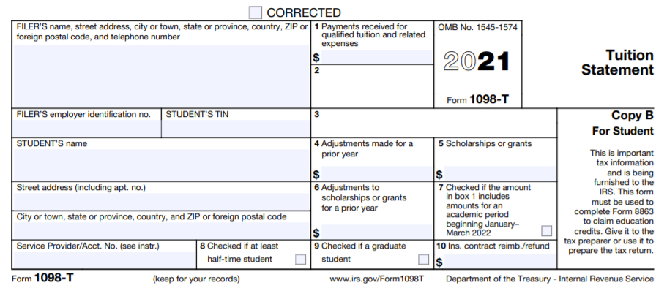
WHAT DO WE MEAN BY OPTIMIZING EDUCATION BENEFITS?
The way we often think about education benefits –
Instead, we want to think about optimizing the tax benefits available to the taxpayer using the qualified educational expenses.
If Box 1 plus books & supplies is GREATER than Box 5, the excess is qualifying expenses for the various education benefits like the AOC.
If Box 5 is GREATER than Box 1 plus books & supplies, the excess is scholarship income.
And that’s as far as we go

Slide 10
WHAT CAN WE DO WITH QUALIFIED EDUCATIONAL EXPENSES?
OFFSET SCHOLARSHIP INCOME
OFFSET
529 PLAN DISTRIBUTIONS
USE AS QEE FOR AOC CREDIT
OR
USE AS QEE FOR LLC CREDIT

Slide 11
LIMITATIONS ON OUR ABILITY TO CHOOSE
There are several limitations on our ability to allocate QEE to whatever benefit we desire (in addition to the technical requirements for the benefit itself):
If a scholarship is “Restricted”, the QEE paid for with the restricted scholarship must first be allocated against scholarship income and is not available to generate other benefits until the restricted scholarship amount is covered. A scholarship is restricted if by its terms it must be used for QEE and thus cannot be used for room and board, general living expenses, or other expenses that are not QEE. Restricted scholarships are definitely the exception to the rule, but you have to ask (unless you know it’s a Pell Grant or UNC or NC Need-Based Scholarship, which are all unrestricted).

Slide 12
LIMITATIONS ON OUR ABILITY TO CHOOSE
Out-of-Scope Limitations – There are two that can become an issue:
Kiddie Tax – Scholarship income that is included in income is treated as unearned income for purposes of the Kiddie Tax. Having too much scholarship income can trigger the Kiddie Tax which makes the student’s return out of scope.
Section 529 Distributions – If the QEE allocated to a section 529 plan distribution is not sufficient to cover the entire amount of the 529 distribution, some or all of the earnings on that distribution will be taxable. A partially or fully taxable 529 distribution is out-of-scope for VITA. This limits our ability to elect to tax the earnings on a 529 distribution in order to generate other tax benefits which is unfortunate as allocating QEE against a 529 distribution is typically the least beneficial allocation.

Slide 13
LIMITATIONS ON OUR ABILITY TO CHOOSE
Living Expense Limitation – When we allocate QEE away from scholarships and to other tax benefits, we are technically allocating the QEE to living expenses that do not qualify as QEE. There is the possibility that a student’s total living expenses other than QEE would be less than the amount we want to reallocate to other tax benefits, and thus we would not be able to allocate to an education credit as much as we want. In the case of the AOC, this is highly unlikely, as the most we are allocating away from scholarships would be $4,000 and this is almost certain to be less than the student’s living expenses (which would include housing costs, food, spending money, etc.). While it is more likely to arise in the LLC context, I have ignored this in the discussion that follows as I believe this to be a highly unlikely scenario.

Slide 14
LIMITATIONS ON OUR ABILITY TO CHOOSE
Need-Based Assistance – If the taxpayer is receiving certain need-based assistance that is dependent on the taxpayer’s income reported on her tax return, allocating scholarship income to such a taxpayer could result in a decrease in benefits. Obviously, the following discussion does not take this situation into account, so it will be up to you to determine if this is an issue for your taxpayer.

Slide 15
LIMITATIONS ON OUR ABILITY TO CHOOSE
Finally, there can be unusual situations where a scholarship received by the student would always be taxable even if we allocate QEE against it, and thus there would never be any reason to allocate any QEE against this scholarship (which means we are free to allocate to the education credits without any concern about allocating against the scholarship). This would be the case if the student is not a “candidate for a degree” at an eligible educational institution
This will not be an issue for the AOC, since being a candidate for a degree is a requirement for qualification for the AOC. However, in addition to covering degree program courses, the LLC also covers courses taken by the student to acquire or improve job skills which would not satisfy the requirement.
If these scholarships are enough to trigger the Kiddie Tax, the student’s return is out of scope.

Slide 16
LIMITATIONS ON OUR ABILITY TO CHOOSE
You are a candidate for a degree if you:
Attend a primary or secondary school or are pursuing a degree at a college or university; or
Attend an educational institution that:
Provides a program that is acceptable for full credit toward a bachelor's or higher degree, or offers a program of training to prepare students for gainful employment in a recognized occupation; and
Is authorized under federal or state law to provide such a program and is accredited by a nationally recognized accreditation agency.
So, if the student doesn’t qualify for the AOC and is trying to claim the LLC, before trying to optimize the education benefits make sure any scholarship is one that satisfies these requirements so that allocating QEE against it makes the scholarship tax-free.
You can find a list of qualifying educational institutions at: https://ope.ed.gov/dapip/#/home

Slide 17
INCOME LIMITS ON THE 4 BENEFITS
Can higher income taxpayers take advantage of all 4 of the education benefits?
There is no income limit for offsetting scholarship income or offsetting 529 distribution earnings.
The two credits (AOC & LLC) both have income limitations. Income for this purpose is generally AGI (with modifications for certain excluded foreign or US Possessions income or housing benefits). For both credits, the credit begins to phase-out for AGI in excess of $160,000 for MFJ returns and $80,000 for all other returns. The credit completely phases out at $180,000 of AGI on an MFJ return and $90,000 on all other returns.
TaxSlayer will apply these limits in calculating the education benefit.

Slide 18
HOW DO WE COMPARE BENEFITS?
AOC is the only use for QEE that can generate a refundable benefit. All the others can only decrease income tax otherwise due (nonrefundable credit or a deduction). So, if the taxpayer trying to claim the benefit has no income tax liability prior to optimizing any education benefit (Line 22 of Form 1040), the AOC is the only choice that will provide any benefit.
We’ll discuss limitations on the ability of taxpayers under the age of 24 to claim the refundable portion of the AOC later.

Slide 19
HOW DO WE COMPARE BENEFITS?
What’s the tax benefit of a deduction (the benefits other than the 2 credits) for our clients (focused on the Federal benefit)?
The vast majority of our clients will receive a maximum benefit of 12% of the amount of the deduction.
Single taxpayers with taxable income (income AFTER the standard deduction and charitable contribution deduction for non-itemizers) up to $40,525 (or a minimum of $53,075 before the standard deduction).
Head of Household taxpayers with taxable income up to $54,200 (or a minimum of $73,000 before the standard deduction).
Married Filing Jointly taxpayers with taxable income up to $81,050 (or a minimum of $106,150 before the standard deduction).
The next tax bracket (22%) covers taxable income up to $86,375 on a Single return, $86,350 on an HoH return, and $172,750 on an MFJ return.

Slide 20
HOW DO WE COMPARE BENEFITS?
What’s the tax benefit of a deduction for our clients? (cont.)
That means for the vast majority of our clients, every $1,000 of QEE applied to offset scholarship income saves at most $120.
Offsetting 529 is even less advantageous, as the QEE must be used to offset both the taxpayer’s cost of the distribution and the earnings on the distribution, but the deduction benefit is only for offsetting the earnings portion.
For taxpayers in the 22% tax bracket, the maximum benefit would be $220 for every $1,000 of QEE allocated to offset scholarship income.

Slide 21
HOW DO WE COMPARE BENEFITS?
What’s the benefit of the LLC?
The LLC is a credit equal to 20% of the first $10,000 of QEE allocated to the LLC for a maximum benefit of $2,000.
A 20% benefit is obviously a more advantageous benefit for taxpayers in the 12% tax bracket (Single up to $40,525 of taxable income and MFJ up to $81,050) than offsetting scholarship income or offsetting a 529 distribution.
At higher levels of income, the LLC may become a less advantageous benefit than a deduction benefit and choosing to use the LLC can result in adverse NC implications due to increased scholarship income that is taxable in NC.

Slide 22
HOW DO WE COMPARE BENEFITS?
What’s the benefit of the AOC?
The AOC is a credit on a maximum of $4,000 of QEE computed as follows:
100% for the first $2,000 of QEE
25% for the next $2,000 of QEE.
This equates to a maximum AOC credit of $2,500. On $4,000 of QEE, the AOC provides a 62.5% benefit, with a 100% credit on the first $2,000 of QEE!
Obviously, this is a far superior benefit to the others as they provide a 20% benefit in the case of the LLC or a 10-12% or 22% benefit for the others depending on the taxpayer’s tax bracket. Even if the student has $10,000 of QEE to use to generate the LLC, the LLC benefit of $2,000 will be less than allocating $4,000 of QEE to the AOC which generates a $2,500 benefit.
If the taxpayer qualifies for the AOC, you will want to allocate $4,000 of QEE against the AOC. The only exception (other than creating an out-of-scope situation) is if the taxpayer is under the age of 24 and is not able to receive the refundable portion of the AOC (to be discussed later).
This may mean you are creating scholarship income for the student to generate the AOC for the parents, but it’s the right thing to do from an overall tax perspective.

Slide 23
HOW DO WE COMPARE BENEFITS?
And don’t forget that if you allocate to one of the 2 credits (AOC or LLC), any QEE left can still be used to offset scholarship income.
For example, if a dependent student has $12,000 of QEE, you could allocate $4,000 to the AOC and the remaining $8,000 can be used against scholarship income.

Slide 24
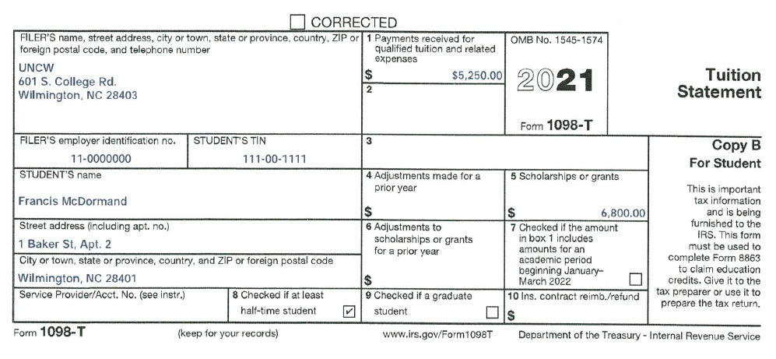
EXAMPLE 1
Fran is a Junior at UNCW and comes to your site with a 1098-T.
She also had a W-2 for a summer job where she earned $4,500.
No 529 Distribution.

Slide 25
QUESTIONS TO ASK
Do you have a copy of your student account statement? This is very helpful in properly determining the amount of QEE. Her student account statement is consistent with the amount shown in Box 1 of the 1098-T. The scholarship is shown on the statement as a Pell Grant, which we know is unrestricted.
Did you spend anything else on books or required supplies? She says she spent $375 on books that she was required to purchase from the school.
Are your parents claiming you on their return? She says yes as they provide most of her support. She saved the money she earned this past summer.
Can your parents claim the AOC? You confirm that the AOC was only claimed on 2 prior tax returns for Fran and the parents’ income is below the income phaseout for the AOC.

Slide 26
WHAT IF WE DON’T OPTIMIZE?
Fran’s scholarship shown in Box 5 ($6,800) exceeds the total of Box 1 ($5,250) plus books ($375) by $1,175 and thus she has scholarship income on her return of $1,175.
Fran’s total income would be $5,675 ($4,500 wages plus $1,175 scholarship income).
Fran would owe no tax and would not be required to file a tax return.
No other education benefit can be claimed as the QEE was used in its entirety to offset scholarship income.
So, we used $5,625 of QEE and received no tax benefit since all we did was reduce income that wouldn’t have been taxed anyway.

Slide 27
INITIAL STEPS TO OPTIMIZE
Before we start trying to figure out how to proceed, think about the following:
Can we use the AOC and is it refundable to the taxpayer? If so, focus on maximizing the QEE allocated to the AOC and then determine if you have other QEE available to use to offset scholarship income or 529 income.
How much QEE do we have for each of the benefits? Remember, if you can use the AOC, just focus on that and then allocate any remaining QEE to offset scholarship income. The definition of QEE is the same for scholarship income and AOC (tuition, required enrollment fees, and course-related books, supplies and equipment), narrower for the LLC (as it requires that books, supplies and equipment be purchased from the educational institution as a condition of enrollment or attendance), and broader under section 529 plans (including such items as room and board).

Slide 28
INITIAL STEPS (cont.)
Before we start trying to figure out how to proceed, think about the following:
Does the student have enough income to meet the filing threshold requirements? As we will discuss, this goes to whether the Kiddie Tax is an issue, as well as whether the student has to pay tax on any scholarship income. If we can add the total amount of the student’s scholarship to income and still be below the filing threshold, we are free to allocate to the education benefits where we want.

Slide 29
HOW DO WE THINK ABOUT THE CHOICES FOR QEE IN OUR EXAMPLE?
Can we use the AOC and is it refundable? Yes to both. The taxpayers here are her parents and they are clearly over 23 years of age.
How much QEE do we have in Example 1? Box 1 of the 1098-T says $5,250 and she also spent $375 on books. For the AOC, LLC and offsetting scholarship income, her total QEE is $5,625.
Does she have enough income to meet the filing threshold requirements? She has wages of $4,500. Even if we included all of her scholarship of $6,800 in her income, her total income would be $11,300, which is less than the filing threshold for her of $12,550 (all her income is earned income for this purpose).
This means we can do whatever we want without worrying about her paying tax or making her return out-of-scope.

Slide 30
QEE CHOICES
Assume her parents’ income puts them in the 12% tax bracket (remember, that would be taxable income of no more than $81,050 after the standard or itemized deduction) and that they have sufficient income tax due to use nonrefundable credits and deductions.
AOC is the best. Using her QEE of $5,625 to offset her scholarship income is the worst as it creates no tax benefit for the QEE.
The 1098-T leads one to think that using QEE to offset scholarship income is the logical choice when it’s usually the worst.
 | AOC | LLC | Offset Scholarship Income of Student
Tax Savings to Parents (or Student) | $2,500 | $1,125 | $0 (because Fran has no tax liability)

Slide 31
EXAMPLE 1 - TAXSLAYER
Fran’s return (she is not required to file but is filing to get back taxes withheld on her wages) – We are using $4,000 of her $5,625 of QEE to generate the AOC. This leaves her with $1,625 of QEE to use against the scholarship of $6,800. Fran has scholarship income of $5,175 ($6,800 scholarship minus $1,625 of QEE allocated against the scholarship income).
In TaxSlayer, go to Income/Less Common Income/Other Compensation/Scholarships and Grants and enter $5,175 in the box for the taxpayer.
NOTE – Scholarship income should always be entered in this manner and NOT as Other Income. This is important for TaxSlayer to properly treat the income as scholarship income for various purposes.

Slide 32
EXAMPLE 1 - TAXSLAYER
Parents’ return – We are allocating $4,000 of the QEE to generate an AOC on the parents’ return.
In TaxSlayer, go to Deductions/Credits/Education Credits.
Select Fran as the eligible student. Choose the American Opportunity Credit. Enter $4,000 as the Qualified Expense.
Complete the remainder of the input page using the 1098-T plus your interview with the taxpayer.
NOTE: If Fran was not eligible to be claimed by anyone, the scholarship income entry and the AOC entries would all be made on her return.

Slide 33
ALTERNATIVE 1 TO EXAMPLE 1
Assume Fran’s parents are in the 22% tax bracket (taxable income after standard/itemized deduction between $81,051 and $172,750) and they have sufficient income tax to use nonrefundable credits or deductions.
 | AOC | LLC | Offset Scholarship Income of Student
Tax Benefit to Parents (or Student) | $2,500 if parents’ AGI < $160,000 Phases out on income between $160K & $180K | $1,125 if parents’ AGI < $160,000 Phases out on income between $160K & $180K | $0 because Fran has no tax liability

Slide 34
ALTERNATIVE 2 TO EXAMPLE 1
Assume Fran’s parents have no income tax liability.
 | AOC | LLC | Offset Scholarship Income of Student
Tax Benefit to Parents (or Student) | $1,000 | $0 | $0 because Fran has no tax liability

Slide 35
WHEN WOULD WE NOT JUST ALLOCATE $4,000 TO AOC?
There are 3 primary situations where it may not make sense to allocate the QEE up to $4,000 to the AOC:
The AOC is not refundable for the taxpayer;
Allocating $4,000 to the AOC causes the student to be subject to the Kiddie Tax or makes a 529 distribution at least partially taxable; or
The taxpayer doesn’t qualify for the AOC (either due to income or because the technical requirements for the credit are not satisfied).
As we will see, there is significant overlap between taxpayers who don’t qualify for the refundable AOC and returns with a Kiddie Tax problem.
Let’s focus first on taxpayers who qualify for the AOC as we will always want to allocate to the AOC if the taxpayer qualifies.

Slide 36
AOC REFUNDABILITY
This issue only arises for certain taxpayers under the age of 24 who are entitled to claim themselves and are claiming the AOC. If the taxpayer is a dependent of another, this issue does not arise.
Before addressing the technicalities of the nonrefundability issue, this is a good time to think once again about whether a student should be claiming herself. We often fall into the habit of letting the taxpayers decide who claims who, but it is a technical and factual question, not a question of choice. For college students, it usually comes down to whether the student is providing more than half of her own support (ignoring any expenses paid by a scholarship). While certainly not impossible, this is a high threshold to meet.
If we let a student improperly claim herself, we not only bring into play the AOC nonrefundability issue (and the Kiddie Tax), but we also prevent the parents from probably getting a bigger education benefit in addition to the Other Dependent Credit they will lose out on.
Bottom line – it’s not the taxpayer’s choice and, in the case of a college student, we should be biased against letting them claim themselves.

Slide 37
AOC REFUNDABILITY
A student claiming herself who is under the age of 24 cannot receive the refundable portion of the AOC (40% of the credit) if all 3 conditions are satisfied:
The student is: (a) under 18 at the end of 2021; (b) age 18 at year end and her earned income is less than ½ of her total support; or (c) over 18 and under 24 at year end , a full-time student, and her earned income is less than ½ of her total support;
At least one of the student’s parents is alive at the end of 2021; and
The student is not filing an MFJ return.

Slide 38
AOC REFUNDABILITY
Earned income for this purpose is income received for personal services (generally, wages or self-employment income).
Earned income includes any part of a scholarship or fellowship grant that represents payment for teaching, research, or other services performed that are required as a condition for receiving the scholarship or grant. Any other scholarship income is NOT included in earned income for this purpose.
Support is defined as it is for purposes of the QC/QR tests.
A student is full-time if during any part of 5 calendar months during the year the student is enrolled as a full-time student as defined by the educational institution.

Slide 39
IMPACT ON QEE ALLOCATION IF AOC IS NONREFUNDABLE
If the AOC is nonrefundable, the AOC becomes like all the other QEE benefits as it can only reduce income tax owed. Once you’ve generated enough benefit to offset the tax owed, you’ve done all you can do. So, our goal is to use the AOC or another education benefit to reduce the income tax otherwise due.
This can get very complicated depending on the taxpayer’s income and the interaction with certain other credits like the Premium Tax Credit.
But remember, we are only focusing on taxpayers under the age of 24 who are entitled to claim themselves. If the parents or other support provider are claiming the education benefits, this issue does not apply.
So, let’s keep it as simple as possible realizing we’re not addressing every nuance.

Slide 40
IMPACT ON QEE ALLOCATION IF AOC IS NONREFUNDABLE
We will later discuss the mechanics of deciding how much QEE to allocate if the AOC is nonrefundable.
Even if the AOC is nonrefundable, we will still want to allocate to the AOC. But how much we should allocate is directly impacted by whether the student is subject to the Kiddie Tax.
If there are other tax credits involved that are based on AGI, the computation becomes more complicated. Examples would include the Premium Tax Credit and the Retirement Savings Credit (but not the EIC, CTC, or CDCC for 2021). However, the situations where these would be an issue on the return of a student under the age of 24 who is going to school at least half time will be very rare. If you are concerned about such a return, use the tool we discuss later to do the optimization or send the student to a paid preparer.

Slide 41
THE KIDDIE TAX
So, what is the Kiddie Tax?
The “Kiddie Tax” taxes the unearned income of a child at the parent’s tax rate rather than the child’s tax rate if certain specific conditions are satisfied.
Impacts the return of the child, NOT the parent.
The context in which this occasionally occurs at Military VITA sites is when a child is receiving benefits under the Military’s Survivor Benefit Plan, as these benefits are unearned income and thus potentially subject to the Kiddie Tax.
At both Military and non-military VITA sites, the big issue with the Kiddie Tax is scholarship income which is treated as unearned income for purposes of the Kiddie Tax even though it’s treated as earned income for most other purposes (such as filing requirement thresholds).

Slide 42
THE KIDDIE TAX
The Kiddie Tax has 5 basic requirements, 3 of which are the same as the 3 conditions for nonrefundability of the AOC (age/earned income, living parent, and not filing MFJ).
The two additional Kiddie Tax requirements are:
The taxpayer has more than $2,200 of unearned income (normally items like interest, dividends, and capital gains, but also includes scholarship income and Military Survivor benefits); and
The taxpayer is required to file a tax return.
Pub. 4012, p. H-3, has a good job aide for determining whether the Kiddie Tax applies.
Thus, for our students under the age of 24, not only do we have to worry about the nonrefundability of AOC if the student is not eligible to be claimed as a dependent, but we also have to watch out for the Kiddie Tax. And the Kiddie Tax issue can apply without regard to which taxpayer (student or support provider) is claiming the education benefit.
If the Kiddie Tax applies, the student’s return is OUT OF SCOPE!

Slide 43
THE KIDDIE TAX
Note that the nonrefundability of the AOC issue only arises if the student is trying to “claim” herself and is attempting to claim the AOC.
The Kiddie Tax is broader in its implications than the nonrefundability of the AOC issue as it makes the student’s return out of scope even if someone else is eligible to claim the student and is claiming the education benefit. Note that in this case, the return of the taxpayer claiming the student is still in scope.
So, we need to watch out for the Kiddie Tax anytime we have a student under the age of 24.

Slide 44
THE KIDDIE TAX
One of the ways to avoid the Kiddie Tax is if the student does not have a filing requirement.
A student who can be claimed as a dependent on another taxpayer’s return must file a return if any of the following tests are met:
The student’s unearned income was over $1,100;
The student’s earned income was over $12,550; or
The student’s gross income was more than the larger of —
$1,100, or
The child’s earned income (up to $12,200) plus $350.
Fortunately for this purpose, scholarship income is not unearned income so the $1,100 of unearned income threshold would generally not apply. Thus, in most cases we are focused on students with more than $12,550 of total income.

Slide 45
THE KIDDIE TAX
If the student cannot be claimed as a dependent, the normal filing thresholds apply, such as $12,550 of income for a Single taxpayer.
This means that so long as we can keep the student’s total income below the filing threshold, including any scholarship income arising out of the allocation of QEE to other tax benefits (including the AOC), the Kiddie Tax will not apply.
If the student has a filing requirement (and the other 3 Kiddie Tax conditions are satisfied), then the only way to keep the student’s return in scope is to limit the amount of scholarship income (plus any other unearned income) to no more than $2,200.

Slide 46
KIDDIE TAX EXAMPLES
All of these examples assume that the 3 primary conditions of the Kiddie Tax are satisfied (age/earned income, living parent, and not filing MFJ).
Sara is a 20-year-old, full-time student at UNCA. She received a Pell Grant for $15,000 (1098-T Box 5) and had QEE of $12,000 (1098-T Box 1 plus books and supplies). She earned $13,000 in wages during the year.
She has $3,000 of scholarship income before we even consider optimizing her education benefits and thus exceeds the $2,200 unearned income limit.
She also has a tax filing requirement due to her total income of $16,000.
Thus, her return is out of scope even before attempting to optimize her education benefits.

Slide 47
KIDDIE TAX EXAMPLES
Connor is a 21-year-old junior at UNCG and is claimed by his parents. He received a Pell Grant for $11,000 (1098-T Box 5) and has QEE of $12,000 (1098-T Box 1 plus books and supplies). He had wages from various jobs of $10,000.
Our normal starting point would be to allocate $4,000 of his QEE to the AOC on his parents’ return and then use the remaining $8,000 of QEE on his return to offset his scholarship, leaving him with $3,000 of scholarship income.
This would give Connor more than $2,200 of unearned income and the $13,000 of total income which would also trigger a filing requirement. Thus allocating $4,000 of QEE to the AOC would create a Kiddie Tax issue for Connor’s return.
We have two choices: (1) allocate $4,000 of QEE to the AOC (best tax result) but realize that his return is out-of-scope; or (2) limit the amount of scholarship income to avoid a filing requirement ($12,550 - $10,000, or $2,550) and allocate the remaining QEE to the AOC. With an $11,000 scholarship, we would allocate $8,450 of QEE ($11,000 scholarship - $2,550 maximum scholarship income) against the scholarship leaving $3,550 of QEE ($12,000 - $8,450) to allocate to the AOC.

Slide 48
KIDDIE TAX CONCLUSIONS
For students under the age of 24, we have to be sure the Kiddie Tax rules do not apply in order to do the student’s return.
If the 3 primary conditions for the Kiddie Tax are satisfied (the age/earned income requirement, at least one living parent, and the student is not filing an MFJ return), the amount of scholarship income that can be on the student’s return without creating a Kiddie Tax issue will be limited to the greater of $2,200 (less any unearned income such as interest, dividends, or capital gains) or the difference between the student’s filing threshold (usually $12,550) and the student’s other taxable income.
This is a significant limitation on our ability to “optimize” the education benefits for such students.

Slide 49
WHAT DO WE DO IF THE TAXPAYER DOES NOT QUALIFY FOR THE AOC?
If the taxpayer does not qualify for the AOC, the choice becomes a harder one as it is dependent on the taxpayer’s tax bracket as to whether the LLC benefit or offsetting scholarship income is better.
For our clients at a 12% tax rate (taxable income up to $40,525 Single or $81,050 MFJ), the LLC will be the better choice. However, because the LLC is not refundable, you only want to generate enough LLC to offset the tax owed and leave the rest of the QEE for scholarship income or 529 distributions.
For clients above those tax rates, the computation gets more complex and there is no simple way to know what is the best option (except using the tool I will discuss later).

Slide 50
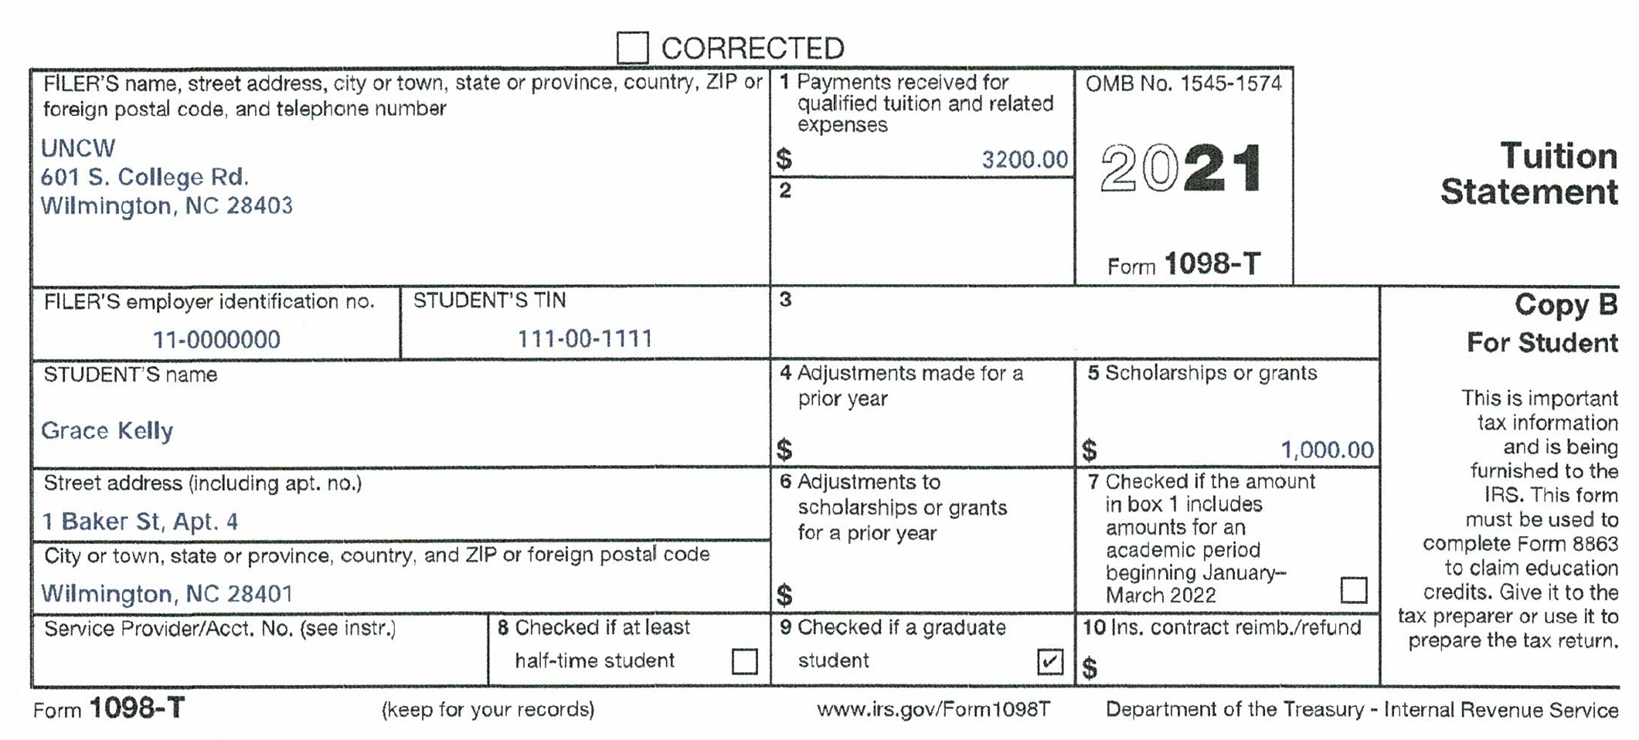
EXAMPLE 2
Grace is 27 years old and is not eligible to be claimed by anyone. She earned $35,000 in wages during the year.
She is taking courses towards a Masters degree on a part-time basis. She completed her undergraduate degree several years ago.

Slide 51
EXAMPLE 2
Grace does not qualify for the AOC as she has completed the first 4 years of postsecondary school.
In our interview with her, she says she spent $300 on books that she bought on the internet and her student account statement is consistent with the amounts shown on the 1098-T. The scholarship is unrestricted.
For the LLC, the books do not count as QEE since they were not required to be purchased from the school. However, they do count as QEE for purposes of offsetting her scholarship income. As a starting point she has $3,200 of QEE that she can use against the LLC or to offset scholarship income, plus another $300 of QEE to allocate against scholarship income.

Slide 52
EXAMPLE 2
So how do we decide what to do?
There are 3 choices:
Do nothing. 1098-T Box 1 exceeds Box 5 by $2,200, so claim the LLC using $2,200 as the QEE.
Offset the $1,000 of scholarship income with part of the QEE and take the LLC for the remaining $2,500 of QEE ($1000 offset by $300 of QEE from books that only count for offsetting scholarship income plus $700 of the remaining QEE, leaving $2,500 of QEE for the LLC).
Offset $300 of the QEE from the books against scholarship income and use the remaining $3,200 of QEE to generate an LLC. This also means she will have $700 of taxable scholarship income.

Slide 53
EXAMPLE 2
Use TaxSlayer to choose the best option.
The rest of the tax return needs to be completed before you deal with education.
Start with the first option. There is no scholarship income to report. Go to Deductions/Credits/Education Credits and choose the student, the LLC and then enter the $2,200 of QEE. Write down the Federal results from Line 22 ($2,058).

Slide 54
EXAMPLE 2
With the second option, there is also no scholarship income to report as we allocated $1,000 of QEE ($300 from books and $700 from LLC-eligible QEE). This leaves $2,500 of LLC QEE. Go to Deductions/Credits/Education Credits and choose the student, the LLC and then enter the $2,500 of QEE. Write down the Federal results from Line 22 ($1,998).

Slide 55
EXAMPLE 2
Now do the third option by going back into Education Credits and change the Qualified Expense to $3,200. Then go to Income/Less Common Income/Other Compensation/Scholarships and Grants and enter $700 of scholarship income and save the page. Note the results on Line 22 ($1,942).

Slide 56
EXAMPLE 2
The total due for the 2 choices is as follows:
$2,058
$1,998
$1,942 – the winner
This result makes sense as the LLC benefit at 20% is greater than the deduction benefit of 12% at her tax bracket. But maximizing the LLC benefit means creating more scholarship income which makes the NC answer worse (but remember that’s only at a 5.25% rate). The NC difference between Options 2 & 3 would be $37 ($700 of scholarship income at a 5.25% rate). This makes the total difference only $19.

Slide 57
WHAT DO WE DO IF THE TAXPAYER DOES NOT QUALIFY FOR THE AOC?
What to do? First, complete the return by:
Allocating QEE against scholarship income (and/or 529 distributions) up to the amount of such income (or distributions);
Reporting any scholarship income in excess of the amount offset with QEE; and
Allocating any remaining QEE against LLC.
This is designed to get us to a starting point where the return has been completed without trying to optimize the education benefits.
Then look at Line 22 of the return. If it is zero, that means no income tax is due and there is no reason to optimize so stop there.
If Line 22 shows income tax due, we should proceed to optimize the education benefits to see if we can eliminate this tax. I will explain later how we will do this.

Slide 58
WHAT IF THERE IS ALSO A 529 DISTRIBUTION?
The prior discussion has basically ignored the implications of having a section 529 plan distribution also in the mix.
These are pretty rare for our client base, but if you have one, it makes optimization of the education benefits very difficult.
The reason is that the return of the taxpayer receiving the 529 distribution (look at the SSN on the 1099-Q) will be out-of-scope if the 529 distribution is taxable in all or part.
To avoid this situation, we are forced to allocate the QEE first against the 529 distribution and only if there is additional QEE, can we look at any other tax benefit (including offsetting scholarship income).
But remember that the definition of QEE is much broader for 529 distributions than for the other education tax benefits.

Slide 59
529 DISTRIBUTION QEE
There is an excellent description of what expenses qualify as QEE for 529 purposes in Publication 970 (see p. 59 of the 2020 version).
Significantly, certain amounts of room and board expenses qualify unlike for any of the other education benefits. There are other items unique to 529 distributions, including up to $10,000 paid to repay a student loan of the 529 beneficiary or a sibling of the beneficiary.
You will always want to allocate the unique 529 QEE items against the 529 distribution amount shown in Box 1 of the Form 1099-Q first before using any QEE that qualifies for the other education benefits.
Only after covering the amount in Box 1 of the 1099-Q can you begin to allocate QEE to other education benefits.

Slide 60
529 DISTRIBUTIONS
As we previously discussed, allocating QEE against a 529 distribution that qualifies as QEE for other education benefits is the WORST use of this QEE.
So, if the 529 recipient’s return is one that we don’t mind being out-of-scope, we can ignore this problem and allocate the QEE to maximize the education benefits.
For example, if the student is the 529 recipient, and we include all the 529 income shown in Box 2 in the student’s income, but the student still does not have a filing requirement, we can ignore the 529 distribution and proceed to allocate the QEE to other education benefits. But if the student wants to file anyway to get back withholding taxes, we will not be able to do the student’s return.

Slide 61
WHAT DO WE DO???
The prior discussion has set out a lot of rules on optimizing education benefits and has shown the complexity of the issue.
If the taxpayer qualifies for the AOC, there are a couple of ways to proceed. First is a workbook that I created to assist you with optimizing the AOC. This workbook will work for almost all of the cases we generally encounter, but there are certain situations where the complexity of the return is beyond my ability to create a fairly simple spreadsheet.

Slide 62
WHAT DO WE DO???
There are 4 primary situations the workbook is not sophisticated enough to address:
The taxpayer has another student on the return that also has scholarship income or is claiming education benefits.
The student is under the age of 24 and is either not eligible for the refundable portion of the AOC or is potentially subject to the Kiddie Tax, but her filing status is other than Single. The only other choices would be Head of Household or Qualifying Widow.
The student is claiming another tax credit that is impacted by adding additional income to her return, such as the Premium Tax Credit or Retirement Savings Credit.
The taxpayer claiming the credit has income large enough to hit the income threshold phase-out for the AOC ($160,000 for MFJ and $80,000 for all other filing statuses).
For the first three, the Education Calculator discussed below can handle these situations.

Slide 63
WHAT DO WE DO???
For the LLC, unfortunately this creates a much more complicated situation to optimize. One of the complexities with optimizing the LLC is that the credit is a nonrefundable credit and thus can only be used to reduce income tax owed. If we add more QEE to the LLC than necessary, we are usually generating additional scholarship income that will be taxed in NC at a 5.25% rate. In some situations, this additional income can be fairly significant and thus would create additional NC tax owed that is not truly owed by the taxpayer.
Another major problem with the LLC is the interaction with the EIC. For taxpayers claiming the LLC who are eligible for the EIC, adding scholarship income to create more LLC may cause them to lose some or all of their EIC. In these situations, the answer often lies somewhere between not optimizing the LLC and fully optimizing the LLC.

Slide 64
WHAT DO WE DO???
But remember that the opportunities for optimizing the LLC are far less frequent than for undergraduate and certificate students.
The primary reason for this is that most taxpayers claiming the LLC are not receiving a scholarship and thus there is nothing to optimize – just claim the LLC based on the QEE.
In addition, even if a scholarship is received, the scholarship must be a scholarship made to a “candidate for a degree” which is often not the case as scholarships are less of an issue for students who are not undergraduates.
Obviously, the big exception for this is graduate students who are receiving a scholarship and where optimizing the LLC may be beneficial.

Slide 65
WHAT DO WE DO???
For the complex AOC situations and for optimizing the LLC, there is a tool, the Education Calculator, on the Colorado TaxAide website (www.cotaxaide.org/tools) that someone at your site should become familiar with in order to address these more complex situations. This tool can deal with complex situations such as a taxpayer who is claiming education credits and also has the Premium Tax Credit that is impacted by any additional scholarship income.
We will look at this tool later.
As an alternative, you could do an iterative approach in TaxSlayer by entering the education information not optimized, then fully optimized, and then half optimized just to compare the results. If the three results are not widely disparate, choose the best and move on.

Slide 66
WHAT DO WE DO???
There are some situations where optimizing will be a real challenge and even the tool won’t help. An example would be a taxpayer who is subject to the AOC or LLC phaseout due to income or where the taxpayer has another tax item (such as Social Security income) that is impacted by adding additional scholarship income to optimize the AOC or LLC. See the list on the Instructions tab of the Education Calculator for a list of these issues.
But remember to keep all of this in perspective – the vast majority of our taxpayers will be claiming the AOC and do not have complex returns that throw us into situations that we can’t handle.

Slide 67
AOC WORKBOOK
I have attempted to create a fairly simple (at least from the user’s perspective) tool that should work in the vast majority of cases where you are considering optimizing the AOC. I have previously discussed the limitations with this tool.
There is an explanation of the tool in a separate document that repeats the primary rules for each step of the process.
The tool itself is an Excel spreadsheet that you can download and use again and again. I have (hopefully) protected the spreadsheet so that the only things you can edit are the inputs required (the yellow boxes).
This tool can be placed on each of the computers you use and the users just need to remember to delete everything in the column with yellow boxes before beginning. This spreadsheet can be printed (it’s a two-page document) and added to the taxpayer’s documents.

Slide 68
EDUCATION CALCULATOR TOOL
There is a publicly-available tool for determining how to optimize education benefits. It is located at https://cotaxaide.org/tools/Education%20Calculator.html.
This tool is a bit complex to use and takes some practice to become proficient at using it.
I would encourage you to select one or two people at your site to become “education benefit optimization” experts rather than expecting all your preparers to become proficient at using it.
This presentation and the Workbook are designed to identify those areas where you can optimize without using the Education Calculator tool versus those where you need to use the tool (which will be a definite minority of cases).

Slide 69
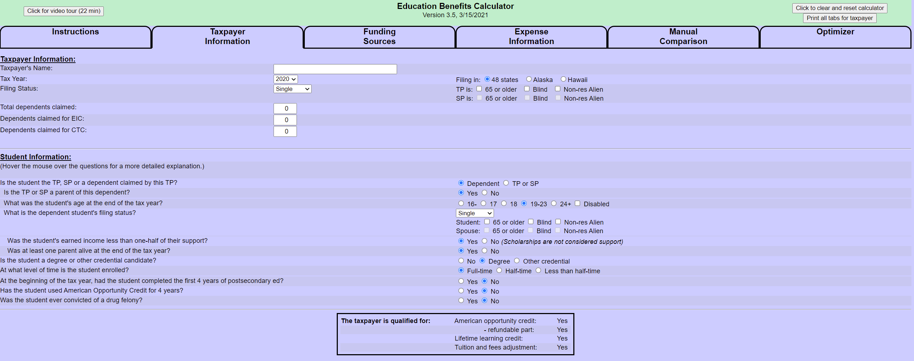
EDUCATION CALCULATOR

Slide 70
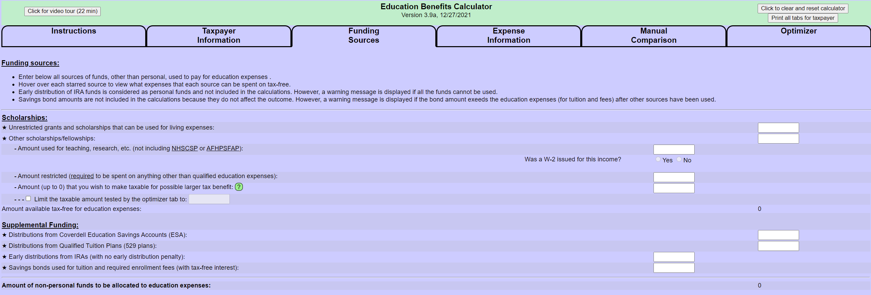
EDUCATION CALCULATOR

Slide 71
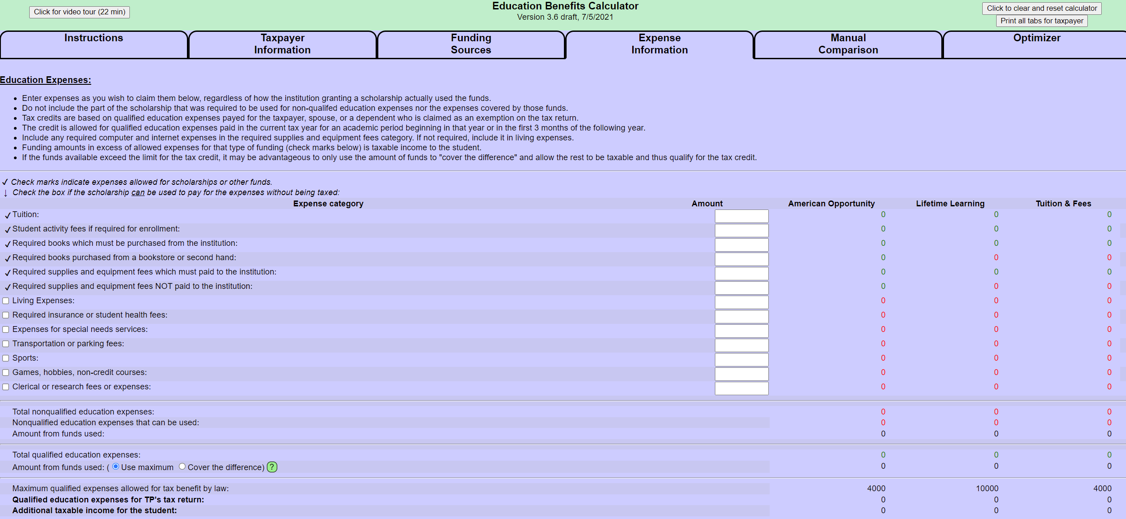
EDUCATION CALCULATOR

Slide 72
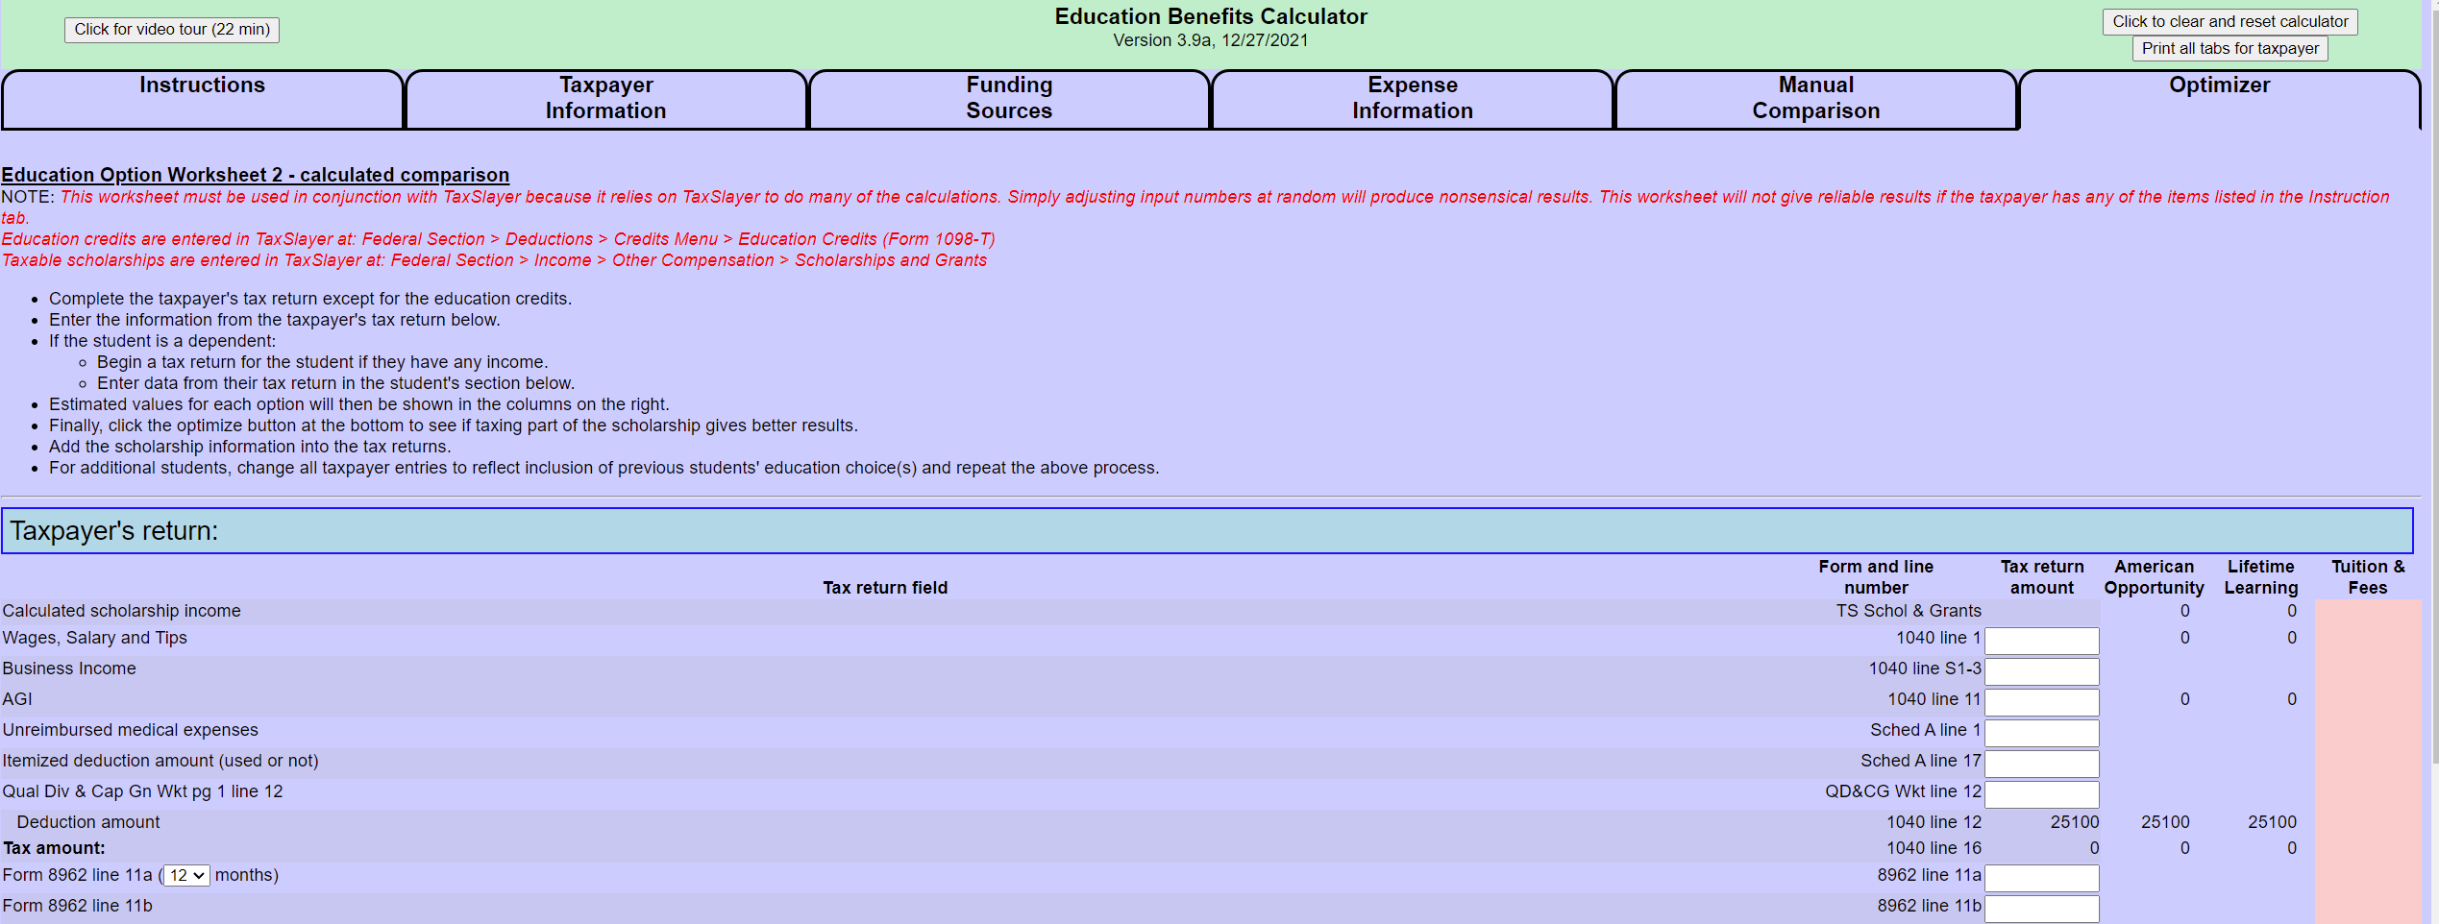
EDUCATION CALCULATOR

Slide 73
EDUCATION CALCULATOR

Slide 74
EDUCATION CALCULATOR

Slide 75
EDUCATION CALCULATOR
You must complete the returns of the student and, if the student is not claiming herself, the taxpayer who is claiming the student, prior to using the Education Calculator. These returns are completed ignoring education (no scholarship income and no AOC or LLC).
Watch out for higher income taxpayers whose income exceeds the income thresholds for the various education benefits, as the tool does not apply these income thresholds (but TaxSlayer will).
One issue I have seen with the Calculator involves the LLC if the student has books, supplies and equipment that were not purchased from the educational institution. In that situation, as discussed on my previous LLC example, these expenses qualify as QEE to offset scholarship income, but do not qualify as QEE for the LLC. Thus, we want to use the expenses associated with these books, supplies and equipment to offset the scholarship income first, as this saves as much of the LLC-eligible QEE as possible to allocate to the LLC.

Slide 76
EDUCATION CALCULATOR
For example (as in my prior LLC example), Grace has $3,200 in QEE reported in her 1098-T Box 1 and $300 in books that were purchased on the internet. She has a $1,000 scholarship reported in Box 5 of her 1098-T.
When we use the Education Calculator in this situation, you should reduce the amount of the scholarship by the QEE that does not qualify for the LLC first. So, we would reduce the $1,000 scholarship amount by $300 (the expense for books) to $700 and use $700 as the scholarship amount on the Funding Sources tab of the tool. The QEE entered on the Expense Information page would be the QEE that is eligible for the LLC ($3,200).

Slide 77
EDUCATION CALCULATOR
Remember, the need to use this tool usually only comes into play if the taxpayer does not qualify for the AOC. The Workbook can be used in almost all situations involving the AOC to tell you how to optimize the AOC.

Slide 78
SUMMARY
Determine if the taxpayer qualifies for the AOC. If so, use the Workbook (or Education Calculator) to assist with the following:
If the QEE exceeds the scholarship by more than $4,000, enter $4,000 as the AOC QEE in TaxSlayer and you are done.
Determine whether: (i) the student has any restricted scholarships; (ii) the student is claimed by someone else and satisfies the 3 primary conditions of the Kiddie Tax in order to know whether you need to limit scholarship income to avoid the Kiddie Tax (or just accept that the student’s return is out-of-scope); or (iii) the student is claiming herself and is not eligible for the refundable AOC.
If the taxpayer qualifies for the refundable AOC, allocate QEE up to $4,000 to the AOC (subject to the Kiddie Tax Caveat) and allocate any remaining QEE to scholarship income.
If a student is entitled to claim herself and qualifies for the AOC, but not the refundable portion, allocate QEE to the AOC (subject to the Kiddie Tax Caveat) and allocate any remaining QEE to scholarship income.

Slide 79
SUMMARY
If the taxpayer claiming the credit does not qualify for the AOC and has scholarships that would qualify as tax-free, first complete the taxpayer’s return without optimizing the LLC. If Line 22 is zero, there will be no benefit from optimizing, so stop there. If there is taxed owed on Line 22, use the Education Calculator to optimize the LLC.

Slide 80
I designed the AOC Workbook to be as close to accurate as possible while avoiding unnecessary complexity. It was designed using the tax rate schedules rather than the tax tables due to the complexity involved in using tax tables. The answer you get should be within a few dollars of the optimal answer which is good enough in my view.
I have tried to test the AOC Workbook with a variety of scenarios. If you ever find a situation where you believe the workbook is giving an incorrect result by more than a few dollars off, please let me know as this is intended to be a tool we can all use with some degree of confidence. You can always check the Workbook results against the Education Calculator results if in doubt.

Slide 81
Bill Hawkins
hawkinsbill79@gmail.com

