Slide 1
2021 NC VITA TAX TRAINING
Part 1
December 2, 2021
Bill Hawkins

Slide 2
INTRODUCTION
This is the first in a series of training presentations I will do for the 2021 tax filing season.
Today – What’s New for 2021
Thursday, Dec. 9 – 1 to 5 pm – A variety of topics including carryover issues from 2020, VITA scope of service, a few NC topics, and my Top 10 list.
Thursday, January 6 – 1 to 5 pm – A deep dive into Education, including scholarship income and optimizing education benefits.
Zoom Recordings made available – The Basics – a guide to Pub. 4012 and TaxSlayer for less-experienced volunteers (hopefully – I need TaxSlayer to be up to date on certain issues before I can do this)
Notes:
Me; style of presentations – detail so you use as a resource; always try to give fairly detailed background but try to give practical advice at the end of each topic; no review or approval; if errors, let me know

Slide 3
TODAY’S PRESENTATION
We are presenting using Zoom Webinar.
Unlike a typical Zoom meeting, there won’t be video or audio of non-participants.
An outline of the presentation was emailed out yesterday to everyone who had registered. If you did not get a copy of the outline, we will post one to the chat feature momentarily. Just click on the chat icon at the bottom and you should see the chat with the outline attached.
If you have a question, please click the Q&A icon at the bottom of your screen and submit your question. We will answer as many as possible during the presentation and will address any unanswered questions after the presentation.
The chat feature is available for you to use but will not be monitored for questions.
Todays’ session is being recorded and a link to watch the presentation will be provided in a few days for you or others in your program to watch the presentation.

Slide 4
WHAT’S NEW FOR 2021?
Tax Legislation Affecting 2021
December 2020 Stimulus Bill
American Rescue Plan Act
Miscellaneous Federal Changes
IRS Form Changes
NC Changes
Changes to Come?

Slide 5
DECEMBER 2020 STIMULUS BILL
This bill contained a provision that temporarily allows a 100% deduction for business meals at a restaurant for 2021 and 2022, rather than the normal 50% deduction limit.
In addition, the bill changes the phaseout for the Lifetime Learning Credit for higher income taxpayers to match the phaseout for the American Opportunity Credit. To pay for this change, the bill repeals the Tuition & Fees Deduction.

Slide 6
AMERICAN RESCUE PLAN ACT
Passed in March 2021.
Impacted 2020 returns – Unemployment Compensation exclusion up to $10,200 and Premium Tax Credit repayment waiver.
Significant provisions impacting 2021 tax returns
Third Stimulus Payment
Child Tax Credit (CTC) Changes, including new Advance payments that began in July
Earned Income Credit (EIC) Changes
Child & Dependent Care Credit Changes
Premium Tax Credit Changes
Taxation of Forgiven Student Loans

Slide 7
THIRD STIMULUS PAYMENT
Made beginning in March 2021 and continuing into the summer.
$1,400 per taxpayer plus $1,400 per qualifying dependent.
Original payment may have been made based on 2019 return if 2020 not yet filed, but the IRS supposedly would look again after the 2020 return was filed to make additional payments based on the 2020 tax return (referred to as “plus-up payments”).
Taxpayer will receive Letter 6475 in early 2022 which will show the total stimulus payments received by the taxpayer from the third round of stimulus payments.

Slide 8
THIRD STIMULUS PAYMENT
Similar eligibility rules to the second stimulus payment
TP must be a US citizen or resident alien with a valid SSN (which is an SSN issued by Social Security before the due date of the return and thus does not include ITINs).
Income must be below $150,000 for Married Filing Joint (and Qualifying Widow); $112,500 for Head of Household; and $75,000 for any other filing status (payment phases out up to $160,000, $120,000, and $80,000, respectively).
If you are claimed as a dependent on another’s return, you are not eligible to receive the payment (but the person claiming you probably is entitled to the payment).
In the case of payments to deceased persons, the person must have been living as of January 1, 2021.

Slide 9
THIRD STIMULUS PAYMENT
Who are the Taxpayer’s Qualifying Dependents entitling the taxpayer to an additional $1,400 payment?
Much broader than either of the other two stimulus payments.
The test is basically the Qualifying Child and Qualifying Relative tests so if the taxpayer gets either the CTC or Other Dependent Credit with respect to a dependent, the taxpayer will get the additional $1,400 additional stimulus payment so long as the dependent has a valid SSN issued by SSA or has an ATIN.
Key differences from 2020 stimulus payments – do not have to be a child under the age of 17 and dependents such as parents can qualify so long as they meet the Qualifying Relative tests (including income of less than $4,300).
Notes:
The rule is the dependent rules. The CTC & ODC rules vary from the dependent tests. The one that I know about is a resident of Canada or Mexico is a dependent but does not qualify for the CTC or ODC, so you would get an EIP for a dependent who is a resident of Canada or Mexico.

Slide 10
THIRD STIMULUS PAYMENT
If neither taxpayer has a valid SSN issued by SSA, they are still entitled to a payment for any Qualifying Dependent who has a valid SSN. This is a change from the prior payments that required either one or both parents to have a valid SSN to receive a payment for a qualifying child.
As before, if one of the spouses is an Active-Duty member of the Military, they will receive $2,800 plus $1,400 per qualifying child even if the other spouse does not have a valid SSN.
The status of the third stimulus payments (but not the amounts) can be checked on the Get My Payment tool on irs.gov, including any Plus-Up payments made. The IRS will also issue a letter to the taxpayer that details the EIP received in 2021.

Slide 11
THIRD STIMULUS PAYMENT
As with the prior stimulus payments, there will be a Recovery Rebate Credit (“RRC”) mechanism on the 2021 tax return.
Because of the Plus-up Payment relook by the IRS, there hopefully will be fewer claims than last year.
As with the prior payments, a Qualifying Dependent born or adopted in 2021 will qualify for the $1,400 payment through the RRC mechanism.
As with the prior payments, there is no requirement to repay amounts received in excess of the amount allowed (other than for recipients who were not eligible to receive any payment based on their 2021 tax return, such as a taxpayer who died prior to 2021).

Slide 12
THIRD STIMULUS PAYMENT
TaxSlayer
The RRC appears on From 1040, Line 30.

Slide 13
CHILD TAX CREDIT CHANGES
The Act made significant changes to the CTC and introduced a new advance payment mechanism for half of the CTC amount that was paid out over the last 6 months of 2021.
These changes are currently only for 2021.
First, the Act increases the eligible age for the CTC from qualifying children under the age of 17 to qualifying children under the age of 18.
Second, the amount of the CTC increases from $2,000 per qualifying child to $3,000 for qualifying children between the ages of 6 through 17 as of the end of 2021, and $3,600 for qualifying children under the age of 6 as of the end of 2021.

Slide 14
CHILD TAX CREDIT CHANGES
Third, the Act makes the CTC fully refundable for 2021 so long as the taxpayer had a principal place of abode in the U.S. for more than half of 2021 (which is also a requirement for the EIC).
Fourth, the requirement for a taxpayer to have at least $2,500 of taxable earned income to be eligible to receive the Additional CTC (the refundable portion of the CTC under prior law) does not apply for 2021 and thus a taxpayer with no earned income qualifies for the fully refundable CTC (so long as they lived in the US more than half the year).
The Act retains the prior requirement for the qualifying child to have an SSN that is valid for employment and the requirement that the taxpayer have an SSN or ITIN.

Slide 15
CHILD TAX CREDIT CHANGES
In determining whether the taxpayer satisfies the requirement to have a principal place of abode in the U.S. for more than half of 2021, the rules for temporary absences due to absences such as military service, education, or business, apply.
If the taxpayer fails to meet the requirement to have a principal place of abode in the U.S. for more than half of 2021, the rules basically revert to the prior law:
The refundable piece of the CTC is limited to $1,400.
If the taxpayer had 2 or fewer qualifying children, the refundable piece is only available if the taxpayer had at least $2,500 in earned income in 2021.

Slide 16
CHILD TAX CREDIT CHANGES
The Act provides two income threshold phase-outs for the CTC.
The first income threshold phase-out reduces the increase in the amount of the CTC ($1,600 for QC under 6 and $1,000 for all other QCs) for modified AGI in excess of the following:
$150,000 for MFJ and QW
$112,500 for Head of Household
$75,000 for Single and MFS
The phaseout is $50 for each $1,000 of modified AGI above these limits.

Slide 17
CHILD TAX CREDIT CHANGES
The second phase-out reduces the CTC from $2,000 to $0 for income above the following amounts:
$400,000 for MFJ
$200,000 for all other filing statuses
This phase-out is also $50 per $1,000 of modified AGI in excess of these amounts.

Slide 18
ADVANCE CHILD TAX CREDIT
For 2021, the Act creates a new “Advance” CTC, which pays one half of the CTC amount to the taxpayer for each qualifying child during the second half of 2021. These payments were normally made on a monthly basis beginning in July generally in the amount of $300 for each qualifying child under age 6 and $250 per month for each qualifying child between the ages of 6 and 17.
Similar to the stimulus payments, taxpayers will be required to reconcile the Advance CTC payments received on their 2021 tax return. The Advance CTC received will reduce the CTC shown on the taxpayer’s 2021 tax return.
If Advance CTC was received by the taxpayer, a 2021 tax return must be filed.

Slide 19
ADVANCE CHILD TAX CREDIT
For taxpayers who received the full 6 months of Advance CTC, this means that they would generally receive $1,800 as Advance CTC for children under 6 and $1,500 for qualifying children over 5 and will receive a CTC on their 2021 tax return in the same amount ($1,800 or $1,500, respectively).
This will have a significant impact on the 2021 tax return for taxpayers who received the full $2,000 per child CTC in 2020, as it reduces the CTC that otherwise would have been on the return from $2,000 under prior law to $1,800 per qualifying child under the age of 6 and from $2,000 to $1,500 per qualifying child over the age of 5.

Slide 20
ADVANCE CHILD TAX CREDIT
The IRS used the 2020 return as the basis for determining the number of qualifying children and to estimate the 2021 income in order to determine the amount of the Advance CTC. If a 2020 tax return had not been processed when the determination was made, the 2019 return was used and then the amount of Advance CTC paid was updated once the 2020 return was processed.
So much like we saw with the Stimulus payments, the 2020 (or 2019) return governed the Advance CTC but the 2021 return controls the CTC.

Slide 21
ADVANCE CHILD TAX CREDIT
The IRS provided a number of tools that allowed taxpayers to update bank account information, addresses, marital status, and income. In addition, a non-filer tool similar to the tool used for the 2020 stimulus payments was provided for taxpayers who did not file 2019 or 2020 tax returns.
Taxpayers could also elect to opt-out of the Advance CTC and wait to claim the CTC on their 2021 tax return.
The Act provides that the Advance CTC payments are not supposed to affect the taxpayer’s eligibility for governmental payments.

Slide 22
ADVANCE CHILD TAX CREDIT
The IRS will issue a letter in January 2022 (Letter 6419) that will show the amount of the Advance CTC payments made to the taxpayer during 2021 and the number of qualifying children used by the IRS in determining the amount of the payments.
Spouses filing a joint return will each receive the letter. The letter will apparently split the amount of Advance CTC equally between the two. The number of qualifying children will be the number claimed jointly by the couple on their joint return. For example, if a couple took the CTC for 2 children on their 2020 return and received $3,000 in Advance CTC, their letters will each show $1,500 as the amount received and 2 children.

Slide 23
ADVANCE CHILD TAX CREDIT
If the taxpayer does not have this letter, they can go to www.irs.gov/ctcportal to obtain the information. To verify their identity, the taxpayer will need to provide a photo of an identity document such as a driver's license, state ID, or passport. The taxpayer will also need to take a selfie with a smartphone or a computer with a webcam. This utilizes the ID.me technology for verifying identity and appears to be the new standard the IRS is using for this purpose.
The taxpayer can also call 800-908-4184 to obtain this information.

Slide 24
ADVANCE CHILD TAX CREDIT
Relying on the taxpayer’s word is permissible but be careful. As you will see below, one of the things you need to know for the return is how many qualifying children the IRS used to compute the Advance CTC. While this may be easy to determine if the taxpayer received $1,500 for any children over 5 and $1,800 for any children under 6, determining this may get much more problematic if the numbers are different.
We will then use this information in the reconciliation on the 2021 return by reducing the CTC to which the taxpayer is entitled to on the 2021 return by the Advance CTC received.

Slide 25
ADVANCE CTC RECONCILIATION
In the reconciliation process, there will be times when the taxpayer received too much Advance CTC. The IRS has listed some examples of when this might occur:
A qualifying child who resided with you may change homes during 2021 and reside more than half of the 2021 tax year with a different individual.
Your income increases in 2021.
Your filing status changes for 2021.
Your main home was outside of the United States for more than half of 2021.
You and the child’s other parent alternate claiming the child.

Slide 26
ADVANCE CTC RECONCILIATION
The fact that Advance CTC was only paid for half of 2021 should significantly reduce the number of returns where repayments could arise.
And even if a repayment would normally be required, there are additional limitations on the requirement to repay excess Advance CTC received.
There are 3 levels to consider in repayment limitations:
Taxpayers who get “full” repayment protection;
Taxpayers who get no repayment protection; and
Taxpayers who get partial repayment protection.

Slide 27
WHAT IS FULL REPAYMENT PROTECTION?
However, “full” repayment protection is not truly full.
“Full Repayment Protection” is equal to $2,000 times the difference between:
The number of qualifying children used by the IRS in determining the amount of the Advance CTC (which will be in the letter the taxpayer will receive from the IRS); and
The number of qualifying children claimed on the 2021 tax return.
For example, if the IRS used 3 qualifying children based on the taxpayer’s 2020 tax return, but the taxpayer only claims 2 on the 2021 tax return, the Full Repayment Protection would equal $2,000 X (3-2), or $2,000.

Slide 28
WHAT IS FULL REPAYMENT PROTECTION?
Accordingly, if the TP claimed 2 qualifying children on her 2020 return (and the IRS uses this number) and still claims 2 on her 2021 return, there would be no repayment protection.
Note that Full Repayment Protection per child is only equal to $2,000, the amount of the CTC before the one-time 2021 increases to $3,000 or $3,600 depending on the age of the child.
We’ll discuss some examples later to understand the impact of this limitation.

Slide 29
FULL REPAYMENT PROTECTION
For taxpayers with 2021 modified AGI equal to or less than the following amounts, Full Repayment Protection is provided to the taxpayer required even if the taxpayer was not entitled to some or all of the Advance CTC received:
MFJ or Qualifying Widow - $60,000
Head of Household - $50,000
Single or MFS - $40,000

Slide 30
NO REPAYMENT PROTECTION
For taxpayers with 2021 modified AGI equal to or greater than the following amounts, the taxpayer will be required to repay any excess Advance CTC received:
MFJ or Qualifying Widow - $120,000
Head of Household - $100,000
Single or MFS - $80,000
In addition, taxpayers who fail to satisfy the requirement to have a principal place of abode in the U.S. for more than half of 2021 receive no repayment protection.

Slide 31
PARTIAL REPAYMENT PROTECTION
For taxpayers with 2021 modified AGI in the ranges described below, partial repayment protection will be received:
MFJ or Qualifying Widow – Modified AGI of more than $60,000, but less than $120,000
Head of Household – Modified AGI of more than $50,000, but less than $100,000
Single or MFS - Modified AGI of more than $40,000, but less than $80,000

Slide 32
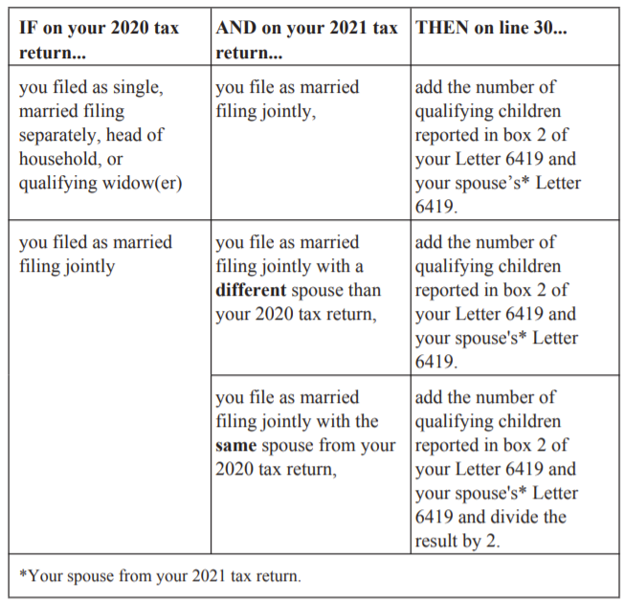
REPAYMENT PROTECTION – MFJ
As previously mentioned, each spouse on an MFJ return will receive the Letter 6419 from the IRS. For joint returns, you must have the letter of both spouses in order to reconcile the Advance CTC and to compute any repayment protection.

Slide 33
ADVANCE CTC REPAYMENT EXAMPLES
EXAMPLE 1 – Mary’s 2020 tax return shows that she filed Head of Household, had modified AGI of $35,000, and claimed 2 qualifying children (one of whom was under 6). On her 2021 return, her modified AGI equals $40,000 and she claims only one qualifying child (the child under the age of 6). During the second half of 2021, Mary received $300 per month for the child under 6 and $250 per month for the older child, for a total Advance CTC of $3,300 ($300 times 6 plus $250 times 6).
Based on her 2021 tax return, Mary is entitled to a CTC of $3,600 for her one qualifying child. The $3,600 is reduced by the amount of Advance CTC received ($3,300) leaving her with a CTC on her 2021 return of $300.
Her Advance CTC did not exceed her actual 2021 CTC and therefore she has no repayment requirement even though she claimed one less child on her 2021 return and received $1,500 more than she should have received in Advance CTC.

Slide 34
ADVANCE CTC REPAYMENT EXAMPLES
EXAMPLE 2 – Same as Example 1 except Mary’s modified AGI for 2021 is $60,000.
In this situation, her repayment protection limit would be impacted by the fact that her modified AGI exceeds $50,000. However, because her Advance CTC of $3,300 does not exceed her 2021 CTC of $3,600, she has no repayment requirement and therefore her repayment protection limit is irrelevant.

Slide 35
ADVANCE CTC REPAYMENT EXAMPLES
EXAMPLE 3 – Jane’s adult daughter and 3-year-old granddaughter lived with her in 2020. She claimed the CTC for her granddaughter and filed as Head of Household. In January 2021, the daughter and granddaughter moved out of Jane’s home, so Jane is no longer able to claim a CTC for her granddaughter on her 2021 return. She filed as Single for 2021 and had Modified AGI of $35,000. She received $1,800 in Advance CTC during 2021.
For 2021, Jane’s return shows a CTC of $0 and thus her initial repayment obligation is $1,800 before applying any repayment protection. Her Repayment Protection would be $2,000, as she is claiming one less child for the CTC and her income is less than $40,000. Consequently, she is not obligated to return any of the $1,800 she received as an Advance CTC during 2021.

Slide 36
ADVANCE CTC REPAYMENT EXAMPLES
EXAMPLE 4 – Same as Example 3, except Jane’s modified AGI on her 2021 return is $50,000.
For 2021, Jane’s return shows a CTC of $0 and thus her initial repayment obligation is $1,800 before applying any repayment protection. Her Full Repayment Protection would be $2,000, as she is claiming one less child for the CTC. Because her income is more than $40,000, she will not be entitled to the Full Repayment Protection. Instead, her repayment protection will be reduced by 0.25 (($50,000 - $40,000) / $40,000), or $500. Thus, her repayment protection will be reduced to $1,500. Because the $1,800 Advance CTC received by Jane exceeds her repayment protection of $1,500, she is obligated to repay $300 of the Advance CTC on her 2021 tax return.

Slide 37
ADVANCE CTC REPAYMENT EXAMPLES
EXAMPLE 5 – Tom and Shirley filed an MFJ return for 2020, had modified AGI of $55,000, and claimed their 2 children, both of whom were over the age of 5. During 2021, they received $3,000 in Advance CTC. For 2021, their modified AGI increased to $70,000 and they still have the 2 qualifying children.
For 2021, their return shows a CTC of $6,000, which is reduced to $3,000 because of the $3,000 Advance CTC received. There is no repayment obligation since the CTC exceeds the Advance CTC received. The fact that their income is high enough to push them out of Full Repayment Protection is irrelevant since they have no repayment obligation.

Slide 38
ALTERNATING CTC CLAIMS
One situation that will be impacted by the Advance CTC reconciliation rules is where a child’s parents alternate years for claiming the child for CTC purposes.
As a reminder, for post-2008 divorces or separations, the custodial parent is the only parent that can claim the CTC unless the custodial parent signs a Form 8332 (or a substantially similar statement) allowing the noncustodial parent to claim the child for CTC purposes.
For divorces or separations prior to 2009, rather than signing Form 8332, the divorce decree or separation agreement can contain language that governs which parent may claim the child.

Slide 39
ALTERNATING CTC CLAIMS
Here is an example.
Fred and Brenda divorced in 2018. In the divorce they agreed to alternate years claiming their daughter Amy even though she lives with Brenda for more than half of each year. Fred claims Amy (who is age 10 at the end of 2021) in even-numbered years (with Brenda signing a Form 8332 for these years), while Brenda claims Amy in odd-numbered years. Because Fred claimed Amy on his 2020 tax return, he received $1,500 in Advance CTC during the second half of 2021 since he never opted out or told the IRS that he was not entitled to the Advance CTC. Amy lived with Brenda for more than half of 2021, so Brenda is entitled to claim Amy in 2021. On Brenda’s 2021 return, she claims Amy and receives a $3,000 CTC.

Slide 40
ALTERNATING CTC CLAIMS
Does Fred have to repay all or part of the $1,500 Advance CTC he received?
Fred received Advance CTC of $1,500 but has no qualifying child on his 2021 tax return and so his 2021 CTC is $0. Thus, Fred received $1,500 more in Advance CTC than the CTC eligible to be claimed on his 2021 return and would be required to repay all $1,500 unless repayment protection applies.
If Fred files Single for 2021 and has modified AGI of less than $40,000, he is entitled to the Full Repayment Protection of $2,000. Fred would therefore not be required to repay any of the $1,500 received.

Slide 41
ALTERNATING CTC CLAIMS
If, however, Fred’s 2021 modified AGI exceeds $80,000, he is not entitled to any repayment protection and will be required to repay the entire $1,500 Advance CTC on his 2021 tax return.
If Fred’s income is between $40,000 and $80,000, he will receive a pro rata share of the $2,000 repayment protection. For example, if Fred’s modified AGI is $60,000 for 2021, his repayment protection limit would be $1,000. Thus, Fred would be required to repay $500 on his 2021 tax return.

Slide 42
ALTERNATING CTC CLAIMS
In conclusion, much like we saw with the stimulus payments, the law clearly contemplates that the parent claiming the child in 2020 is able to keep some or all of the Advance CTC received in 2021 (assuming the parent is entitled to repayment protection) even though the other parent receives the full CTC with respect to that child on the 2021 tax return.
This same issue will arise in cases, like Example 3 above, where the taxpayer had the right to claim the child in 2020 but no longer has such right in 2021.

Slide 43
FINAL THOUGHTS ON ADVANCE CTC
Obviously, the increase in the CTC by $1,000 or $1,800 depending on the age of the child is a big win for all taxpayers claiming the CTC.
The Advance CTC allows taxpayers who qualify for the CTC to receive half of the money earlier during 2021 rather than waiting to claim the credit on their 2021 tax return.
In the case of taxpayers who have no tax liability, this is a big win as they get $1,500 to $1,800 per child during 2021 and then get the same amount again as a refund on their 2021 tax return. Remember that only $1,400 of the CTC under prior law was refundable so these taxpayers win in all cases.

Slide 44
FINAL THOUGHTS ON ADVANCE CTC
The impact of the Advance CTC becomes more mixed for taxpayers who have a tax liability.
These taxpayers will receive the full benefit of the CTC ($3,000 or $3,600 per qualifying child), half through the Advance CTC mechanism and half through the CTC on the 2021 tax return.
But the credit on the 2021 tax return will be less than the credit shown on the 2020 return for taxpayers who received the full $2,000 CTC in 2020 – a reduction of $200 per qualifying child under the age of 6 and $500 for each older qualifying child.

Slide 45
FINAL THOUGHTS ON ADVANCE CTC
Thus, their 2021 tax return, looking at it on a stand-alone basis, will be worse than what it would have looked like under prior law. Obviously, the overall economic situation is better due to the increased CTC.
For taxpayers who are used to getting a certain level of refunds, this may come as a disappointment to them and will take some explaining on your part (the taxpayer already got the difference and more through the Advance CTC mechanism).
So, don’t be surprised to see taxpayers owing more or getting smaller refunds than in the past due to the Advance CTC, but remind them they are always better off with the bigger CTC.

Slide 46
FINAL THOUGHTS ON ADVANCE CTC
This becomes even more complicated for 2022 if the Build Back Better bill is enacted into law in its current form. For 2022, the entire CTC will be paid in advance during the year with no credit appearing on the 2022 tax return for those receiving the full advance payments.
So, all the problems we will see for this year will be exacerbated for next year for people expecting a certain level of refunds since now they will have no CTC on the tax return.

Slide 47
FINAL THOUGHTS ON ADVANCE CTC
For those who receive excess Advance CTC, the repayment protection for 2022 will, if enacted, increase to the full amount of the credit (as contrasted to $2,000 for 2021). While this will help reduce the number of repayments required, I would expect we will see even more next year if the bill is enacted in its current form.
Remember, taxpayers can always opt out of the Advance CTC by going to IRS.gov and clicking on “Manage Your Child Tax Credit Payments.”

Slide 48
CTC IN TAXSLAYER
Not yet.
Things that TaxSlayer should ask:
Did the taxpayer (or spouse on an MFJ return) have a principal place of abode in the US for more than half of 2021?
How much Advance CTC did the taxpayer (and spouse on a joint return) receive during 2021?
The number of qualifying children used by the IRS in determining the amount of the Advance CTC for the taxpayer (and for the spouse if a joint return)?
I will provide any updates in later training sessions.

Slide 49
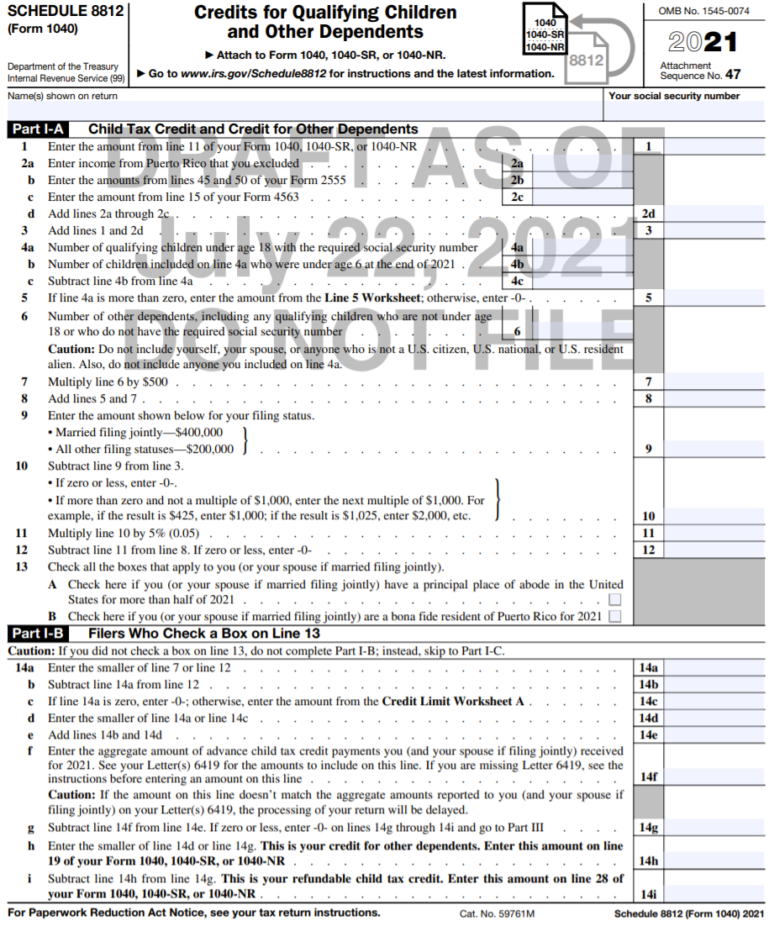
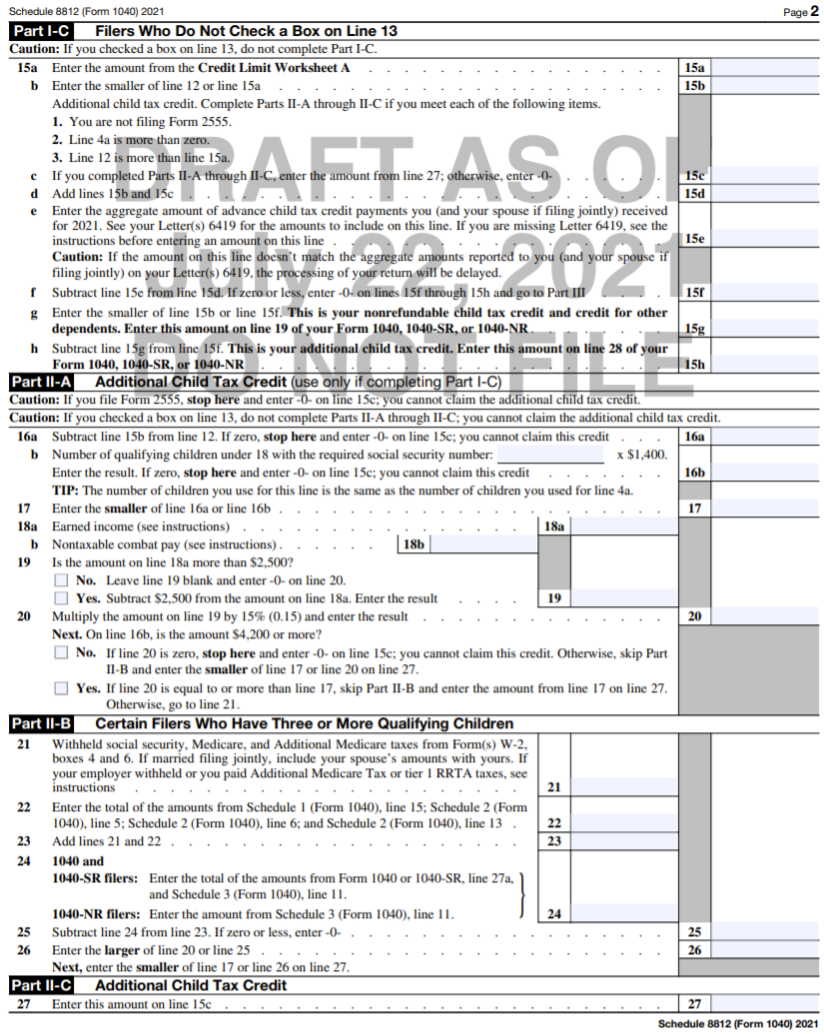

Slide 50
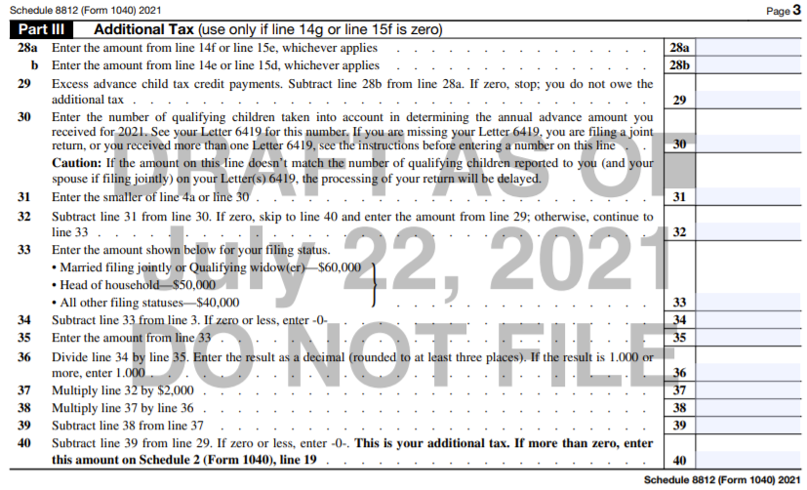
ADVANCE CTC REPAYMENTS

Slide 51
EIC CHANGES FOR 2021
The Act also makes several significant changes to the determination of the Earned Income Credit for 2021.
The first group of changes impact taxpayers who do not have qualifying children. First, for these taxpayers, prior law required that the taxpayer be at least 25 years of age to qualify for the EIC. The Act changes the qualification age as follows:
“Qualified Former Foster Youth” or “Qualified Homeless Youth” who have attained the age of 18;
“Eligible Students” who have attained the age of 24; and
Any other taxpayer who has attained the age of 19.

Slide 52
EIC CHANGES FOR 2021
A “Qualified Former Foster Youth” is generally a person who was in foster care on or after the date he/she turned age 14.
A “Qualified Homeless Youth” is an individual who certifies that he/she is either an unaccompanied youth who is a homeless child or youth, or is unaccompanied, at risk of homelessness, and self-supporting.
If you have an 18-year-old taxpayer who wants to claim the EIC, you will need to ask the taxpayer whether he/she qualifies as a Qualified Former Foster Youth or a Qualified Homeless Youth.

Slide 53
EIC CHANGES FOR 2021
An “Eligible Student” is a student at an eligible educational institution who is carrying at least half the normal workload.
The Act removes the age 65 limit for the EIC for taxpayers with no Qualifying Children for 2021.
In addition, the credit amount is increased for taxpayers with no Qualifying Children to a maximum credit of $1,502, up from $538 in 2020.

Slide 54
EIC CHANGES FOR 2021
Finally, if a taxpayer’s earned income for 2019 is higher than in 2021, the taxpayer may elect to use the 2019 earned income for purposes of determining the EIC for 2021. This is the same election provided for 2020 for both the EIC and CTC.
2019 earned income generally equals 2019 Form 1040, Line 1 (less any scholarship income included on that line) plus the net earnings from self-employment (2019 Schedule SE, line 3) minus the adjustment for one-half of SE Tax (2019 Schedule SE, Line 13). For detailed instructions see the 2019 Form 1040 Instructions EIC Worksheet Step 5 (p. 40) and if the taxpayer had SE income in 2019, Worksheet B (p.44).

Slide 55
EIC CHANGES FOR 2021 & BEYOND
The Act has a second set of changes that impact taxpayers other than just those with no Qualifying Children. These changes are permanent changes to the law.
First, under prior law, the taxpayer, spouse (on an MFJ return), and children were all required to have SSNs that were valid for employment to claim the EIC. The Act changes this rule in the case of singles or couples who have valid SSNs, but whose children do not. In this case, the taxpayer(s) can qualify for the credit determined as if they had no qualifying children.

Slide 56
TAXPAYER ID NUMBER RULES
Tax Benefit | Taxpayer TIN Requirement | Qualifying Person TIN
EIC | Must have an SSN that is valid for employment (No ITIN) | Must have an SSN that is valid for employment (No ITIN or ATIN)*
CTC | Must have a valid TIN (Any SSN or ITIN) | Must have an SSN that is valid for employment (No ITIN or ATIN)
Other Dependent Credit | Must have a valid TIN (Any SSN or ITIN) | Must have a valid TIN (Any SSN, ITIN, or ATIN)
2021 EIP/RRC | Must have an SSN issued by SSA (No ITIN)** | Must have an SSN issued by SSA or an ATIN (No ITIN)
Child & Dependent Care Credit | Must have a valid TIN (Any SSN or ITIN) | Must have a valid TIN (Any SSN, ITIN, or ATIN)
*If Qualifying Person does not have a valid SSN, parent(s) can still claim EIC as if they had no qualifying persons so long as the taxpayer (both taxpayers if an MFJ return) has a valid SSN for employment.
**If taxpayer (including spouse on an MFJ return) does not have a valid SSN, taxpayer(s) can still receive EIP/RRC for any Qualifying Dependent. SSN not required for spouse of active-duty Military.

Slide 57
EIC CHANGES FOR 2021 & BEYOND
Second, a taxpayer filing MFS previously could not claim the EIC. The Act allows a married but separated taxpayer to elect to be treated as not married for purposes of the EIC if the taxpayer satisfies the following conditions:
The taxpayer does not file an MFJ return;
The taxpayer has a Qualifying Child living with him/her for more than half the year; and
Either: (a) the taxpayer does not have the same principal place of abode as the other spouse for the last 6 months of the year; or (b) the taxpayer does not live with the spouse at year end and is legally separated under state law under a written separation agreement (NC law allows written legal separations) or a decree requiring a spouse to make payments for the support or maintenance of the other spouse (which in my view makes them no longer married).

Slide 58
EIC CHANGES FOR 2021 & BEYOND
Note that while this test is similar to the Head of Household “considered unmarried” test for married taxpayers, the taxpayer could satisfy the EIC test without being able to file as Head of Household. Some examples:
The taxpayer did not pay more than half of the costs of keeping up the home which is a requirement for HoH filing status but not for the new EIC rule;
The spouses lived together during the last 6 months of the year (which disqualifies either spouse from HoH) but entered into a written separation agreement and separated prior to year end; or
While the EIC test can be satisfied by any Qualifying Child, the HoH test uses a much more restrictive definition (a son, daughter, stepchild, or eligible foster child) and thus excludes grandkids and siblings.

Slide 59
EIC CHANGES FOR 2021 & BEYOND
The “considered unmarried” test for the Child & Dependent Care Credit is more like the HoH test than the new EIC test. It requires that:
The spouses lived apart for the last 6 months of the year;
The taxpayer’s home was the main home of the qualifying person; and
The taxpayer paid more than half the cost of keeping up that home for 2021.

Slide 60
EIC CHANGES FOR 2021 & BEYOND
Third, under prior law, a taxpayer could not qualify for the EIC if his/her investment income was more than $3,650. Under the Act, that limit is increased to $10,000 and is indexed for inflation for future years.

Slide 61
EIC CHANGES IN TAXSLAYER
Not all there yet (or else I haven’t found it).
TaxSlayer should ask whether a taxpayer who is 18 years of age at the end of 2021 satisfies the definition of a Qualified Homeless Youth or a Qualified Former Foster Youth?
Not quite sure how TaxSlayer will handle whether the taxpayer is an “eligible student”. May just rely on checking the box that is already on the Personal Information page.
TaxSlayer has added to the Personal Information page a question for the MFS exception.

Slide 62
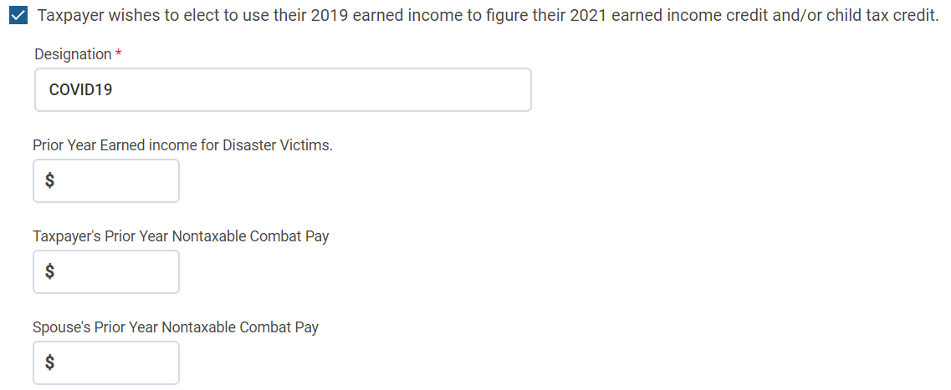
EIC CHANGES IN TAXSLAYER
On the Personal Information page there is a question, like last year, for using 2019 earned income.

Slide 63
EIC CHANGES – IRS FORMS
Form 1040 is modified in two ways. First, under Line 27a, a checkbox is provided that allows a taxpayer to claim that he/she qualifies for the Qualified Homeless Youth or Qualified Former Foster Child exception to the age 19 requirement.
Second, Line 27c is added to report the amount of the 2019 earned income if an election is made to use 2019 earned income.

Slide 64
EIC CHANGES – IRS FORMS
Schedule EIC is amended to add the new MFS exception.

Slide 65
CHILD & DEPENDENT CARE CREDIT
The Act provides enhancements to the Child & Dependent Care Credit (CDCC) for 2021.
First, the Act makes the CDCC a fully refundable credit for 2021 so long as the taxpayer has his/her principal place of abode in the U.S. for more than half the year (with an exception for Active-Duty Military). In the case of an MFJ return, this condition is satisfied if either spouse has a principal place of abode in the U.S. for more than half the year. For all other years, this credit was/is nonrefundable.
Because the credit is refundable for 2021, a taxpayer who qualifies for the credit will want to file even if the taxpayer would not otherwise be required to file.

Slide 66
CHILD & DEPENDENT CARE CREDIT
If the taxpayer did not have a principal place of abode in the U.S. for more than half the year, the taxpayer is still entitled to the CDCC, but as a nonrefundable credit and thus limited to the income tax owed by the taxpayer.
Second, the dollar limit for the expenses eligible for the CDCC is increased from $3,000 to $8,000 for one qualifying individual and from $6,000 to $16,000 for two or more qualifying individuals.

Slide 67
CHILD & DEPENDENT CARE CREDIT
Third, the top credit percentage is increased from 35% to 50%.
These changes mean that the maximum amount of the credit goes from $1,050 in 2020 to $4,000 in 2021 for one qualifying child and from $2,100 to $8,000 for two or more qualifying children.
Fourth, the phaseout for higher income taxpayers begins at $125,000 of AGI versus $15,000 under prior law.

Slide 68
CHILD & DEPENDENT CARE CREDIT
In addition, the phaseout above these levels is substantially changed. Under prior law, the credit phased out beginning at 35% for income below $15,000 and ending at 20% for income over $43,000.
For 2021, the credit percentage reduces from 50% to 20% as income rises from $125,000 to $183,000, then plateaus at a 20% rate from income above $183,000 to $400,000, and then completely phases out above $438,000.
So, for our taxpayer base, the credit will be 50% of the expenses versus a credit of somewhere between 20% and 35% under prior (and future) law.

Slide 69
CHILD & DEPENDENT CARE CREDIT
The following table shows some examples of the maximum credit at various income levels:
And remember it’s fully refundable for 2021!
 | 1 Child |  | 2 or More
AGI | 2020 | 2021 | 2020 | 2021
$15,000 | $1,050 | $4,000 | $2,100 | $8,000
$25,000 | $900 | $4,000 | $1,800 | $8,000
$35,000 | $750 | $4,000 | $1,500 | $8,000
$50,000 | $600 | $4,000 | $1,200 | $8,000
$75,000 | $600 | $4,000 | $1,200 | $8,000

Slide 70
CDCC IN TAXSLAYER
Not there yet.
TaxSlayer should be asking:
Did the taxpayer (or spouse on an MFJ return) have a principal place of abode in the US for more than half of 2021?

Slide 71
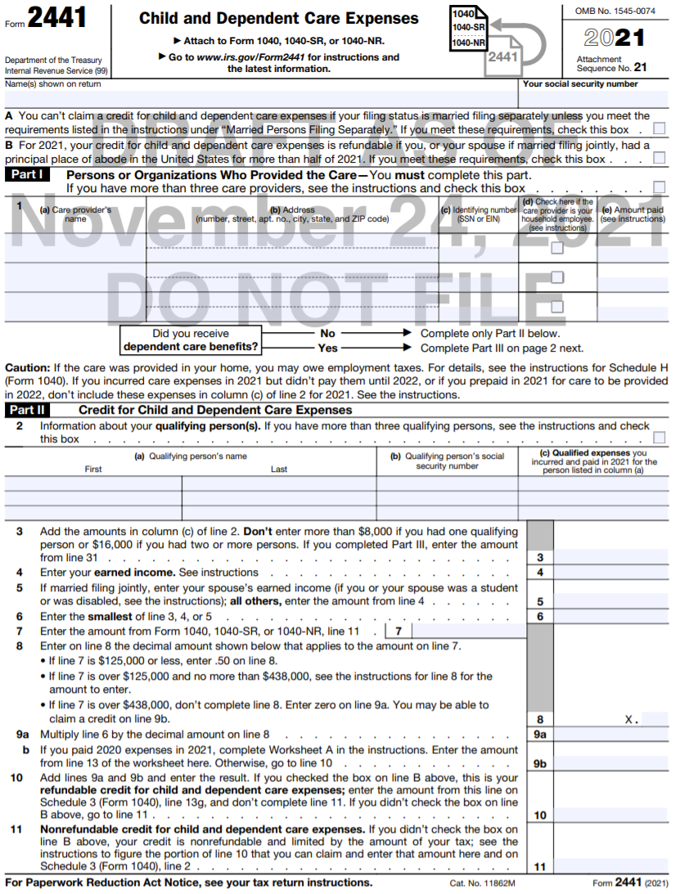
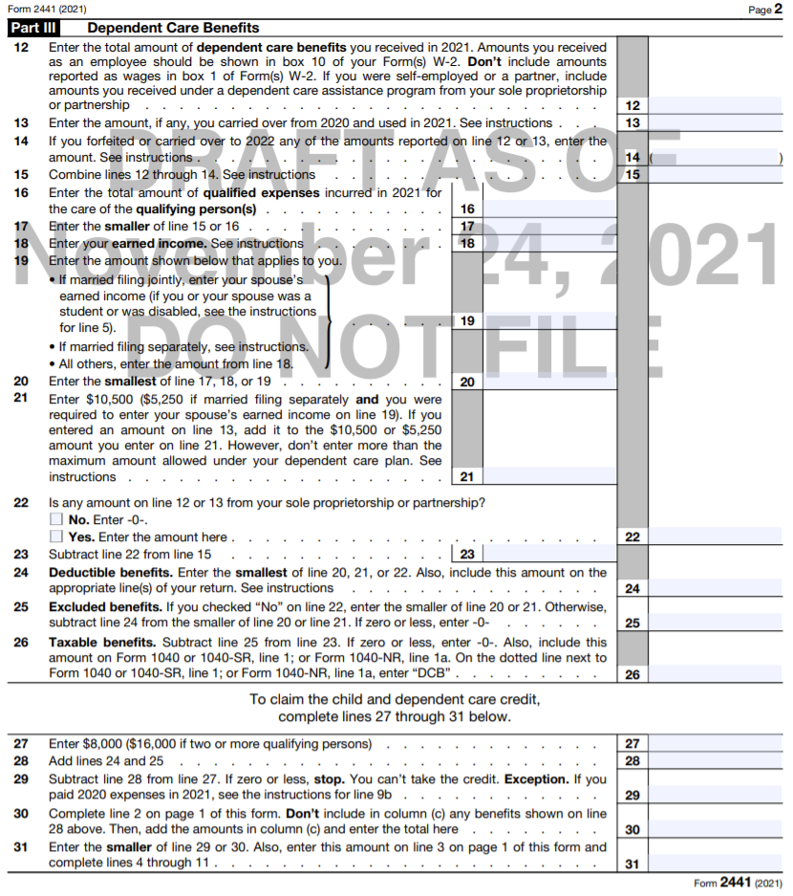

Slide 72
PREMIUM TAX CREDIT
The Act substantially increases the Premium Tax Credit for Marketplace insurance for the years 2021 and 2022.
First, it lowers the percentage of a taxpayer’s income required to be contributed towards the cost of Marketplace insurance. Under prior law, this percentage could be as much as 9.83% of the taxpayer’s income but will now top out at 8.5%. And for taxpayers below 150% of the Federal Poverty Line (FPL), no contribution will be required up to the cost of the Second Lowest Cost Silver Plan.
Second, under prior law, no Premium Tax Credit was available to taxpayers with income above 400% of the FPL. The Act provides a Premium Tax credit for taxpayers above this threshold for 2021 and 2022 based on a contribution by the taxpayer of 8.5% of their income.

Slide 73
PREMIUM TAX CREDIT
Fully Subsidized up to 2nd Lowest Cost Silver Plan
150% Poverty Line
$19,140
$25,860
$32,580
$39,300
$46,020
$52,740
$59,460
$66,180

Slide 74
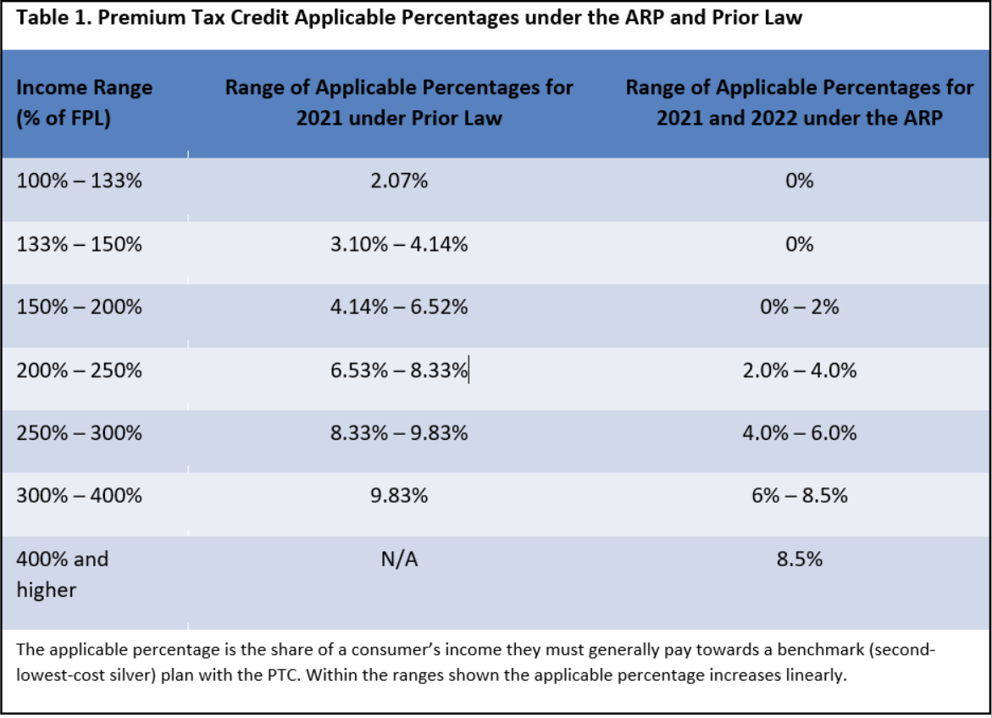
PREMIUM TAX CREDIT
The following table shows the effect of these changes to the percentage of income a taxpayer is required to contribute:
Chart from “The American Rescue Plan’s Premium Tax Credit Expansion – State policy considerations” https://www.brookings.edu/blog/usc-brookings-schaeffer-on-health-policy/2021/04/19/what-does-the-american-rescue-plans-premium-tax-credit-expansion-and-the-uncertainty-around-it-mean-for-state-health-policy/
Notes:
Pub 4012, H-23 has a chart of the FPL.

Slide 75
PREMIUM TAX CREDIT & UC
The Act creates special rules for taxpayers who have Marketplace insurance and received or “were approved to receive” Unemployment Compensation (UC) at any time during 2021.
First, the Act provides that a taxpayer who receives or is approved to receive UC during 2021 qualifies for the PTC even if the taxpayer’s income is below 100% of FPL.
Second, the Act provides that in the case of a taxpayer receiving UC in 2021, their “household income” for purposes of the PTC is capped at 133% of FPL. Thus, for these taxpayers, the Premium Tax Credit will pay 100% of the cost of the Second-Lowest Cost Silver Plan without regard to their actual household income.

Slide 76
PREMIUM TAX CREDIT & UC
The UC must have been received by the taxpayer or the spouse to qualify for these two provisions. UC paid to a dependent does not allow the taxpayer to take advantage of these rules.
There is another provision that allows the special rules to apply if a “non-dependent” member of the taxpayer’s household receives UC during 2021, but this creates a Shared Policy Allocation issue that will make the return out of scope.
Note that these changes do not affect the other requirements that must be satisfied in order to receive the PTC such as no overlapping health coverage.

Slide 77
PREMIUM TAX CREDIT – THOUGHTS
These changes should result in fewer taxpayers needing to repay any PTC for 2021 and eliminates the prior requirement to repay all Advance PTC received if the taxpayer’s income exceeded 400% of FPL. Note that the special rule for 2020 that did not require taxpayers to repay excess Advance PTC received is NOT applicable for 2021.
In addition, many taxpayers with Marketplace Insurance are likely to receive additional PTC on their 2021 tax returns due to the increased subsidies. And remember that this is a refundable tax credit.

Slide 78
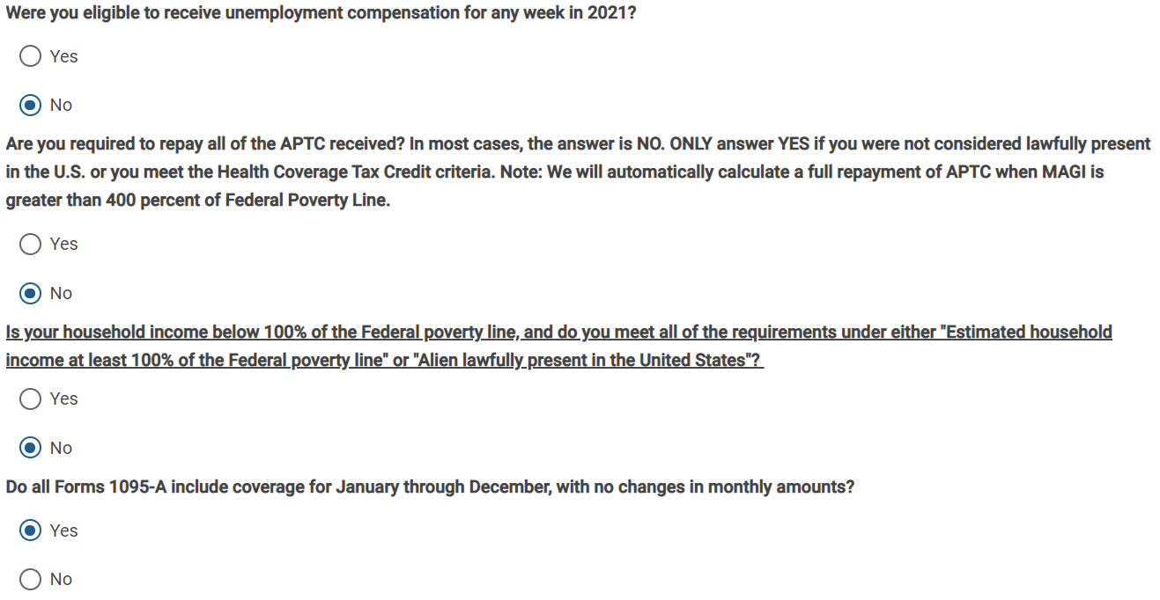
PTC CHANGES IN TAXSLAYER

Slide 79
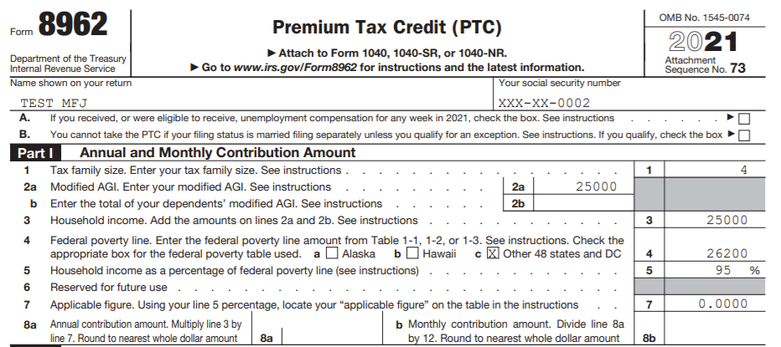
PTC CHANGES – FORM 8962
Question 6 used to deal with income in excess of 400% of FPL and the requirement to repay all the Advance PTC received which no longer applies for 2021 & 2022.

Slide 80
TAXATION OF FORGIVEN STUDENT LOANS
The Act provides that there is no income from the forgiveness in whole or in part of a student loan during the years 2021 through 2025.
These provisions do not apply if the loan is from an educational institution or “private” education lender and the borrower is required to provide services to the educational institution or private education lender in exchange for the forgiveness.

Slide 81
TAXATION OF FORGIVEN STUDENT LOANS
This became even more significant with the announcement in August by the Biden Administration that student loans of persons qualifying as having a “Total and Permanent Disability” would be forgiven in full. This relief must be applied for (see https://disabilitydischarge.com/). It is estimated that this will impact more than 300,000 borrowers holding $5.8 billion in student loans.
I assume, but do not know for sure, that if a student qualifies for the forgiveness provision, he/she will not receive a Form 1099-C in which case there is nothing for us to do.

Slide 82
MISCELLANEOUS CHANGES
Here are some of the inflation adjustments for 2021:
Standard deduction (and primary filing threshold test)
Single goes from $12,400 to $12,550
Head of Household goes from $18,650 to $18,800
MFJ goes from $24,800 to $25,100
The additional amount for over 65 or blind goes from $1,650 to $1,700 for Single or Head of Household and from $1,300 to $1,350 for MFJ and Qualifying Widow returns
The deduction for business miles goes down from 57.5¢ to 56¢ and for medical and moving miles from 17¢ to 16¢. Charitable miles stay at 14¢.
HSA contribution limits have increased by $50 to $3,600 for a self-only plan and by $100 to $7,200 for a family plan (and go to $3,650 and $7,300, respectively, for 2022 contributions).

Slide 83
MISCELLANEOUS CHANGES
The IRS has clarified what amended returns can be e-filed. All 2019 and later amended returns can be e-filed unless the return falls into one of these categories:
If the original return was filed as a paper return, the amended return must be filed as a paper return.
If the Primary SSN on the return is different from the Primary on the original return, the return must be paper filed.
If the spouse’s SSN is different from the original return, the return must be paper filed.
If the filing status is different from the original return, the return must be paper filed.
NC, to my knowledge, still requires that amended returns be paper-filed.

Slide 84
MISCELLANEOUS CHANGES
Personal protective equipment, such as masks, hand sanitizer, and sanitizing wipes, for the primary purpose of preventing the spread of coronavirus are deductible medical expenses and also qualify for the $250 adjustment for educator expenses.
The only Scope change of which I am aware is that noncash charitable contributions of more than $500 can now be done with a Military certification for Active-Duty Military taxpayers only. See Pub. 4491, pp. 20-10 & 11.

Slide 85
IRS FORM CHANGES
Form 1040, Schedules 1, 2 and 3 have been expanded and now list a number of specific items that were previously captured in the “Other” category.
Form 1040, Schedule 8812, which previously calculated the Additional CTC, has been revised. It is now used to claim the CTC, the Other Dependent Credit, the Additional Child Tax Credit and to reconcile the Advance CTC. The nonrefundable credits flow to 1040, line 19, the refundable CTC to line 28, and any repayment of Advance CTC to Schedule 2, line 19.

Slide 86
NC CHANGES FOR 2021
The Governor signed the 2021-22 Budget bill on November 18, 2021. This bill updates the date as of which NC adopts the Internal Revenue Code and thus adopts such changes as the permanent change to a 7.5% floor for medical expenses and the deductibility of expenses funded by a Payroll Protection Program loan. The bill also updates the list of provisions that NC will not follow.
NC did not previously conform for 2020 to the charitable contribution deduction for nonitemizers. When this provision was extended for 2021 by Congress, the deduction was changed from a deduction in computing AGI to a deduction after AGI. This has the effect of making it inapplicable to NC for 2021 since NC starts with AGI.

Slide 87
NC CHANGES FOR 2021
The bill clarifies that NC will not follow the 2020 exclusion from Federal income of the first $10,200 of unemployment compensation. Thus, NO amended returns!
The bill has several provisions that impact 2021 tax returns.
First, NC will not follow the extension for 2021 (just as it did for 2020) of the provision that increases the AGI limit for cash charitable contributions to 100%.

Slide 88
NC CHANGES FOR 2021
Second, NC continues to not conform for 2021 to the following Federal provisions: PMI deduction; the nontaxability of Qualified Principal Residence Indebtedness; and the nontaxability of certain employer payments of student loans.
Third, NC now adds two more provisions that it will not follow: the new exclusion rules for discharges of student loan debt from 2021 to 2025; and the increased meals limit of 100% for 2021 and 2022.

Slide 89
NC CHANGES FOR 2021
Finally, beginning for 2021, NC will not tax certain Military retirement pensions. The payments covered are:
Normal retirement payments for service in the Armed Forces where the service member served at least 20 years;
Disability Retirement payments to service members who were medically retired (this benefit is through the Department of Defense and not the VA – VA Benefits and certain DoD benefits are already nontaxable and thus a 1099-R would not be received for these); and
Benefits paid under the Survivor Benefit Plan attributable to service of a retired member of the Armed Forces who served at least 20 years or was medically retired.

Slide 90
NC CHANGES FOR 2021
These benefits will appear on a Form 1099-R issued by the DFAS (Defense Finance Accounting Service).
Thus, if a taxpayer has a Form 1099-R from DFAS, you must ALWAYS ask the taxpayer how many years of service the service member had with the Armed Forces prior to retirement, and if less than 20, you must ask whether the benefit is a Disability Retirement Benefit. Any retirement benefit paid to a nondisabled service member or to a beneficiary of the service member under the Survivor Benefit Plan where the service member had less than 20 years of service or was not medically retired will not qualify for the NC exclusion.

Slide 91
NC CHANGES AFTER 2021
Certain other significant changes were included in the Budget Bill that will apply beginning in 2022.
The NC Standard Deduction will increase to an amount that is greater than the current Federal Standard Deduction.
 | Old NC | New NC | Federal for 2021
MFJ/QW | $21,500 | $25,500 | $25,100
Head of Household | $16,125 | $19,125 | $18,800
Single/MFS | $10,750 | $12,750 | $12,550

Slide 92
NC CHANGES AFTER 2021
The NC income tax rate will decrease from the current 5.25% to 4.99% for 2022, and then reduce each succeeding year until 2027 when it will be 3.99%.
The NC Child Deduction for children who qualify for the Federal CTC will increase by $500. The new deduction will be $3,000 for incomes below $40,000 MFJ/QW, $30,000 HoH, and $20,000 Single/MFS, and will decrease as income increases. As before, the deduction completely phases out for income above $140,000 MFJ/QW, $105,000 HoH, and $70,000 Single/MFS.

Slide 93
CHANGES TO COME?
The Build Back Better Act that has passed the House and is being debated in the Senate contains a host of provisions that will generally impact 2022 and beyond.
The Senate is likely to make some changes and hopes to pass the bill by Christmas.

Slide 94
CHANGES TO COME?
The following is a list of the more significant tax provisions contained in the House Bill:
Extend CTC enhancement for 2022
Extend EIC enhancement for taxpayers with no qualifying children for 2022
Extend PTC enhancements for the years 2023-2025
Excludes Pell Grants from income for 2022-2025
State and Local Taxes – increases limit for itemized deduction to $80,000 for 2021-2030 and then back to $10,000 for 2031 (remember this limit was part of the 2017 tax changes that will expire after 2025)

Slide 95
CHANGES TO COME?
If you thought tax extenders was an issue in the past, just wait until we are dealing with the potential of annual fights over major changes to the Child Tax Credit, Earned Income Credit and Premium Tax Credit, among others.
Hopefully, Congress won’t repeat their prior penchant of waiting to address the expiring provisions until near the end of the year or even worse, during the filing season!
The only change that will impact (at this point) 2021 is the increase in the state and local tax deduction limit from $10,000 to $80,000.
Changes are likely in the Senate especially with respect to the state and local tax deduction.

Slide 96
Bill Hawkins
hawkinsbill79@gmail.com

