Slide 1
2023 NC VITA TRAINING
December 2023

Slide 2
TODAY’S TOPICS
What’s New for 2023?
Retirement Plan Tax Changes
Energy Tax Credits
Form and Reporting Changes
Form 1099-K Delay
Inflation Adjustments
TaxSlayer Changes
Education
NC Exemptions for Bailey and the Military
Gig Economy Workers
Miscellaneous

Slide 3
WHAT’S NEW FOR 2023

Slide 4
WHAT’S GONE?
100% deduction for business meals at a restaurant.

Slide 5
RETIREMENT PLAN CHANGES
Congress passed the SECURE Act 2.0 in December 2022.
Makes numerous changes to the tax consequences of retirement plans.
The following are the provisions most applicable to VITA sites.

Slide 6
CHANGES TO RMD AGE
The legislation increases the Required Minimum Distribution age to 73 beginning in 2023 and to 75 in 2033.
Birth Year RMD by April 1 of Birth Year RMD by April 1 of
1950 2023 1956 2030
1951 2025 1957 2031
1952 2026 1958 2032
1953 2027 1959 2033
1954 2028 1960 2036
1955 2029 1961+ Year after turning 75

Slide 7
RMD PENALTY
Prior to 2023, failure to satisfy the RMD payout requirements resulted in a penalty equal to 50% of the amount that should have been withdrawn.
Beginning in 2023, the penalty is reduced to 25%.
In addition, the penalty is further reduced to 10% for IRA owners if the shortfall is withdrawn and a corrected tax return is filed by the earliest of: (1) mailing of a notice of deficiency; (2) the date the IRS assesses the tax; or (3) the end of the 2nd taxable year after the tax was imposed.

Slide 8
RMD PENALTY
Taxpayers may still request a waiver of the penalty as under prior law.
The RMD penalty continues to be out of scope for VITA, including any request for a waiver of the penalty. However, use the information previously provided to help your clients understand the importance of addressing this issue.

Slide 9
RMD PENALTY
How do you “correct” the failure to pay an RMD and get the 10% rate? The draft Form 5329 instructions state:
You may be subject to a reduced additional tax rate of 10% of the amount not distributed if, during the correction window, you take a distribution of the amount on which the tax is due and submit a return reflecting this additional tax.
It is not clear to me if that means an amended return for the year the 25% penalty was paid or a return for a later year when the correction is made. Pub. 590-B once issued should discuss this in more detail.
In either event, it would appear that the corrected return would be out of scope as it must include a Form 5329 with Part IX completed.

Slide 10
EXCEPTIONS TO 10% TAX
The Act adds several new exceptions to the 10% additional tax on early distributions from IRAs and 401(k) plans:
Terminal Illness –Distributions that are made after the date on which your physician has certified that you have an illness or physical condition that can reasonably be expected to result in death in 84 months or less after the date of the certification. Effective for distributions after December 29, 2022.

Slide 11
EXCEPTIONS TO 10% TAX
Prior law allowed an exception for distributions (not from IRAs) to “public safety officers” received after separation from service when the separation from service occurs in or after the year you attained age 50 (vs. 55 for everyone else). The Act adds that distributions to a public safety officer with at least 25 years of service qualify even if the taxpayer is below age 50 at the time of separation. Effective for distributions after December 29, 2022.
Public safety officers now also include state and local corrections officers and private-sector firefighters. Effective for distributions after December 29, 2022.

Slide 12
EXCEPTIONS TO 10% TAX
Under prior law, if you made excess contributions to an IRA but corrected the excess contribution by withdrawing the excess amount and associated earnings before the due date of the return, the 10% additional tax was applied to the amount of the associated earnings withdrawn if the taxpayer was under the age of 59½. For distributions of such earnings after December 29, 2022, the 10% additional tax no longer applies.

Slide 13
EXCEPTIONS TO 10% TAX
Disaster Relief – For taxpayers affected by Federally-declared disasters, distributions up to $22,000 are exempt from the additional tax if made within 180 days of the disaster (and the income can be spread over 3 years and repaid as with the COVID plan distribution treatment). Effective for disasters on or after January 26, 2021. The spreading of income and repayments are reported on Form 8915-F and are out of scope for VITA.

Slide 14
EXCEPTIONS TO 10% TAX
Here are a couple more that become effective for 2024.
Domestic Abuse – Distributions up to the lesser of $10,000 or 50 percent of the participant’s account to participants that self-certify that they experienced domestic abuse (physical, psychological, sexual, emotional, or economic abuse). Effective beginning in 2024.

Slide 15
EXCEPTIONS TO 10% TAX
Emergency Expenses – An exception is provided for distributions used for emergency expenses, which are unforeseeable or immediate financial needs relating to personal or family emergency expenses. Only one distribution is permissible per year of up to $1,000, and a taxpayer has the option to repay the distribution within 3 years. No further emergency distributions are permissible during the 3-year repayment period unless repayment occurs. Effective beginning in 2024.

Slide 16
OTHER CHANGES
Section 529 Plans for Education Expenses – Starting in 2024, any amounts remaining in a 529 Plan that has been in existence for 15 years may be rolled over into a Roth IRA. The rollover is subject to both the normal annual contribution limits for contributions to Roth IRAs and to a lifetime limit of $35,000.
The $1,000 additional contribution for IRAs for taxpayers over age 50 will now be indexed for inflation.

Slide 17
OTHER CHANGES
Previously, public safety officers were allowed to exclude up to $3,000 for payments made by a governmental retirement plan directly to an insurance company for health or long-term care insurance of the participant, spouse, or dependents. The Act eliminates the requirement that the plan pay the premiums directly to the insurance company. This means that retired public safety officers for 2023 can reduce the taxable amount of a distribution from a governmental retirement plan by the amount of any health or long-term care insurance premiums paid for the taxpayer, spouse, or dependents up to $3,000 even if paid by the taxpayer to the insurance company.

Slide 18
OTHER CHANGES
Beginning in 2027, the Retirement Savings Credit will be replaced by a government match to the plan. However, the taxpayer will be able to elect to still receive a nonrefundable credit like the current credit rather than the matching contribution.

Slide 19
ENERGY TAX CREDITS
As part of the Inflation Reduction Act, Congress significantly changed the Energy Tax Credit that is in scope for VITA. The credit is now called the “Energy Efficient Home Improvement Credit”. The credit remains a nonrefundable credit.
The credits for solar, wind, geothermal, and electric vehicles remain out of scope for VITA.
These changes are effective for the 2023 tax year.

Slide 20
ENERGY TAX CREDITS
The legislation made a number of significant changes:
No more $500 lifetime limit.
The amount of the credit has been significantly increased.
Qualifying improvements have significant new eligibility criteria.
Roofs and air-circulating fans no longer qualify.
Two new categories have been added – electrical panels and home energy audits.

Slide 21
ENERGY TAX CREDITS
The credit equals 30% of qualifying costs subject to certain limits.
In the case of heat pumps, heat pump water heaters, and biomass stoves and boilers, there is an aggregate annual credit limit of $2,000.
For all other qualifying items, there are both dollar limits by category, plus an aggregate annual credit limit of $1,200.
Thus, a taxpayer could receive as much as $3,200 per year in energy credits versus $500 lifetime under the prior law.

Slide 22
ENERGY EFFICIENT HOME IMPROVEMENT CREDIT
CREDIT IS 30% OF COSTS SUBJECT TO CATEGORY AND AGGREGATE DOLLAR LIMITS
$2,000 AGGREGATE LIMIT
$1,200 AGGREGATE LIMIT
Heat Pumps
Exterior Doors - $250/$500
Windows/Skylights - $600
Insulation – No Limit
Central AC - $600
Gas Water Heaters - $600
Furnaces & Boilers - $600
Electrical Panels - $600
Home Energy Audit - $150
HP
Water Heaters
Biomass

Slide 23
ENERGY TAX CREDITS
These new rules are quite complex in their application and will not be simple to address in practice.
This will all get much easier starting in 2025 as the taxpayer will be required to provide a product identification number to include on the return to claim the credit.

Slide 24
ENERGY STAR
As you will see, for most qualifying products, the product must be Energy Star certified (or some variant thereof).
For more information on these credits and the Energy Star requirements go to https://www.energystar.gov/about/federal_tax_credits.
Your client should have paperwork that shows whether the product was Energy Star certified.
In addition, for qualifying products, they should have received or should be able to get from the seller or manufacturer (or manufacturer’s website) a Manufacturer’s Certification Statement that the product qualifies for the credit.
Without this documentation, determining whether the product qualifies will be challenging.

Slide 25
ENERGY TAX CREDITS
The discussion below will break qualifying improvements down into 3 categories:
Qualified Energy Efficiency Improvements
Residential Energy Property Expenditures
Home Energy Audits

Slide 26
QUALIFIED ENERGY EFFICIENCY (“QEE”) IMPROVEMENTS
This category includes exterior doors, windows, and insulation.
All of these improvements are subject to the $1,200 aggregate limit.
In addition, doors and windows have their own separate dollar limits for the maximum credit for such improvements.

Slide 27
QEE – GENERAL REQ’TS
To qualify, the installation of doors, windows, and insulation in a home must meet the following requirements:
The improvement must be to an existing home and not part of the original construction.
The home must be located in the U.S.
The home must be owned and used as the taxpayer’s principal residence (and thus second homes and improvements made by tenants or landlords do not qualify).

Slide 28
QEE – GENERAL REQ’TS
The improvement must be new property.
The improvement must be expected to remain in use for at least 5 years.
Qualifying costs are just the costs of the items themselves and do not include the cost of labor or site preparation work to install the items.

Slide 29
EXTERIOR DOORS
Exterior doors must be Energy Star certified.
For doors with less than half the door covered by glass, the Energy Star standards are the same without regard to where you live.
In the case of doors where more than half the surface area is glass, there are different criteria based on the climate zone you are in.

Slide 30
EXTERIOR DOORS
While South Carolina has only one zone (South Central), North Carolina has two, North Central and South Central. For N.C., you’ll have to find the zone for the appropriate county using the following tool: https://www.energystar.gov/products/building_products/residential_windows_doors_and_skylights/climate_zone/search

Slide 31
EXTERIOR DOORS
Unfortunately, as if this wasn’t complicated enough, Energy Star made significant changes effective October 23, 2023.
These changes not only changed the criteria for qualification for doors, but they also changed the map so that a significant part of what was North Central in N.C. became South Central. The tool discussed on the prior page reflects the Oct. 23 changes so good luck figuring out the zone prior to Oct. 23.

Slide 33
EXTERIOR DOORS
Glazing Level refers to the amount of glass in the door. Opaque means no glass, ≤ ½ Lite means glass takes up no more than half of the door, and > ½ Lite means glass takes up more than ½ of the door.
SHGC - Solar Heat Gain Coefficient

Slide 34
EXTERIOR DOORS
Hopefully, the IRS will provide guidance on how we deal with the changes to the Energy Star criteria as of October 23. The instructions for Form 5695 have yet to be issued.
For the improvements discussed in the next category (Residential Energy Property Expenditures), the Act provided that the criteria were based on the rules at the beginning of the year, but unfortunately there does not appear to be a similar rule for doors, windows, or skylights.
If the documentation supports the door being “Energy Star Certified” when it was purchased, I think you should be good.

Slide 35
EXTERIOR DOORS
The credit equals 30% of the cost of the door NOT including the cost to install the door.
There is a separate limit for doors. The credit for the most expensive door cannot exceed $250, and the credit for two or more doors cannot exceed $500.
In addition, doors are subject to the $1,200 aggregate limit.

Slide 36
EXTERIOR DOORS
The only way to know for certain that the door qualifies is to have the taxpayer provide evidence to support the qualification.
There is a complicated way to look up the qualification if you have the information needed (manufacturer, type of door, and the model number or series). You’ll have to decide for your site whether you want to take the taxpayer’s word that it qualifies, require proof from the taxpayer that it qualifies, or go through the qualification lookup process.

Slide 37
EXTERIOR DOORS
To look up qualifying doors, go to https://search.nfrc.org/search/cpd/cpd_search_default_ByMfr.aspx?SearchOption=M
Select the manufacturer, the product type (sliding glass patio door or exterior swinging door), check the “Energy Star Products Only”, and then click on “Find Product Lines”.
On the next page find the series or model number and then click on the appropriate Product Line.

Slide 38
EXTERIOR DOORS
You will then need to find the Manufacturer Product Code from the list. Good luck with that step.
There will then be check marks for the zones in which that door qualifies (look for a check mark in either NC (North Central) or SC (South Central) based on the zone in which the dwelling is located.
As an alternative, you can also try to find the information on the manufacturer’s website.

Slide 39
WINDOWS AND SKYLIGHTS
The window or skylight must meet the requirements of the Energy Star “Most Efficient” category, which is a limited subset of Energy Star-certified windows and skylights.
To meet this standard, the window must have a maximum U-Factor of 0.20 and a maximum SHGC of 0.25 in the South Central zone and 0.40 in the North Central zone. Apparently, the Oct. 23 changes did not impact these criteria, although the map changed.

Slide 40
WINDOWS AND SKYLIGHTS
To determine whether a particular window qualifies, go to https://www.energystar.gov/products/most_efficient
Find the section for Windows and then select the type of window (vertical slider, casement, etc.).

Slide 41
WINDOWS AND SKYLIGHTS
You will then see a list by manufacturer. Find the window on the list (if it’s not there, it doesn’t qualify). In the far-right column, make sure your zone is listed - either NC (North Central) or SC (South Central). I provided the steps to determine zones under exterior doors. I cannot guarantee that the zones are always the same for windows and doors, so check on that website.

Slide 42
WINDOWS & SKYLIGHTS
The credit equals 30% of the cost of the windows and skylights NOT including the cost to install the windows or skylights.
There is a separate dollar limit for windows and skylights. The credit for windows and skylights cannot exceed $600.
In addition, windows and skylights are subject to the $1,200 aggregate limit.

Slide 43
INSULATION
Insulation and air sealing materials must be “specifically and primarily designed to reduce heat loss or gain of your home that meets the criteria established by the IECC” as in effect on January 1, 2021, to qualify. Good luck.
If the item provides structural support or a finished surface (such as drywall or siding) or its principal purpose is to serve any function unrelated to the reduction of heat loss or gain, it does not qualify.
There is no specific dollar limit for insulation, but the $1,200 aggregate limit applies.

Slide 44
RESIDENTIAL ENERGY PROPERTY EXPENDITURES
This category includes heat pumps, water heaters, boilers, central AC, furnaces, and electrical panels.
For heat pumps, heat pump water heaters, and biomass stoves and boilers, there is an aggregate $2,000 limit on the credit.
The other items in this category are subject to the same $1,200 aggregate limit as the prior category and Home Energy Audits. In addition, some of these items have separate dollar limits on the credit for those items.

Slide 45
REPI – GENERAL REQ’TS
To qualify, the installation of items in this category in a home must meet the following requirements:
The improvement must be to an existing home and not part of the original construction.
The home must be located in the U.S.
The home must be used as a residence of the taxpayer (and thus second homes and improvements made by tenants qualify, but landlord improvements do not).

Slide 46
REPI – GENERAL REQ’TS
The improvement must be new property.
Qualifying costs include both the costs of the items themselves and the cost of site preparation and labor to install the items.

Slide 47
HEAT PUMPS
All ducted heat pumps that are Energy Star certified qualify. These are generally pretty easy to look up on the manufacturer’s website if you know the model.
A ductless heat pump must be Energy Star certified and meet the following requirements:
SEER2 ≥ 16
EER2 ≥ 12
HSPF2 ≥ 9
Ducted is the typical home system, while ductless are generally wall-mounted units.
Subject to the $2,000 aggregate limit.

Slide 48
HEAT PUMP WATER HEATERS
These are significantly different from and more expensive than normal water heaters as they have a fan and heat exchanger mounted to the top of the water heater. These are often referred to as hybrid water heaters. These are the only electric water heaters that can qualify for the credit.
Heat pump water heaters must be Energy Star certified to qualify for the credit.
Subject to the $2,000 aggregate limit.

Slide 49
BIOMASS STOVES/BOILERS
Biomass fuel includes agricultural crops and trees, wood and wood waste and residues (including wood pellets), plants (including aquatic plants), grasses, residues, and fibers.
The stove or boiler must have a thermal efficiency rating of at least 75% measured by the higher heating value of the fuel to qualify.
Subject to the $2,000 aggregate limit.

Slide 50
CENTRAL AIR CONDITIONERS
For split systems (separate outdoor unit and indoor air handler), the unit must be Energy Star certified and have a SEER2 rating of 16 or above.
For packaged systems (one single unit usually on a wall), the unit must be Energy Star certified.

Slide 51
CENTRAL AIR CONDITIONERS
For a list of qualifying Central AC units, see https://www.energystar.gov/productfinder/product/certified-central-air-conditioners/results. (Click on “Tax Credit Eligible” in the left-hand column to refine your search).
The credit equals 30% of the costs including labor but is limited to a maximum of $600 for all Central AC units. The $1,200 aggregate limit also applies.

Slide 52
GAS WATER HEATERS
Oil water heaters do not qualify.
Natural gas or propane water heaters may qualify.
Units with tank storage must have a Uniform Energy Factor (UEF) of ≥ 0.81 for tanks less than 55 gallons and a UEF of ≥ 0.86 for larger tanks.
Tankless gas water heaters must have a UEF of ≥ 0.95.

Slide 53
GAS WATER HEATERS
A list of qualifying gas water heaters: https://www.energystar.gov/productfinder/product/certified-water-heaters/results. You must indicate whether the water heater has a tank or is tankless in the left column. There will be an indication for those models that are tax credit eligible.
The credit equals 30% of the costs including labor but is limited to a maximum of $600 for all gas water heaters. The $1,200 aggregate limit also applies.

Slide 54
FURNACES & HOT WATER BOILERS
Natural gas and propane furnaces must be Energy Star certified and have an Annual Fuel Utilization Efficiency (AFUE) of ≥ 97%.
Oil furnaces must be Energy Star certified and use certain fuels. The oil furnace must be rated by the manufacturer for use with fuel blends at least 20 percent of the volume of which consists of biodiesel, renewable diesel, or second-generation biofuel.

Slide 55
FURNACES & HOT WATER BOILERS
Natural gas and propane hot water boilers must be Energy Star certified and have an AFUE of ≥ 95%.
Oil hot water boilers must be Energy Star certified and use certain fuels. The equipment must be rated by the manufacturer for use with fuel blends at least 20 percent of the volume of which consists of biodiesel, renewable diesel, or second-generation biofuel.

Slide 56
FURNACES & HOT WATER BOILERS
For a list of qualifying furnaces see https://www.energystar.gov/productfinder/product/certified-furnaces/results
For a list of qualifying boilers see https://www.energystar.gov/productfinder/product/certified-boilers/results

Slide 57
FURNACES & HOT WATER BOILERS
The credit equals 30% of the costs including labor but is limited to a maximum of $600 for all furnaces and boilers. The $1,200 aggregate limit also applies.

Slide 58
ELECTRICAL PANELS
This is a new category of qualifying improvements.
Any improvement to, or replacement of, a panelboard, sub-panelboard, branch circuits, or feeders qualifies if it satisfies the following three requirements:
The electrical improvements are installed in a manner consistent with the National Electric Code.
The electrical improvements have a load capacity of not less than 200 amps.

Slide 59
ELECTRICAL PANELS
Requirements (cont.)
The electrical improvements are installed along with, and enable the installation and use of:
any qualified energy efficiency improvements (exterior doors, windows, skylights, and insulation), or
any qualified energy property (heat pump water heater, heat pump, central air conditioner, water heater, furnace or hot water boiler, or biomass stove or boiler).

Slide 60
ELECTRICAL PANELS
Thus, electrical panel improvements only qualify if such improvements were done as part of the installation of other qualifying energy credit property and cannot be “stand-alone” improvements.
The credit equals 30% of the costs including labor but is limited to a maximum of $600 for all qualifying electrical improvements. The $1,200 aggregate limit also applies.

Slide 61
HOME ENERGY AUDITS
This is a new category of eligible expenses for the credit.
The credit equals 30% of the cost of the audit but is limited to a maximum of $150. The $1,200 aggregate limit also applies.

Slide 62
HOME ENERGY AUDITS
The Home Energy Audit must satisfy the following requirements for 2023:
The dwelling unit must be located in the U.S.
The dwelling unit must be owned or used by the taxpayer as the taxpayer’s principal residence. Thus, renters can claim the credit, but second homes do not qualify.
The audit must include an inspection of a dwelling (including condos and manufactured homes).

Slide 63
HOME ENERGY AUDITS
2023 Requirements (cont.):
The home energy auditor must provide a written report that identifies the most significant and cost-effective energy efficient improvements for that dwelling, including an estimate of the energy and cost savings for each such improvement.

Slide 64
HOME ENERGY AUDITS
In addition to these requirements, additional requirements will apply to home energy audits conducted after 2023:
The inspection was conducted either by a Qualified Home Energy Auditor or under the supervision of a Qualified Home Energy Auditor.

Slide 65
HOME ENERGY AUDITS
2024 Requirements (cont.):
The report must be written and signed by a Qualified Home Energy Auditor. It must include the Qualified Home Energy Auditor’s name and relevant EIN. There must be an attestation that the Qualified Home Energy Auditor is certified by a Qualified Certification Program and provide the name of such program.
The audit must be consistent with the most recent DOE-led and industry-validated Jobs Task Analysis.

Slide 66
TAXSLAYER
TaxSlayer has added the section for “Qualified Energy Efficiency Improvements” (doors, windows, and insulation).
Nothing yet on the rest, Residential Energy Property Expenditures or Home Energy Audits.

Slide 67
ENERGY CREDIT RECAP
The energy tax credits that are in scope for VITA have been significantly enhanced.
Some old categories are gone (roofs and air-circulating equipment) and new ones have been added (electrical panels and Home Energy Audits).
The qualification requirements are complex and vary significantly by category.
Your site will have to determine what proof you will require of taxpayers claiming the credit.

Slide 68
ENERGY REBATES
The Inflation Reduction Act (IRA) also provided for $8.8B in rebates to taxpayers for home energy efficiency and electrification projects. The refunds will be paid by the states under programs established by the states.
The funding for these projects will go to the individual states and each state will create its own rules for participating in the program. NC has not yet issued its requirements and does not expect the program to begin until 2024.
It is possible that rebates will be given retroactively for projects completed after August 16, 2022, but NC has not committed to giving retroactive rebates.

Slide 69
ENERGY REBATES
According to the US Department of Energy, these rebates will not be taxable income to recipients.
However, nontaxable rebates, like the IRA rebates, reduce the costs taken into account in determining an energy tax credit.
Thus, you must ask the taxpayer if they received any rebates when purchasing the improvements giving rise to the energy tax credit in order to determine the qualifying costs of the improvements.

Slide 70
OTHER REBATES
Rebates from a public utility are also generally treated as nontaxable rebates and thus reduce the costs taken into account in determining an energy tax credit.
Rebates from other parties such as a manufacturer, will also generally be nontaxable and reduce the costs taken into account for an energy tax credit.

Slide 71
FORM & REPORTING CHANGES

Slide 72
FORM 1099-K
This form is used to report payments received by taxpayers from third party settlement organizations including payment apps, credit card processors, and online marketplaces.
The form will be used to report payments to the taxpayer from gig economy companies such as Uber and DoorDash, marketplaces such as Amazon and eBay, and other companies that facilitate cash transfers such as PayPal and Venmo. I understand that Zelle is taking the position that they are not required to report under these rules.
We have seen this form most frequently in the past from gig economy companies such as Uber where they are reporting credit card charges received on behalf of their drivers.

Slide 73
FORM 1099-K
Previously, a Form 1099-K was issued only if the taxpayer received payments totaling at least $20,000 and had at least 200 transactions.
For 2022, that limit was reduced to $600 with no minimum number of transactions. However, the IRS delayed implementation of these new reporting requirements until the 2023 tax year.
On November 21, 2023, the IRS announced another delay in implementing the new 1099-K requirements.

Slide 74
FORM 1099-K
For 2023, the old standard of payments totaling at least $20,000 and at least 200 transactions will continue to apply.
For 2024, the dollar limit will fall to $5,000. It is not clear to me whether the transaction threshold will remain for 2024.
For 2025, the new $600 limit will apply with no transaction threshold.
So, I will save all of the slides I already created on this topic for next year.

Slide 75
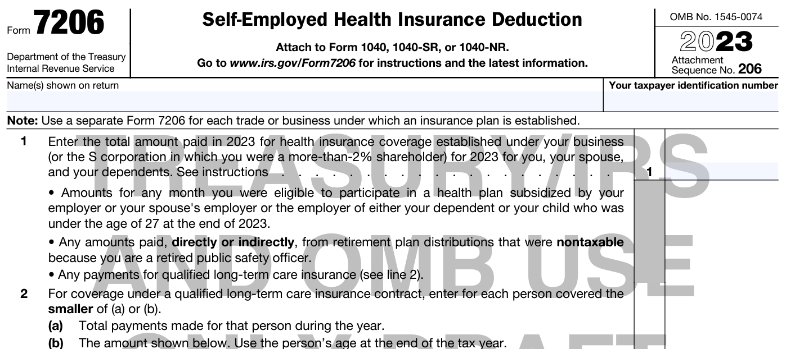
OTHER FORM CHANGES
The deduction for Self-Employed Health Insurance was previously determined using a worksheet in the 1040 instructions. This has now been moved to a new form – Form 7206.

Slide 76
INFLATION ADJUSTMENTS

Slide 77
STANDARD DEDUCTION
MFJ/QSS – goes from $25,900 to $27,700
Single/MFS – goes from $12,950 to $13,850
Head of Household – goes from $19,400 to $20,800
Aged/Blind Adjustment – increases $100 to $1,850 if unmarried and not a surviving spouse, and to $1,500 for all others

Slide 78
OTHER CHANGES
Child Tax Credit – Refundable limit increases from $1,500 to $1,600
EIC – Maximum credit increases from $6,935 with 3 or more kids to $7,430
Annual Exclusion for Gifts – increases from $16,000 to $17,000
Maximum IRA deduction increases by $500 to $6,500 ($7,500 if age 50 or older)

Slide 79
OTHER CHANGES
Qualified Relative Gross Income Test – gross income limit increases from $4,400 to $4,700
Business use of a car – increases to 65.5¢/mile [medical (22¢/mile), moving (22¢/mile), and charitable (14¢/mile), are unchanged]
HSA Contribution Limit – increases to $7,750 for family plans and $3,850 for self-only plans (increased by $1,000 if 55 or older)
Kiddie Tax Unearned Income Threshold – increases from $2,300 to $2,500

Slide 80
OTHER CHANGES
Investment income limit for EIC increases to $11,000
Foreign Earned Income Exclusion – increases from $112,000 to $120,000
Repayment limits for the Premium Tax Credit

Slide 81
NC CHANGES

Slide 82
NC TAX RATE CHANGES
The only significant change in NC during 2023 for our purposes was legislation that further reduces individual income tax rates for years after 2023.
There is also a mechanism that would adjust these rates even further to as low as 2.49% if certain thresholds in General Fund revenue are met.
TAX YEAR | TAX RATE
2023 | 4.75%
2024 | 4.50%
2025 | 4.25%
After 2025 | 3.99%

Slide 83
TAXSLAYERCHANGES

Slide 84
TAXSLAYER
The carryforward includes a warning if the prior year return had an IP PIN.
There is a warning given if the prior year return had a 1095-A and the current year return does not.
TaxSlayer still does not support e-filing of NC amended returns (I think because NC won’t accept them yet).

Slide 85
TAXSLAYER
These are the carryforward items in TaxSlayer as of August 22, 2023.
Carryforward of an IP PIN Warning if IP PIN Existed on Prior Year Return - Presented as an e-file warning if present on prior year but not current year
Carryforward of Applied Federal Refund from Previous Year - Applicable Federal value will automatically carry to Payments & Estimates menu > Federal Estimated Payments
Carryforward of Simplified Method Worksheet items - Current values included are plan cost at annuity start date, starting date of annuity, and age of recipient at start date
Carryforward of Form FEC (Foreign Earned Compensation) data
Carryforward of Education Credits - This includes the educational institution details
Carryforward of Taxpayer Notes - This includes the title and details of notes added to a return from the prior year

Slide 86
TAXSLAYER
Carryforward of Form 1099-MISC payer data
Carryforward of the Unallowed Loss from Schedule E
Taxpayer (spouse if MFJ) name, filing status, taxpayer identification number (SSN/ITIN), date of birth, and phone number
Carryforward of dependents
Carryforward of W-2/W-2PR employers
Carryforward of 1099-R/RRB-1099-R payers including state and state ID’s
Carryforward of Schedule D - Specifically the carryforward of capital loss and depreciation worksheet
Carryforward of Schedule C - Specifically business name, business code and description
Carryforward of Schedule E - Specifically rental information and Schedule K-1 payer information

Slide 87
TAXSLAYER
Carryforward of Child Care providers and associated dependents
Carryforward of Schedule B financial institution info for Forms 1099-INT/DIV
Carryforward of State and Local Refunds if itemized in the prior year
Carryforward of F5405 First Time Homebuyer Repayment - Presented as an e-file warning if repayment present on prior year but not current year
Carryforward of Form 1095-A - Presented as an e-file warning if F1095-A was present on prior year but not current year

Slide 88
SIMPLIFIED METHOD
I am a big fan of the cotaxaide.org tools. My favorite is the Simplified Method tool (Annuity/Pension Exclusion Calculator).
Now that TS carries forward Simplified Method Worksheet entries, if you use the cotaxaide tool, I suggest entering the information from the calculator, including the Amounts previously recovered (as shown in the Simplified General Rule Worksheet box in the calculator), so that the carryforward feature will (hopefully) work for subsequent years.

Slide 89
VIEWING THE RETURN
There is a new “Preview Return” button at the top of every page so you can create the pdf without going to Summary/Print.

Slide 90
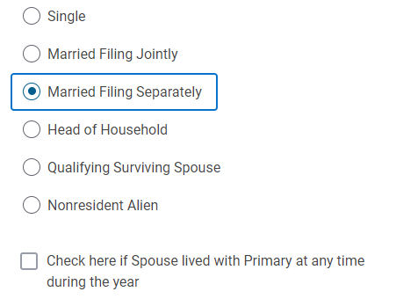
MFS RETURNS
If you select MFS, a question pops up about living with the spouse during the year which is important for properly taxing Social Security income on an MFS return.

Slide 91
PREMIUM TAX CREDIT
TaxSlayer is adding the functionality to add page 2 of Form 8962. This deals with the shared policy allocation rules.
HOWEVER, to my knowledge this topic is still out of scope for VITA at least according to Pub. 4012 andpub. 4491.

Slide 92
SCHEDULE D
New TaxSlayer menu addition

Slide 93
SCHEDULE D

Slide 94
SCHEDULE D
Although this is not yet functional, the purpose of this is to allow you to skip several of the entries required on the regular Schedule D input page, including dates of purchase and sale and whether the basis was reported to the IRS.
I believe this section is for capital gain and loss transactions that qualify for an exception to having to file Form 8949 (which requires all of that detail).
The TaxSlayer menu item states that it is for 1099-B transactions where there are no adjustments, but there is more to the exception than just no adjustments.

Slide 95
SCHEDULE D
To qualify for the exception as detailed in the 8949 instructions, the following must be true:
The taxpayer received a Form 1099-B (or substitute brokerage statement) that shows basis was reported to the IRS and doesn’t show any adjustments for accrued market discount (which is out of scope for VITA) or wash sale loss disallowed.
The Ordinary box in Box 2 isn’t checked (also out of scope).

Slide 96
SCHEDULE D
There are no adjustments required to the basis, type of gain or loss, or amount of gain or loss. See Pub. 4012, pp. D-36 & 37 for the types of adjustments to basis that might have to be made. This would kick out adjustments for nondeductible losses, such as the sale of a home or personal items.
The taxpayer is not electing to defer income due to an investment in a Qualified Opportunity Fund (also out of scope).

Slide 97
SCHEDULE D
For our purposes, this means we can use this new summary schedule to report capital gains and losses so long as:
the sale is reported on a 1099-B or brokerage statement,
the basis was reported to the IRS, and
there are no wash sale or other adjustments to the basis or gain/loss reported.

Slide 98
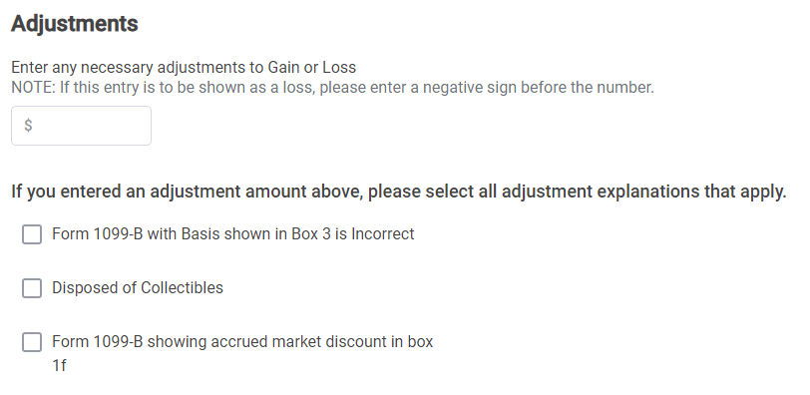
SCHEDULE D
For some reason they decided to remove the letter code for adjustments.

Slide 99
CDCC
There is a new flow for Child & Dependent Care Credit.
You no longer have to enter the amount paid to the daycare and the amount per child, but only the amount per child.
In addition, you will now get a series of pages with questions on the CDCC after inputting the provider and qualifying person information although I understand these will be collapsed to a single page.

Slide 100
CDCC

Slide 101
EDUCATION
The inputs for Education Credits have also changed significantly.
It is largely the same questions and inputs as before, just broken up into lots more pages requiring lots more clicks.
The most significant substantive change is the inputs for what used to be a single number – the Qualified Educational Expenses (“QEE”).

Slide 102
EDUCATION
So now we have up to 3 numbers to enter rather than one. And using “Grants” as the terminology rather than “Scholarships and Grants” is a mystery.

Slide 103
EDUCATION
What do we enter in these boxes? Note that these separate entries do not show up on the return, so it’s not important that we follow the TaxSlayer input choices so long as you get to the correct net result for the amount of QEE.
As an alternative to entering the three numbers, you can always just enter in the Tuition box the net QEE that qualifies for the AOC or LLC just like we used to do and leave the other two boxes blank.

Slide 104
EDUCATION
This box should be the amount shown in Box 1 of the Form 1098-T. In the alternative, you can just enter the amount of QEE that can be allocated to the AOC and skip the other two boxes.
This will be Box 5 of Form 1098-T UNLESS YOU OPTIMIZE which we will discuss next. If you optimize, the amount entered here will be the tax-free portion (if any) of the scholarship or, as I suggest, just ignore it if you are entering the net QEE in the Tuition Paid box.
This will be the total of all other QEE not shown in Box 1, such as books and supplies. BUT there’s a problem with this, as discussed below.
TaxSlayer will add the first and third boxes together and then subtract the amount shown in the second box to compute the net QEE available for the Education Credit. TaxSlayer does NOT optimize the credit.

Slide 105
EDUCATION
This is TaxSlayer’s new fancy looking final page where it will guide you in selecting the AOC or LLC. But there are several problems with these changes to the education credit inputs in TaxSlayer.

Slide 106
EDUCATION
First, QEE is different between the AOC and LLC. So, their third box entitled “Other Qualifying Expenses” may (and often would) require different inputs for the AOC and LLC.
Second, I have been unable to think of any situation where the LLC could ever be better than the AOC. You may choose not to claim the AOC when available because you don’t want to waste one of the four years, but it’s not because the LLC creates a bigger credit.

Slide 107
EDUCATION
I believe these inputs will lead preparers to think that they can let TaxSlayer figure out the better credit for you and all you have to do is enter the requested inputs.
YOU have to figure out whether the taxpayer qualifies for one or both credits. TaxSlayer isn’t asking all the questions you need to consider such as whether the taxpayer is in a degree program. If they qualify for both, you must choose, but remember the AOC is always better unless there is some other reason not to claim the AOC.
YOU have to figure out the QEE for the credit you are requesting.
DO NOT assume TaxSlayer is doing any of this for you.

Slide 108
EDUCATION
As you might have guessed by now, I am not a big fan.
This will lead to preparers inappropriately determining the LLC because they use the wrong definition of QEE.
In addition, it increases the chance for mistakes if you are optimizing the AOC since you must adjust the entries to get to the right answer.
Finally, it leads to complacency as it gives the impression TaxSlayer is figuring all of this out for you.

Slide 109
EDUCATION
My suggestion is to never rely on these inputs.
Go through the process of determining whether the taxpayer qualifies for one or both credits, choosing the credit to claim, and determining the amount of QEE for the credit you want to claim just like we used to do.
You can then just enter the appropriate QEE in the Tuition Paid box.
And if you are optimizing, as we will discuss next, don’t use the “Grants” input but follow the suggestions I provide in the next section.

Slide 110
EDUCATION CREDITS

Slide 111
FORM 1098-T
Form 1098-T – The starting point for addressing education credits
OOS
OOS

Slide 112
Determine if Student Qualifies for AOC or LLC
DO THE REST OF THE RETURN BEFORE STARTING ON EDUCATION
AOC
LLC
Determine QEE
Determine QEE
Is QEE minus Scholarship ≥$4,000?
Is QEE > Scholarship?
YES
NO
YES
NO
Enter $4,000 as QEE for AOC
Are all Scholarships Restricted?
Difference is QEE for LLC
Difference is Scholarship Income
YES
NO
Is QEE ≥ Scholarship?
Go to AOC Workbook
YES
NO
QEE minus Scholarship is QEE for AOC
Scholarship minus QEE is Scholarship Income

Slide 113
INITIAL STEP - AOC vs. LLC
The two education credits are the American Opportunity Credit (AOC) and the Lifetime Learning Credit (LLC).
The AOC is a credit of up to $2,500. For the first $2,000 of Qualified Educational Expenses (QEE), the tax credit is a dollar-for-dollar credit ($1 of QEE = $1 of tax credit). The next $2,000 of QEE is a 25% credit for an additional credit of up to $500 ($2,000 x 25%). 40% of the credit (maximum of $1,000) is generally refundable.
The LLC is a 20% credit on up to $10,000 of QEE, for a maximum, nonrefundable credit of $2,000.
Thus, the AOC is almost always the way to go if the student qualifies for both.

Slide 114
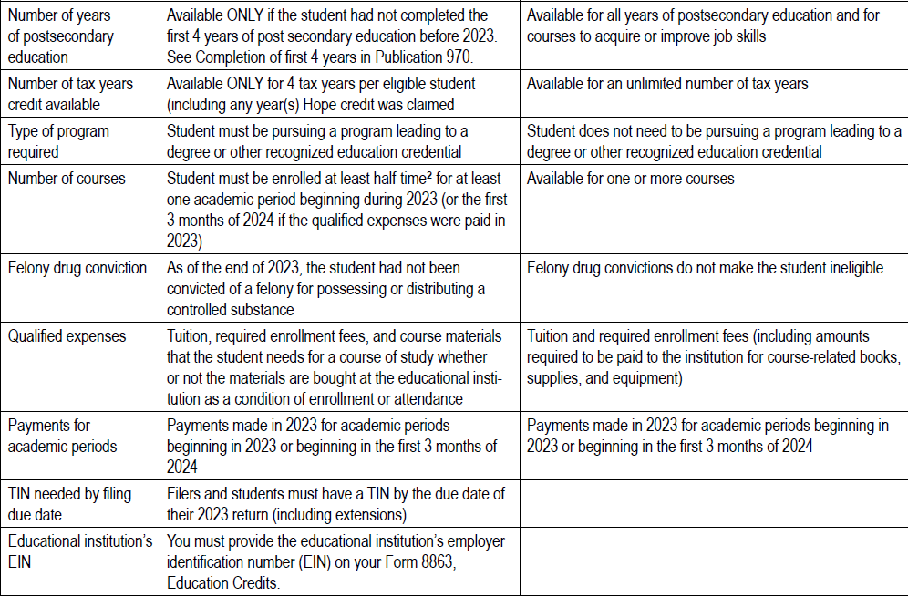
TaxSlayer won’t let you do the LLC without an EIN.

Slide 115
AOC vs. LLC
Remember that the AOC doesn’t generally apply to graduate school (although the fall semester in graduate school could get pulled in if the student graduated that year and did not have enough credits to graduate from undergraduate school as of the beginning of that year).
Also, due to the 4-years of AOC limitation, be careful not to use AOC when you shouldn’t. Don’t use it for college courses taken while the student is in high school as you would be wasting one of the 4 years (and, in fact, they don’t qualify for AOC if not in a degree program and not half time). Use the LLC instead in this situation. Also, if the student took the credit for the fall of his/her freshman year, they should pay the Spring semester Senior year before the end of December of their Senior year.

Slide 116
LLC STEP 1 - LLC QEE
QEE for purposes of the LLC are tuition, fees, and course materials required for a student to be enrolled at or attend an eligible educational institution but only if such course materials are required to be purchased from the educational institution.
QEE does NOT include charges and fees for room, board, meals, insurance, medical expenses (including student health fees), transportation, and similar personal, living, or family expenses. In addition, unlike the AOC, course materials that are not required to be purchased from the school do not qualify.

Slide 117
Determine if Student Qualifies for AOC or LLC
LLC
Determine QEE
Is QEE > Scholarship?
YES
NO
Difference is QEE for LLC
Difference is Scholarship Income

Slide 118
AOC STEP 1 - AOC QEE
QEE for purposes of the AOC are tuition, fees, and course materials required for a student to be enrolled at or attend an eligible educational institution without regard to where the course materials are purchased.
QEE does NOT include charges and fees for room, board, meals, insurance, medical expenses (including student health fees), transportation, and similar personal, living, or family expenses.
This is the same definition of QEE as applies in determining whether the student has scholarship income.

Slide 119
AOC QEE
The AOC QEE will almost always be the amount shown in Box 1 of the 1098-T plus the amount paid for books and other course materials.
We will be comparing this amount to the total scholarship amount shown in Box 5 of the 1098-T to determine whether there is QEE to generate an AOC and/or whether the student has scholarship income.
Reviewing the student’s Account Statement with the educational institution may help in the determination of QEE, as some schools seem to report amounts in Box 1 that do not reconcile with the account statement.

Slide 120
529 DISTRIBUTIONS
Section 529 plans, like the NC 529 Plan, are tax-advantaged plans that allow money to be invested for the educational expenses of a student without the current payment of tax on the earnings. When such amounts are distributed, they are tax-free so long as spent on QEE.
Distributions from a section 529 plan are reported on Form 1099-Q.
529 Distributions are in scope for VITA only if the distribution is tax-free.

Slide 121
529 DISTRIBUTIONS
In a non-VITA context, it is almost always preferable to allocate QEE to generate the AOC rather than using it to cover 529 Distributions. However, we can’t make that choice.
So, we must first reduce the QEE by the amount of 529 Distributions, just like we do for Restricted Scholarships, as discussed below, before optimizing.
However, QEE for 529 Distributions is broader than QEE for the AOC.

Slide 122
529 DISTRIBUTIONS
529 QEE includes the cost of room and board (subject to limits) for a student who is enrolled at least half-time. See the Pub. 970 discussion of Qualified Tuition Programs for more information about 529 QEE.
You will want to first allocate the 529 Distribution against this “unique” QEE before allocating to QEE that qualifies for the AOC.

Slide 123
529 DISTRIBUTIONS
As an example, Student paid $5,000 for tuition and other AOC QEE and paid $4,000 for room and board expenses that qualify as QEE for 529 purposes. If the 529 distribution shown in Box 1 of the 1099-Q is $4,000 or less, we would allocate all of the room and board QEE against the 529 Distribution. Only if the Box 1 amount exceeded $4,000 would we have to reduce the QEE available for the AOC.

Slide 124
529 DISTRIBUTIONS
For the remainder of this discussion, QEE will be the amount of AOC QEE after reduction for any 529 Distributions. Again, hopefully any 529 Distributions can be covered by QEE that is unique to 529 Distributions and it will only be if the 529 Distribution is greater that we will have to reduce AOC QEE.
If you have a client where the student qualifies for the AOC and has significant 529 Distributions, you may want to consider sending them to a competent paid preparer.

Slide 125
Determine if Student Qualifies for AOC or LLC
AOC
Determine QEE
Is QEE minus Scholarship ≥$4,000?
YES
NO
Enter $4,000 as QEE for AOC
SHOULD WE OPTIMIZE?

Slide 126
AOC OPTIMIZATION
This is a great opportunity for proactively helping our clients.
Optimization adds scholarship income to the student’s tax return to allow the reallocation of QEE to the AOC. Optimization is designed to increase the AOC for the parents or student at either no tax cost to the student or at a cost that is less than the increased AOC benefit. This is especially wonderful when the student doesn’t have a filing requirement even after adding the additional scholarship income as you can generate AOC at no tax cost.
There are some limitations on optimization, including the impact of restricted scholarships and the Kiddie Tax, but the AOC Workbook deals with both of these issues. I will discuss what you need to know about these issues outside of the AOC Workbook.

Slide 127
WHAT CAN WE DO WITH QUALIFIED EDUCATIONAL EXPENSES?
OFFSET SCHOLARSHIP INCOME
OFFSET
529 PLAN DISTRIBUTIONS
USE AS QEE FOR AOC CREDIT
USE AS QEE FOR LLC CREDIT
OR

Slide 128
AOC OPTIMIZATION
If the taxpayer qualifies for the AOC and her QEE does not exceed her Scholarship Income by more than $4,000, we have to determine whether we can optimize.
The first step in this process (assuming no 529 Distributions) is to see if the taxpayer has Restricted Scholarships.

Slide 129
RESTRICTED SCHOLARSHIPS
A scholarship is restricted if, by its terms, the scholarship proceeds may only be used to cover tuition and other QEE items.
If, however, the scholarship can be used to cover non-QEE costs such as room and board or spending money, it is an unrestricted scholarship. This would include the major programs such as Pell Grants and UNC and NC-Need Based scholarships.
We are not allowed to optimize restricted scholarships, only unrestricted scholarships. Thus, we have to allocate QEE first against the amount of restricted scholarships and only if there is QEE left, can we look at optimizing the AOC.
If the student has both restricted and unrestricted scholarships, the AOC Workbook will take the restricted scholarships into account when it optimizes the credit.

Slide 130
Determine if Student Qualifies for AOC or LLC
AOC
Determine QEE
Is QEE minus Scholarship ≥$4,000?
YES
NO
Enter $4,000 as QEE for AOC
Are all Scholarships Restricted?
YES
NO
Is QEE ≥ Scholarship?
Go to AOC Workbook
YES
NO
QEE minus Scholarship is QEE for AOC
Scholarship minus QEE is Scholarship Income

Slide 131
AOC WORKBOOK
I have attempted to create a fairly simple (at least from the user’s perspective) tool that should work in the vast majority of cases where you are considering optimizing the AOC.
There is an explanation of the tool in a separate document that repeats the primary rules for each step of the process.
The tool itself is an Excel spreadsheet that you can download and use again and again. I have (hopefully) protected the spreadsheet so that the only things you can edit are the inputs required (the yellow boxes).
This tool can be placed on each of the computers you use and the users just need to remember to delete everything in the yellow boxes before beginning. This spreadsheet can be printed for Quality Review, and then added to the taxpayer’s documents.
We’ll do an example using the Workbook at the end of this section.

Slide 132
AOC WORKBOOK LIMITATIONS
The Workbook is designed to work in the vast majority of cases seen at VITA sites. However, it is not intended to work in certain cases which are too complex for a relatively simple spreadsheet and my small brain. Here are examples of situations where this Workbook may not provide the correct result and you would either need to use the Education Calculator at www.cotaxaide.org/tools or send the taxpayer to a paid preparer:
The taxpayer has more than one student with respect to which education credits are being claimed or other scholarship income is reported (in most cases, the Education Calculator can handle these, but it’s not easy).
The student’s return has certain complexities to it such as Social Security income, IRA deductions, other credits that are impacted by the student’s income, such as the Premium Tax Credit, or other unusual items impacted by the amount of the student’s income. It does account for the impact of optimizing on the EIC and CTC. The Education Calculator can correct for some of the other complexities that can arise, but not all. See the Instructions to the Education Calculator.
This Workbook only works for student returns where the AOC is nonrefundable if the student’s filing status is Single. If it is Head of Household or Qualifying Surviving Spouse, use the Education Calculator.
This Workbook does not factor in the Income Threshold limits on the AOC as this should be a rare event at a VITA site (and I don’t think the Education Calculator would work in these situations either). These limits are $160,000 for an MFJ return and $80,000 for all other filing statuses.
The Workbook does not account for the state tax impact. The state tax effects are not likely to materially change the optimal answer provided in the Workbook.

Slide 133
KIDDIE TAX
This will not be a comprehensive discussion of the Kiddie Tax. The reason understanding the Kiddie Tax is important is because it is out of scope for VITA. So, we need to avoid it to keep the student’s return in scope.
The Kiddie Tax taxes the unearned income of a child at the parent’s tax rate rather than the child’s tax rate if certain specific conditions are satisfied.
Impacts the return of the child, NOT the parent.
The big issue with the Kiddie Tax is scholarship income which is treated as unearned income for purposes of the Kiddie Tax even though it’s treated as earned income for most other purposes (such as filing requirement thresholds). This can significantly limit the ability to optimize the AOC in situations where the Kiddie Tax would apply.
Pub. 4012, p. H-5 has a great chart for determining whether the Kiddie Tax applies.

Slide 134
KIDDIE TAX
There are numerous ways to avoid the Kiddie Tax:
If the student is age 24 or older.
If the student is married and filing a joint return.
If the student has less than $2,500 in unearned income (including any scholarship income).
If the student does not have a filing requirement (generally, income less than $13,850).
If the student’s earned income (only from working) is more than half of his/her total support for the year.
With the filing threshold in 4 increasing so much the last few years, the chances are much greater that the student will fail 5 if they have income above the filing threshold in 4.

Slide 135
KIDDIE TAX
The AOC Workbook is designed to take all of these into account to avoid creating a Kiddie Tax issue for the student.
Watch out for situations where the scholarship exceeds the QEE by more than $2,500 because the return may be out of scope even without optimizing (if you put this situation in the Workbook it will tell you whether it is out of scope even if you’re unsure whether to optimize).

Slide 136
AOC REFUNDABILITY
If a student is claiming herself and she is under 24, she may not be entitled to the refundable portion of the AOC.
This largely overlaps with situations where the Kiddie Tax would apply.
This is another great reason to be careful about allowing a student to improperly claim herself and take the AOC.
The AOC Workbook is designed to take into account the limitations on refundability for students claiming themselves.
You must tell TaxSlayer that the taxpayer is not entitled to the refundable portion of the AOC.

Slide 137
EDUCATION CREDITS IN TAXSLAYER
As already discussed, TaxSlayer has changed the input for the amount of AOC QEE. Instead of entering a single number, there are now 3 boxes to complete.
When we are not optimizing, the entries are straightforward – put the amount shown in Box 1 of the 1098-T in the box entitled “Tuition”, put the amount shown in Box 5 in the box entitled “Grants”, and put the total of all AOC QEE other than the amount in Box 1 in the box entitled “Other Qualified Expenses”.

Slide 138
EDUCATION CREDITS IN TAXSLAYER
If instead we have optimized the AOC using the AOC Workbook, we must adjust the numbers entered to get the appropriate amount of AOC QEE on the return.
Remember, these inputs are solely to derive the AOC. The inputs for the amount of scholarship income are done elsewhere on the student’s return as discussed later.

Slide 139
EDUCATION CREDITS IN TAXSLAYER
When we optimize, we are reducing the amount of the scholarship that is tax-free in order to “free up” QEE to allocate against the AOC.
What we want to enter in TaxSlayer under “Grants”, if anything, is the tax-free amount of the scholarship after optimization.
The AOC Workbook will instruct you on the data to enter in TaxSlayer. It instructs you to put the entire AOC QEE after optimization in “Tuition Paid”. No TaxSlayer entries are required for “Grants” or “Other Qualifying Expenses” when you use the AOC Workbook.

Slide 140
AOC QEE - TAXSLAYER
The AOC goes on the return of the taxpayer “claiming” the student.
If someone other than the student claims the Child Tax Credit or Other Dependent Credit with respect to the student, that taxpayer will claim the AOC on their return.
If no one else claims the student, the AOC goes on the student’s return.
Be careful with allowing a student to claim the AOC as it is almost always better for the support provider to claim the credit so long as the support provider satisfies the tests to claim the CTC or ODC.

Slide 141
SCHOLARSHIP INCOME
SCHOLARSHIP INCOME IS ALWAYS THE INCOME OF THE STUDENT!
As you work through the flowchart and the AOC Workbook, there may be situations where the student has scholarship income, either because the scholarship amount exceeds the QEE or because we have optimized to add scholarship income to the student to increase the AOC.
Unless you have used the AOC Workbook, be sure to watch out for the Kiddie Tax if the student is under 24 and has a filing requirement. See Pub, 4012, pp. H-5.
In TaxSlayer – enter scholarship income in Income/Other Income/Other Compensation/Scholarships and Grants

Slide 142
EXAMPLE
Joe College is a full-time sophomore at UNC-Asheville majoring in Atmospheric Sciences. His parents provided more than half of his support and he lived with them when not at school. Joe worked part-time during the summer and earned $7,500, which was less than half of his support.
Joe has never been convicted of a felony and his parents have claimed the AOC on one prior return.
He spent $7,000 on room and board, $200 for a parking pass, and $550 on books and supplies that he purchased on the internet.
The scholarship was a Pell Grant.

Slide 143
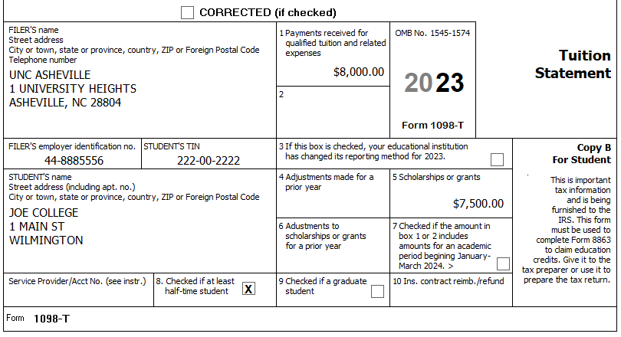
EXAMPLE
Joe received the following 1098-T from UNCA.
Use the flowchart to determine the tax consequences of the 1098-T.

Slide 144
Determine if Student Qualifies for AOC or LLC
AOC
LLC
Determine QEE
Determine QEE
Is QEE minus Scholarship ≥$4,000?
Is QEE > Scholarship?
YES
NO
YES
NO
Enter $4,000 as QEE for AOC
Are all Scholarships Restricted?
Difference is QEE for LLC
Difference is Scholarship Income
YES
NO
Is QEE ≥ Scholarship?
Go to AOC Workbook
YES
NO
QEE minus Scholarship is QEE for AOC
Scholarship minus QEE is Scholarship Income

Slide 145
AOC vs. LLC – Joe qualifies for the AOC as he is full-time, in a degree program, has only claimed the AOC one year, has not completed the first 4 years of post-secondary education, and has not been convicted of a drug felony.
QEE Calculation (no 529 Distributions to worry about)
1098-T, Box 1 $8,000
Books +550
Total $8,550
QEE = $8,550 and Scholarship = $7,500, so we must keep going down the flowchart since QEE doesn’t exceed the scholarship by at least $4,000.
Pell Grants are not restricted scholarships.
So, we need to go to the AOC Workbook.

Slide 146
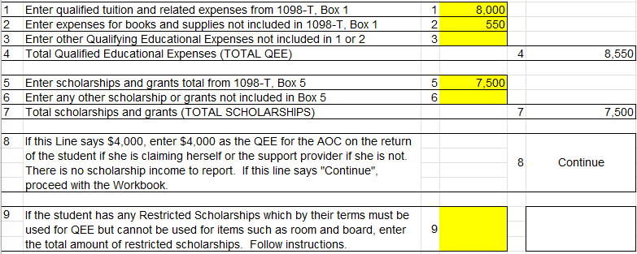

Slide 147
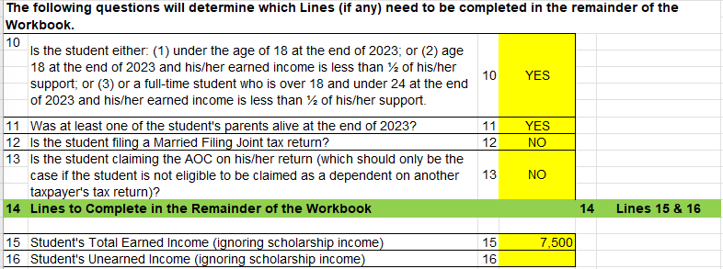

Slide 148
REMEMBER – When you use the AOC Workbook, you do NOT need to complete the “Grants” input or the “Other Qualifying Expenses” input, as the Workbook has already netted all the numbers out to the amount of QEE that qualifies for the AOC.

Slide 149
Assume the same facts except that Joe earned $11,000 in his summer job.
This shows how the Workbook avoids the Kiddie Tax by limiting his total income to $13,850 ($11,000 earned + $2,850 scholarship income).
What if his income was $12,000?
This shows how the Workbook avoids the Kiddie Tax by limiting his unearned income (including scholarship income) to $2,500.

Slide 150
EDUCATION CALCULATOR
If your situation is more complex than the AOC Workbook is designed to handle, there is another tool available at www.cotaxaide.org/tools - the Education Benefits Calculator.
This is a far more comprehensive tool than the Workbook, but that comes with complexity. Be sure to watch the video tour (top left of the first page of the calculator) before attempting to use it.

Slide 151
NC EXEMPTIONS FOR BAILEY AND UNIFORMED SERVICES RETIREMENT BENEFITS

Slide 152
BAILEY
NC may not tax certain retirement benefits received by retirees of the State of NC and its local governments or by retirees of the United States government, including military, if the retiree was vested in the plan as of August 12, 1989.
Arose out of a series of court cases involving federal retirees who were taxed on pension benefits when state retirees were exempt from state tax on their pensions. The U.S. Supreme Court found this unconstitutional.
In N.C., effective August 12, 1989, the law was changed so that all state and federal retirees were treated the same.

Slide 153
BAILEY
Issues to be addressed in determining whether retirement distributions are taxable by NC in light of Bailey:
Is the plan a “Qualifying Plan”?
Was the retiree vested as of August 12, 1989?
Are pre-retirement distributions or distributions to beneficiaries and former spouses covered by the exemption?
Are amounts rolled into a Bailey Qualifying Plan covered by the exemption?
Are amounts rolled out of a Bailey Qualifying Plan still eligible for the exemption?
How are amounts rolled from a Bailey Qualifying Plan to a Roth IRA treated for NC income tax purposes?

Slide 154
BAILEY – Qualifying Plans
Qualifying State and Local Plans
The list is extensive and can be found starting at page 44 of www.ncdor.gov/2022-personal-taxes-bulletin/open
The list includes the following State and Local plans:
NC Teachers’ and State Employees’ Retirement Plan (the “TSERS”)
NC Local Government Employees’ Retirement Plan
NC Supplemental Retirement Income Plan (the state’s 401(k) plan)
NC Deferred Compensation Plan (the state’s section 457 plan)
Optional Retirement Program (a plan for employees of the University of North Carolina system that they may elect to participate in rather than the TSERS)
And many more

Slide 155
BAILEY – Qualifying Plans
What State and Local plans are not included?
Plans of other states or of other local governments located outside of N.C.
Section 403(b) plans of the state or of a local government (these are tax-sheltered annuity plans that mostly cover teachers and exempt organization employees).
401(k) plans and 457 plans (a kind of nonqualified deferred compensation plan) other than the NC Supplemental Retirement Income Plan and the NC Deferred Compensation Plan.

Slide 156
BAILEY – Qualifying Plans
Qualifying Federal Plans
The list is extensive and can be found following the list of NC plans in the Personal Income Taxes Bulletin previously cited.
The list includes the following Federal plans:
Federal Civil Service Retirement System
Federal Employees’ Retirement System
Thrift Savings Plan
Military plans, such as the Military Retirement System
And many more

Slide 157
BAILEY – Vesting Test
In general, a retiree was vested in a Qualifying Plan if he/she had five or more years of creditable service as of August 12, 1989.
If a vested employee left the Qualifying Plan and then comes back after August 12, 1989, the entire benefit is treated as vested so long as the retiree did not withdraw his/her contributions to the Qualifying Plan before returning to covered employment.

Slide 158
BAILEY – Vesting Test
There are many exceptions to the 5-years of creditable service rule, which are plan specific. Here are a couple (there are more in the Directives cited later):
NC Supplemental Retirement Income Plan and Deferred Compensation Plan – The retiree is treated as being vested on August 12, 1989, if he/she contributed to the plan by August 12, 1989.
Federal Thrift Savings Plan – 3 pieces
Employee contributions – retiree made first employee contribution by August 12, 1989
Employer matching contribution – same as Employee contribution
Employer fixed percentage component – retiree had at least three years of service as of August 12, 1989
If you have this situation, see https://www.dor.state.nc.us/practitioner/individual/directives/pd-99-2.html
Good luck getting the detail you would need to do this correctly.

Slide 159
BAILEY – Qualifying Distributions
Retirement distributions to a retiree qualify.
The following distributions have also been found to qualify for the exclusion from a Qualifying Plan:
Distributions after terminating employment but prior to reaching retirement age;
Distributions to beneficiaries upon the death of the participant without regard to whether the participant had reached retirement age; and
Distribution paid to a former spouse under an equitable distribution order or a Qualified Domestic Relations Order.

Slide 160
BAILEY – Rollovers
Amounts rolled out of a Bailey Qualifying Plan retain their exempt status only if rolled into another Bailey Qualifying Plan.
Amounts rolled out of a Bailey Qualifying Plan do not retain their exempt status if rolled into any other kind of plan, including an IRA.
Amounts rolled into a Bailey Qualifying Plan qualify for the exemption, even if rolled from a nonqualifying plan!
Amounts rolled out of a Qualifying Plan and into a Roth IRA which are taxable for Federal purposes are exempt from tax when rolled over for NC income tax purposes.

Slide 161
BAILEY – More Information
The following provide more detail about the Bailey rules:
Directive PD-99-1 https://www.dor.state.nc.us/practitioner/individual/directives/pd-99-1.html
Directive PD-99-2 https://www.dor.state.nc.us/practitioner/individual/directives/pd-99-2.html
Directive PD-00-1 https://www.dor.state.nc.us/practitioner/individual/directives/pd-00-1.html
Directive PD-03-1 https://www.dor.state.nc.us/practitioner/individual/directives/PD-03-1.pdf
Directive PD-04-1 https://www.dor.state.nc.us/practitioner/individual/directives/PD-04-1.pdf
Directive PD-14-1 https://www.dor.state.nc.us/practitioner/individual/directives/pd-14-1.pdf

Slide 162
BAILEY
So how do you know if a distribution is covered by the Bailey exemption?
Ask lots of questions!
Look for “Vested as of August 12, 1989” on the Form 1099-R’s issued by the State. If a Form 1099-R is issued by the state, does not have this language, but the taxpayer insists they qualify, try to get them to call the State. We’ve found that when the language wasn’t there, they didn’t qualify (with one possible exception).
How do you reflect the Bailey exemption in TaxSlayer?
In the State section, go to Subtractions from Income and enter the amount that qualifies for the exemption in the box provided for Bailey exemptions (which should not exceed the taxable portion of the distribution on the Federal return).

Slide 163
UNIFORMED SERVICES RETIREMENT BENEFITS
Beginning in 2021, NC exempts from NC taxable income benefits paid by certain retirement plans to members of the military and their survivors.
This exemption was expanded in 2022 to include the commissioned corps of the National Oceanic and Atmospheric Administration (NOAA) or the U.S. Public Health Service (USPHS). I will refer to the military and commissioned corps of NOAA and USPHS as “Uniformed Services”.
To qualify the participant must have had at least 20 years of service in the Uniformed Services or have been medically retired.

Slide 164
UNIFORMED SERVICES
The payments covered are:
Normal retirement payments for service in the Uniformed Services where the service member served at least 20 years;
Disability Retirement payments to service members who were medically retired (this benefit is through the Department of Defense and not the VA – VA Benefits and certain DoD benefits are already nontaxable and thus a 1099-R would not be received for these); and
Benefits paid under the Survivor Benefit Plan attributable to service of a retired member of the Uniformed Services who served at least 20 years or was medically retired.

Slide 165
UNIFORMED SERVICES
These benefits generally will appear on a Form 1099-R issued by DFAS (Defense Finance Accounting Service).
If a taxpayer has a Form 1099-R from DFAS, you must ALWAYS ask the taxpayer how many years of service the service member had with the Uniformed Service prior to retirement, and if less than 20, you must ask whether the benefit is a Disability Retirement Benefit.

Slide 166
UNIFORMED SERVICES
Payments from the Thrift Savings Plan to qualifying Uniformed Services retirees also qualify for the exclusion.
The 1099-R’s for these benefits will be in the name of the Thrift Savings Plan and will not show they are for service in the Uniformed Services. Again, you must ask to determine if these are qualifying benefits.
If the taxpayer worked both as a qualifying member of the Uniformed Services and as a civilian Federal employee, only the Uniformed Services portion qualifies.

Slide 167
UNIFORMED SERVICES
What benefit payments are not covered?
Lump-sum severance paid to a service member who was medically retired does not qualify for the exclusion.
Payments to civilian employees of the Uniformed Services do not qualify for the exclusion.

Slide 168
UNIFORMED SERVICES
For a taxpayer who worked for the government as both a member of the Military and as a civilian employee of the Federal government, retirement pay received as a civilian employee does not qualify for the exclusion. If an employee with 20 years of service in the Military (or medically retired) does not waive his/her Military retirement pay but subsequently works as a civilian, the retirement payments for the Military service qualify, but the retirement payments for the civilian employment do not.

Slide 169
UNIFORMED SERVICES
Payments made from the retirement plan to an ex-spouse due to a divorce do not qualify even if payments to the service member would have qualified.
Any payments made to a survivor from any plan other than the Survivor Benefit Plan, including the Thrift Savings Plan, do NOT qualify even if the payments to the service member qualified. The Survivor Benefit Plan benefits are paid by DFAS.

Slide 170
UNIFORMED SERVICES
How do you reflect the Uniformed Services exemption in TaxSlayer?
In the State section, go to Subtractions from Income and enter the amount that qualifies for the exemption in the box provided for US Armed Forces exemptions (which should not exceed the taxable portion of the distribution on the Federal return).

Slide 171
RETIREMENT EXCLUSIONS
If a retirement payment qualifies for both the Uniformed Services Retirement Plan exclusion and the Bailey exclusion, NC has stated that it should be excluded as a Bailey exclusion.
Note that the Bailey exclusion is much broader than the Uniformed Services exclusion in many ways, including a broad range of covered plans, broad coverage of payments to survivors and ex-spouses, and the inclusion of certain rollovers.

Slide 172
MEDICAID EXPANSION
While this is not a tax issue, we have an opportunity to inform our client base of the new Medicaid expansion in NC.
Under the new rules that were effective Dec. 1, 2023, the income limits have been increased to 138% of the Federal Poverty Level.
More information and an online application are available at www.medicaid.ncdhhs.gov

Slide 173
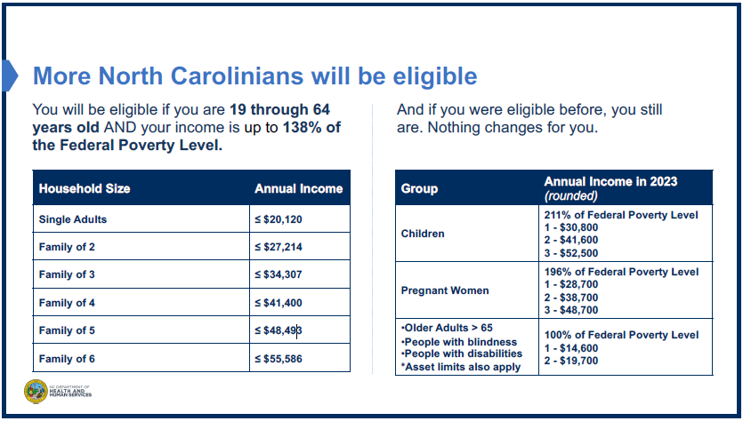

Slide 175
GIG ECONOMY WORKERS

Slide 176
GIG ECONOMY WORKERS
As we see more gig economy workers with the proliferation of Uber, DoorDash, and sellers on sites like eBay, we need to be ready to address the tax issues raised by these workers.

Slide 177
SCOPE
Here are the primary scope issues with respect to gig economy workers:
Taxpayers with a Schedule C who are entitled to the adjustment to income for Self-Employed Health Insurance (SEHI) and are also eligible for the Premium Tax Credit (PTC) from Marketplace insurance are out of scope. This is because of the interaction of the adjustment for Self-Employed Health Insurance and the PTC. It takes 17 pages in Pub. 974 to explain how to handle this situation.

Slide 178
SCOPE
If the taxpayer is not entitled to one of these two benefits, the return in my view is still in scope. Examples would include:
A taxpayer who is not entitled to the SEHI deduction because of eligibility for employer health insurance.
A taxpayer who itemizes and uses the premiums as medical expenses on Schedule A.
A taxpayer with no net profit on Schedule C.

Slide 179
SCOPE
Other examples would include:
The taxpayer is not entitled to the PTC because he/she was eligible for Minimum Essential Coverage provided by an employer.
The taxpayer’s income is below 100% of the Federal Poverty Line and does not satisfy one of the exceptions.
The taxpayer files MFS and does not qualify for one of the exceptions for domestic abuse or spousal abandonment.

Slide 180
SCOPE
I personally do not think you can “choose” not to take the SEHI deduction and keep the return in scope as not taking the deduction could have implications to the tax return and thus you have created an “inaccurate” return. For example, if you don’t take the SEHI adjustment and the taxpayer is entitled to the EIC, the change in AGI from not taking the SEHI adjustment could affect the EIC calculation. This result is less clear to me if the SEHI adjustment has no impact on the tax return.

Slide 181
SCOPE
Other scope issues
Schedule C with a loss. Big issue for drivers with lots of miles as the mileage deduction occasionally throws them into a loss.
Schedule C with expenses in excess of $35,000. May become a bigger issue with taxpayers in the business of buying and selling such as on eBay since the cost of the goods that are sold would be included in expenses.

Slide 182
SCOPE
TP wants to claim business use of a home.
The business has employees or contract workers other than the taxpayer.
Rental income activity, such as VRBO.
Hobby income or not-for-profit activity.
Depreciation expense.
NIL income.

Slide 183
SE INCOME & DEDUCTIONS
Three primary sources of income – Form 1099-NEC, Form 1099-K, and cash income. You could also see a 1099-MISC.
Deductions – The primary deductions we see are the fees paid to the affiliated service (should be reported along with the income received in a year-end report), any hardware/software purchased to perform the service (including cell phone cost), items for customers (such as water and air fresheners), and mileage.

Slide 184
SE DEDUCTIONS
You can’t deduct:
Out of scope deductions such as employe/ contractor costs, depreciation, and actual car expenses.
Items covered by the mileage allowance (such as gas, repairs, car washes, and auto insurance).
Personal expenses, like food or beverages for the taxpayer.

Slide 185
MILEAGE
What are “good” miles for purposes of the cents-per-mile deduction?
Miles with a customer or food in the car.
Miles from dropping off one customer/order to picking up the next (not usually reported by the company). Apps like Stride work great for this.
What are not good miles?
Trips to or from home (commuting)
Personal trips like going to get lunch

Slide 186
SEHI
There is an adjustment to income for Self-Employed Health Insurance for many of our clients completing a Schedule C. The insurance can cover the taxpayer, spouse, dependent, or a child under the age of 27 at the end of 2023.
While we normally enter this in the General Expenses portion of Schedule C inputs in TaxSlayer, it is an adjustment to income that has no effect on the Schedule C but instead appears on Form 1040, Schedule 1, Line 17.

Slide 187
SEHI REQUIREMENTS
You have to make a profit in your Schedule C business (and the deduction is limited to the profit made in the business).
You can’t take the deduction for any month you were eligible to participate in a subsidized health plan of an employer (including your spouse’s, dependent’s, or child’s employer) at any time during that month, even if you didn’t actually participate.

Slide 188
SEHI REQUIREMENTS
There is uncertainty about whether the insurance must be paid for by the self-employed person in the case of someone filing a Schedule C.
Medicare premiums of a spouse or dependent qualify even if the premiums are deducted from the spouse or dependent’s benefit.
It is less clear if premiums for other insurance paid by someone other than the self-employed person qualify. I have seen positions taken both ways. Best to make sure the self-employed person is paying the premiums other than for Medicare insurance.

Slide 189
SEHI REQUIREMENTS
Health insurance for this purpose can also include long-term care insurance, subject to limitation.
If a public safety officer takes advantage of the $3,000 exclusion for health insurance premiums paid when the taxpayer also receives a retirement distribution from a governmental retirement plan, only the amount paid above the exclusion amount is deductible for the SEHI.

Slide 190
SEHI REQUIREMENTS
Premiums used to generate the SEHI cannot also be deducted as medical expenses for purposes of itemized deductions. Not much of an issue these days. The way to do this in TaxSlayer for Medicare premiums is to not include the Medicare premiums paid when you enter the SSA-1099 information into TaxSlayer, as the entry of Medicare premiums on the SSA-1099 carries this amount automatically to Schedule A.
But if the taxpayer itemizes and chooses to use the health insurance premiums as medical expenses on Schedule A, the taxpayer cannot also use these premiums to generate the SEHI.

Slide 191
MISCELLANEOUS ISSUES

Slide 192
SCHEDULE D SCOPE
Capital gains and losses reported on Schedule D are subject to a long list of scope restrictions for VITA. See Pub. 4012, pp. vi and xxi for a complete list.
The most important scope item is that a capital gain or loss reported on Schedule D from the sale of any asset other than stock, mutual funds, or a personal residence is out of scope. Sales of bonds are in scope only if reported on a brokerage statement and with capital gain or loss only (Box 2 of the 1099-B can’t have the “Ordinary” box checked).
This will be a big issue with the expansion of Form 1099-K, but we’ll save that discussion for next year.

Slide 193
SCHEDULE D SCOPE
One thing to remember is that the scope limitations apply to sales reported on Schedule D (or Form 8949), but would not apply to a sale reported on Schedule C.
A complete explanation of the difference between reporting a sale on Schedule D vs. Schedule C is beyond our scope today. It generally comes down to frequency and profit motive.

Slide 194
SCHEDULE D SCOPE
Casual sales of property, such as selling a used car or furniture, should be reported on Schedule D.
If the taxpayer is in the business of selling goods on a regular basis, for example by selling goods on eBay, this would be reported on a Schedule C.
In between these two are “hobby” sales, where the taxpayer may or may not be frequently selling items, but lacks the “profit motive” necessary for it to be a business. These sales are reported as Other Income. For example, someone who has a hobby of painting and occasionally sells a painting would not use Schedule C to report the sale, but instead use Other Income. Hobby sales are out-of-scope for VITA.

Slide 195
SCHEDULE D SCOPE
Other significant scope issues for Schedule D include:
Cryptocurrency transactions. This is only for “taxable” transactions from crypto including sales of crypto or the receipt of crypto in exchange for goods or services. Buying crypto with “real” currency or just holding crypto assets does not make the return out of scope.
Reduced exclusions for the sale of a home.
Previously rented or depreciated property.

Slide 196
Filing Status Possibilities
Never Married
Single
Head of household
Married
Married, filing jointly
Married, filing separately
Head of household
Divorced
Single
Head of household
Legally Separated
Requires a court order. Voluntary separation does not qualify.
Single
Head of household
Widowed
Qualifying surviving spouse
Single
Head of household
MFJ/MFS
ONCE MARRIED YOU ARE MARRIED UNTIL ONE OF THE LAST 3 STATUSES APPLIES

Slide 197
Marital Status | Filing Status
Filing Status | Single | Qualifying Surv. Sp. | MFS | MFJ | HoH
Never Married | x |  |  |  | x
Divorced | x |  |  |  | x
Legally Separated | x |  |  |  | x
Filing status is SINGLE unless both of the following conditions are met:
Taxpayer paid more than half the costs of maintaining the home; and
A Qualifying Person lived in the taxpayer’s home for more than half the year.
A Qualifying Person includes any person who qualifies as a Dependent of the taxpayer other than an unrelated person
If a parent is the Qualifying Person, they do not need to live with the taxpayer if the taxpayer pays more than half the costs of maintaining the parent’s home
If both conditions are met the most beneficial filing status is HEAD OF HOUSEHOLD.
Notes:
If a divorce or legal separation occurs during the year, the taxpayer is treated as unmarried for the year.

Slide 198
Marital Status | Filing Status
Filing Status | Single | Qualifying Surv. Sp. | MFS | MFJ | HoH
Married |  |  | x | x | x
Most beneficial to file MFJ
Least beneficial to file MFS
Higher tax rates, lower standard deduction than MFJ
Do not qualify for education credits, Credit for the Elderly and Disabled, and usually the Premium Tax Credit
Limited ability to claim Earned Income Credit and the Child and Dependent Care Credit
If the taxpayer lived with his/her spouse at any time during the year, 85% of Social Security income is taxable
Possible to file HoH if all the following conditions are met
Taxpayer paid more than half the costs of maintaining the home and
A child, stepchild, or foster child of the taxpayer who qualifies as a Dependent (some exceptions) lived in the taxpayer’s home for more than half the year (note that a grandchild does not qualify) and
The taxpayer and spouse did not live together during the last 6 months of the year.
A Married TP cannot file as SINGLE

Slide 199
MFS COMMENTS
We generally should encourage taxpayers to file MFJ as it offers the most benefit. The cotaxaide tools include a great tool that you can use to determine the tax effects of filing MFJ vs. MFS.
If the taxpayer or spouse chooses to file an MFS return, here are a few things to remember
If one files MFS then the spouse must either file as MFS or, if he/she qualifies, as HoH.
Filing MFS with valid SS# for the spouse can be e-filed.
Filing MFS with no SS# for the spouse requires that a paper return be filed and you will enter a dummy SS# for the spouse (111-00-1111).
If the other spouse files MFS and itemizes, the taxpayer cannot take the standard deduction but must itemize.

Slide 200
Marital Status | Filing Status
Filing Status | Single | Qualifying Surv. Sp. | MFS | MFJ | HoH
Widowed | x | x | x | x | x
In the year of the spouse’s death, the taxpayer may still file an MFJ return so long as the taxpayer did not remarry before year-end. Can also file MFS for the year of death.
In subsequent years, the most beneficial to TP is to file as a QUALIFYING SURVIVING SPOUSE, however, 4 conditions must be met
Spouse died in 2021 or 2022 and
The taxpayer did not remarry by the end of 2023 and
The taxpayer paid more than half the costs of maintaining the home and
A child or stepchild (but not a foster child) of the taxpayer lived with the taxpayer all year (except for temporary absences) and is a Dependent of the taxpayer or would be except he/she earned more than $4,700 or because he/she filed a joint return
Note this is an “all year” requirement rather than ½ year requirement that is needed for HoH filing status. In addition, the only qualifying persons are children, so, for example, grandchildren would not qualify.
If they don’t meet all these conditions then just like Never Married, Divorced, or Separated, they will file either as SINGLE or HEAD OF HOUSEHOLD unless the taxpayer remarries.

Slide 201
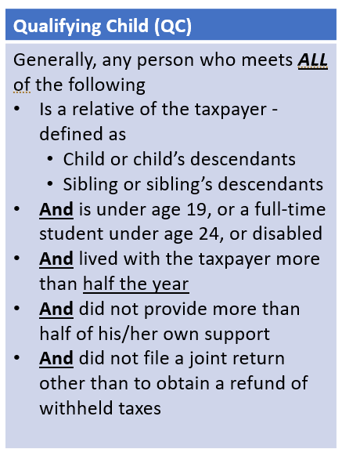
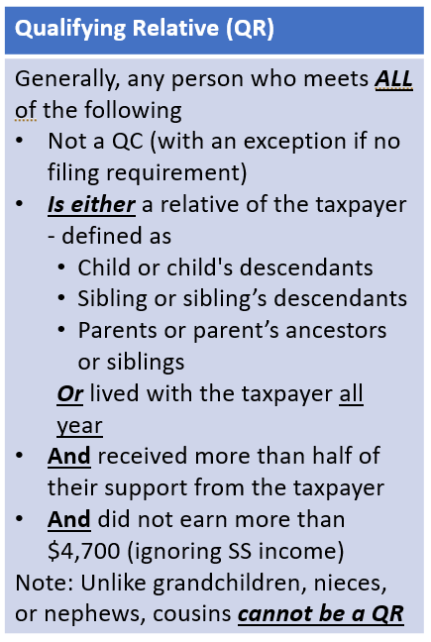
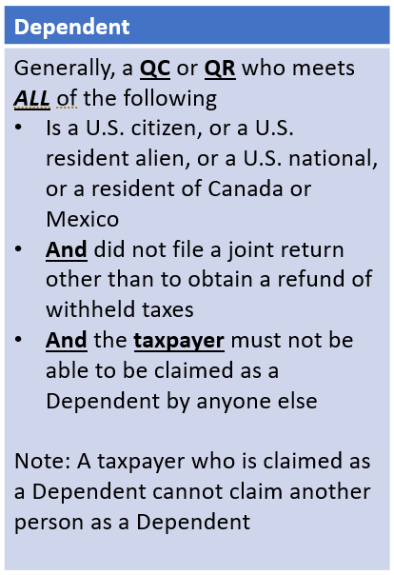
QUALIFYING PERSON DEFINITIONS

Slide 202
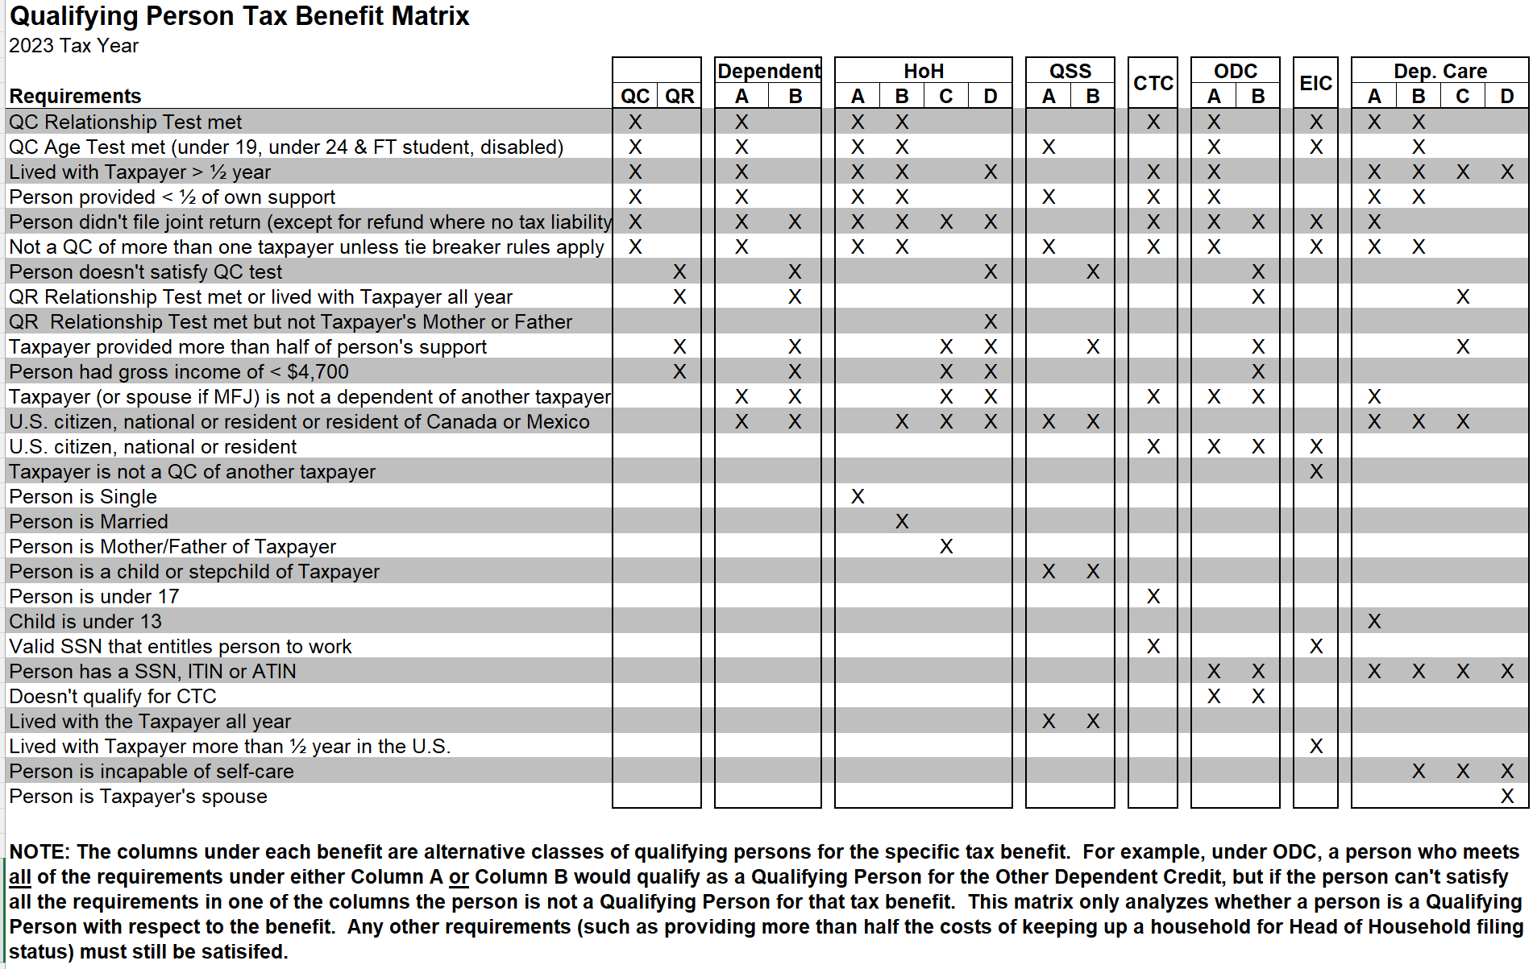

Slide 203
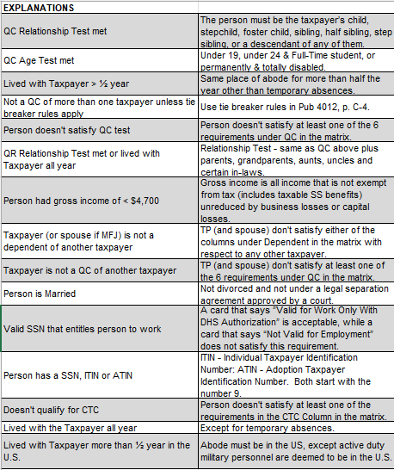

Slide 204
TAXPAYER ID NUMBER RULES
Tax Benefit | Taxpayer TIN Requirement | Qualifying Person TIN
EIC | Must have an SSN that is valid for employment (No ITIN) | Must have an SSN that is valid for employment (No ITIN or ATIN)*
CTC | Must have a valid TIN (Any SSN or ITIN) | Must have an SSN that is valid for employment (No ITIN or ATIN)
Other Dependent Credit | Must have a valid TIN (Any SSN or ITIN) | Must have a valid TIN (Any SSN, ITIN, or ATIN)
Child & Dependent Care Credit | Must have a valid TIN (Any SSN or ITIN) | Must have a valid TIN (Any SSN, ITIN, or ATIN)
*If Qualifying Person does not have a valid SSN, parent(s) can still claim EIC as if they had no qualifying persons so long as the taxpayer (both taxpayers on an MFJ return) has a valid SSN for employment.

Slide 205
All training materials are available on https://reinvestmentpartners.org/nctac-vita-partners-resources/page.html
A link to these materials, as well as an incredible number of other resources for NC VITA sites is available at https://taxvolunteers.com/vita
Bill Hawkins
hawkinsbill79@gmail.com

