Slide 1
NC VITA TRAINING
December 2024 Bill Hawkins

Slide 2
TODAY’S TOPICS
What’s New for 2024?
Form and Reporting Changes
Inflation Adjustments
NC Changes – Direct File
Disaster Declarations
TaxSlayer Changes
Rejects
Education
Miscellaneous Topics
Upcoming Tax Reform

Slide 3
RESOURCES
www.taxvolunteers.com/vita
All of my prior year training materials are available on https://reinvestmentpartners.org/nctac-vita-partners-resources/page.html
You can also reach this site through the taxvolunteers website by clicking on the “NC VITA Training Resources” tab near the top of the page.

Slide 4
WHAT’S NEW FOR 2024?

Slide 5
EXCEPTIONS TO 10% TAX
Two new exceptions to the 10% additional tax on early distributions from IRAs and 401(k) plans apply for distributions beginning in 2024:
  Emergency Personal Expense Distributions
  Domestic Abuse Victim Distributions
These distributions are still included in income but avoid the 10% additional tax.

Slide 6
EMERGENCY PERSONAL EXPENSE DISTRIBUTIONS
These are distributions “for purposes of meeting unforeseeable or immediate financial needs relating to necessary personal or family emergency expenses.”
Examples provided by IRS: medical care; imminent foreclosure or eviction from a primary residence; the need to pay for burial or funeral expenses; or auto repairs.

Slide 7
EPED - Limitations
Three Limitations
  Only one Emergency Personal Expense Distribution (EPED) per calendar year.
  Dollar Limitation – The maximum is limited to the lesser of:
    $1,000; or
    The total nonforfeitable accrued benefit in the plan over $1,000.
    For example, if an IRA has a balance of $1,500, the maximum EPED is $500.

Slide 8
EPED - Limitations
Three Limitations (cont.)
  Once an EPED is made, no more EPEDs may be made for the following 3 calendar years unless:
    The previous EPED is fully repaid; or
    The aggregate of the individual’s contributions to the plan after the prior EPED is at least equal to the amount of the prior EPED that has not been repaid.

Slide 9
DOMESTIC ABUSE VICTIM DISTRIBUTIONS
These are distributions to a “domestic abuse” victim if made during the one-year period beginning on any date on which the individual is a victim of domestic abuse by a spouse or domestic partner.

Slide 10
DOMESTIC ABUSE VICTIM DISTRIBUTIONS
“Domestic abuse” means physical, psychological, sexual, emotional, or economic abuse, including efforts to control, isolate, humiliate, or intimidate the victim, or to undermine the victim’s ability to reason independently, including by means of abuse of the victim’s child or another family member living in the household.

Slide 11
DAVD Limitations
The kinds of plans that may allow Domestic Abuse Victim Distributions (DAVDs) are more limited than for EPEDs, but still include IRAs and 401(k) plans.
The aggregate amount that an individual may treat as a DAVD cannot exceed the lesser of: (a) $10,000 (as indexed for inflation); or (b) 50% of the present value of the nonforfeitable accrued benefit in the plan. For example, if an IRA has a $5,000 account balance, the maximum DAVD is $2,500.

Slide 12
DAVD Limitations
There is no 3-year limitation as with EPEDs, only an aggregate limit of $10,000 (or 50% of the balance if lesser).
It is not clear whether repayments have any impact on the aggregate limit.

Slide 13
EPED/DAVD – General Rules
Plan administrators are permitted to rely on the taxpayer’s written certification that the distribution qualifies as an EPED or DAVD.
EPEDs and DAVDs may not be rolled over.

Slide 14
EPED/DAVD - Repayment
The taxpayer is generally permitted to repay the EPED/DAVD any time within the 3-year period beginning on the day after the distribution is received.
A repayment is treated as if the original amount received was rolled over to an eligible retirement plan within 60 days.

Slide 15
EPED/DAVD - Repayment
So, if a repayment means that the original distribution is treated as if it were rolled over, and thus not includible in income, how is the income included on the prior year’s return reduced?
  My best guess is the taxpayer will be required to file an amended return for the year of the distribution. My bet is we aren’t likely to see many repayments.

Slide 16
EPED/DAVD REPORTING
Hopefully, in most cases, an EPED or DAVD will be shown on a Form 1099-R with a Code 2 in Box 7 for participants under the age of 59½, meaning that the plan has agreed that an exception applies to prevent the 10% additional tax.
In this case, you merely enter the 1099-R information into TaxSlayer.

Slide 17
EPED/DAVD REPORTING
What if the 1099-R has a Code 1 in Box 7? We now have a longer list of exceptions that could apply to ask the taxpayer about. But there is a technical issue.
The issue is that the Notice released by the IRS has language that draws into question the ability of taxpayers to claim that a distribution is an EPED or a DAVD if not designated by the 1099-R.

Slide 18
EPED/DAVD REPORTING
The Notice states:
  Q. A-15: If an applicable eligible retirement plan does not permit emergency personal expense distributions, may an individual treat an otherwise permissible distribution as an emergency personal expense distribution? [Emphasis added.]

Slide 19
EPED/DAVD REPORTING
  A. A-15: If an applicable eligible retirement plan does not permit emergency personal expense distributions and an individual receives an otherwise permissible distribution that meets the requirements of an emergency personal expense distribution (as defined in Q&A A-1 of this notice), the individual may treat the distribution on the individual's federal income tax return as an emergency personal expense distribution to the extent the distribution meets the various limitations on an emergency personal expense distribution (see Q&As A-4 through A-6 of this notice).

Slide 20
EPED/DAVD REPORTING
This language appears to limit the ability of taxpayers to “self-claim” the EPED exception to those situations where the “plan does not permit emergency personal expense distributions”. Thus, if the plan permits EPEDs and the taxpayer didn’t request this treatment from the plan, there is some question as to whether the taxpayer can properly claim the EPED exception. There is identical language in the DAVD section.

Slide 21
EPED/DAVD REPORTING
Hopefully, the IRS will clarify this issue in Publication 590-B when it is released for 2024 tax returns. (Last year this publication was released March 12 so don’t hold your breath.)
Until then, I personally would claim the exception if it applies without regard to the issue, including on the Advanced Certification test.

Slide 22
EPED/DAVD REPORTING
Last time I checked, TaxSlayer had not yet added these exceptions to its software for 2024.

Slide 23
ENERGY CREDITS
Several things to discuss with this topic.
Scope- Remember that the only energy credits in scope for us are those reported in Part II of Form 5695. This means that credits for solar and geothermal reported in Part I of Form 5695 and EV credits are NOT in scope for VITA. In TaxSlayer, the section for Residential Clean Energy Credit is out of scope as these are the Part I credits.

Slide 24
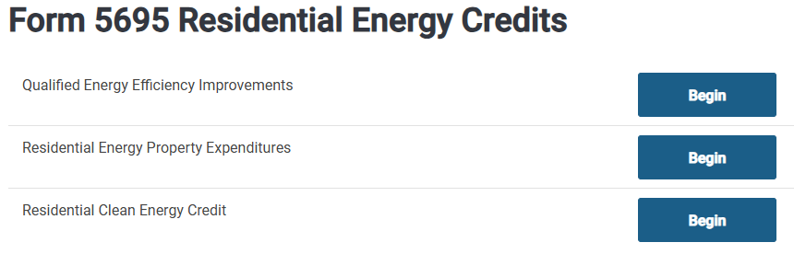
ENERGY CREDITS
In Scope – Windows, Doors, Insulation
In Scope – Heat Pumps, Water Heaters, Energy Audits, etc.
Out of Scope – Solar, Wind, and Geothermal

Slide 25
ENERGY CREDITS
New for 2024 – Home Energy Audits – In addition to the requirements that applied in 2023, three new requirements apply to the Audit for 2024:
  The inspection was conducted either by a Qualified Home Energy Auditor or under the supervision of a Qualified Home Energy Auditor.

Slide 26
ENERGY CREDITS
  The report must be written and signed by a Qualified Home Energy Auditor. It must include the Qualified Home Energy Auditor’s name and relevant EIN. There must be an attestation that the Qualified Home Energy Auditor is certified by a Qualified Certification Program and provide the name of such program.

Slide 27
ENERGY CREDITS
  The audit must be consistent with the most recent DOE-led and industry-validated Jobs Task Analysis.
  Basically, I think you need to see the Audit report and make sure it looks legitimate. I personally will not be too concerned about making sure that it satisfies all the requirements, particularly the third one above.

Slide 28
ENERGY CREDITS - Qualification
The biggest issue with Energy Credits last year was determining whether the improvement qualified for the credit.
The best source for this information is under the Tax Credit eligibility section of the Energy Star website (www.energystar.gov).
Manufacturers’ websites can also be helpful.

Slide 29
ENERGY CREDIT
The following is a summary of the qualifying requirements for the primary improvements that qualify for the credit:
Heat Pumps – Ducted must be Energy Star certified (for split systems which is the predominant type, this requires HSPF2 ≥7.8; SEER2 ≥15.2; and EER2 ≥11.7).

Slide 30
ENERGY CREDIT
Requirements:
Central AC – split system (the predominant type) must be Energy Star certified and have a SEER2 rating ≥16.
Gas Furnace – Energy Star certified with an AFUE rating of ≥97%.
Electric Water Heaters – Remember that the only electric water heater that qualifies is a heat pump water heater and it must be Energy Star certified.

Slide 31
ENERGY CREDIT
Requirements:
Gas Water Heaters – Must be Energy Star certified and meet the following additional requirements:
  For tank water heaters less than 55 gallons, have a UEF of ≥0.81.
  For tank water heaters ≥55 gallons, have a UEF of ≥0.86.
  For tankless, have a UEF of ≥0.95.

Slide 32
ENERGY CREDIT
Requirements:
Windows and Skylights – Must be Energy Star “Most Efficient”. The “Most Efficient” requirements for qualifying windows and skylights have tightened for 2024.
  For SC and all of NC other than the western mountain area, windows must have a U-Factor of ≤0.28 and an SHGC of ≤0.23.

Slide 33
ENERGY CREDIT
Requirements:
Windows and Skylights –
  For the mountains of NC, windows must have a U-Factor of ≤0.25 and an SHGC of ≤0.40.
  For skylights, they must have a U-Factor of ≤0.50 and an SHGC of ≤0.25.

Slide 34
ENERGY CREDIT
Requirements:
Exterior Doors – Depends on the amount of glass in the door:
  No glass, must have a U-Factor of ≤0.17.
  For less than or equal to half glass, must have a U-Factor of ≤0.23 and an SHGC of ≤0.23.

Slide 35
ENERGY CREDIT
Requirements:
Exterior Doors –
  If greater than half glass, for all except the NC mountains, must have a U-Factor of ≤0.28 and SHGC of ≤0.23.
  For the NC mountains, must have a U-Factor of ≤0.26 and an SHGC of ≤0.40.

Slide 36
ENERGY CREDITS - TaxSlayer
Qualified Energy Efficiency Improvements (windows, skylights, doors, and insulation) – In order for this credit to be claimed (and to avoid a reject), you must check the box for the 3 questions as shown below (and not the 4th) and enter an address:

Slide 37
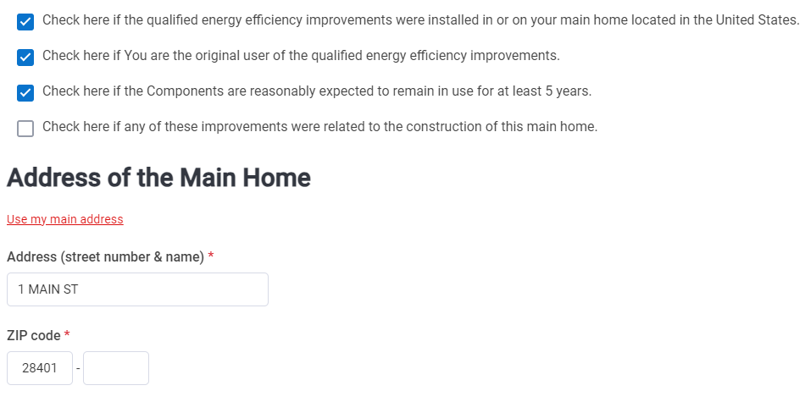
ENERGY CREDITS - TaxSlayer

Slide 38
ENERGY CREDITS - TaxSlayer
Residential Energy Property Expenditures (heat pumps, AC, furnaces, water heaters, electrical panels, etc.) – In order for this credit to be claimed (and to avoid a reject), you must answer the 2 questions as shown below and enter an address :

Slide 39

ENERGY CREDITS - TaxSlayer
You must click the “Add Address” box and enter an address. In addition, you must enter the cost of the qualifying expenditure in the appropriate box that appears.

Slide 40
ENERGY CREDIT
My hope is that sellers of these improvements will be more attuned to the energy credit requirements for 2024 and will provide documentation to support qualification for the credit.
Beginning in 2025 (unless delayed or repealed), we will no longer need to determine whether the improvement qualifies, as the taxpayer will be required to provide a code number from the seller/manufacturer that must be entered on the tax return to claim the credit. But, of course, that assumes that the taxpayer will come to the site with the appropriate information.

Slide 41
INHERITED IRAS
The IRS has issued new rules governing distributions for inherited IRAs for non-spouse beneficiaries.
The requirement to begin taking distributions under these rules has been delayed until 2025. No penalty will be imposed for not taking a distribution required under the new rules in 2020-2024.

Slide 42
INHERITED IRAS
The penalty under the new law is generally 25%, although there is a mechanism to reduce the penalty to 10%.
Generally, under the new rules, if the deceased owner had started receiving Required Minimum Distributions, the beneficiary must receive annual payments with everything distributed by the end of the 10th year after death.

Slide 43
INHERITED IRAS
If the deceased owner was not required to have started receiving Required Minimum Distributions prior to death, the beneficiary is required to distribute the entire account by the end of the 10th year after death but can choose to take the funds out any way the beneficiary chooses.

Slide 44
INHERITED IRAS
These rules are very complex, so be sure to have your clients speak with the IRA administrator about the amount and timing of any required distribution.

Slide 45
FORM AND REPORTING CHANGES

Slide 46
NEW INTAKE SHEET
The IRS has substantially revised the Intake Sheet. It has now grown to SIX pages in length.
There are new areas that must be completed by preparers.

Slide 47
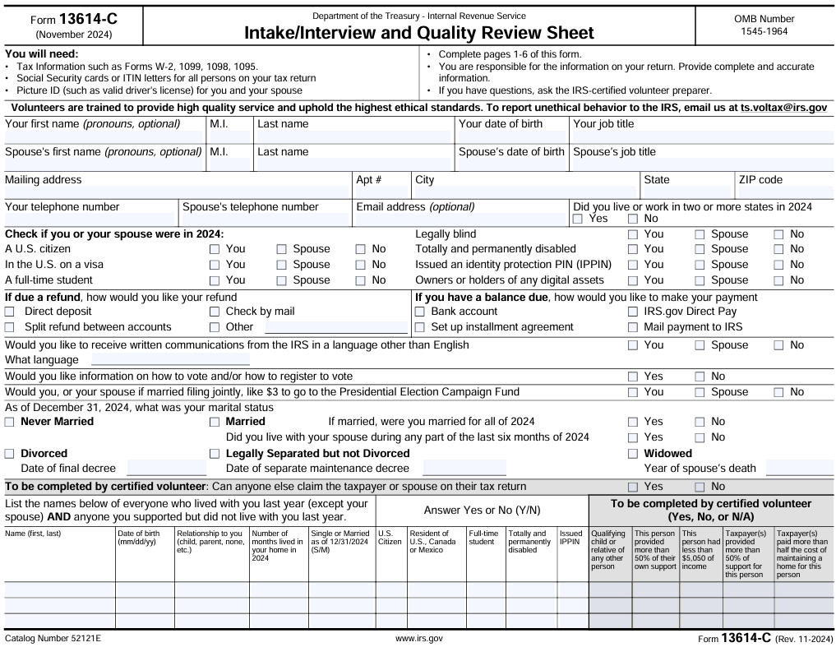

Slide 48
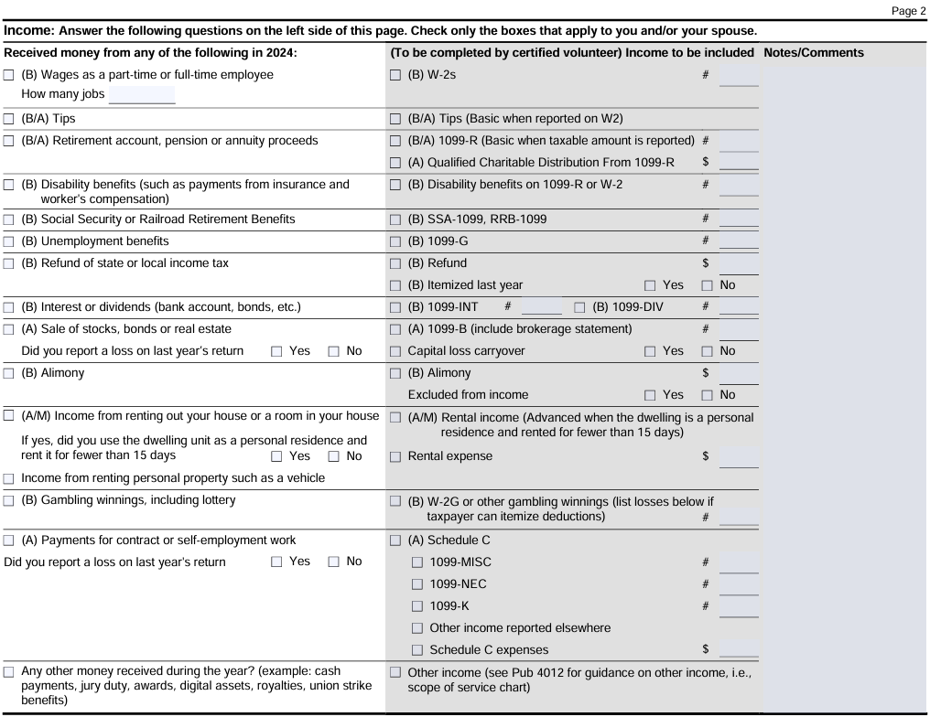
SCOPE?
SCOPE?
SCOPE?

Slide 49
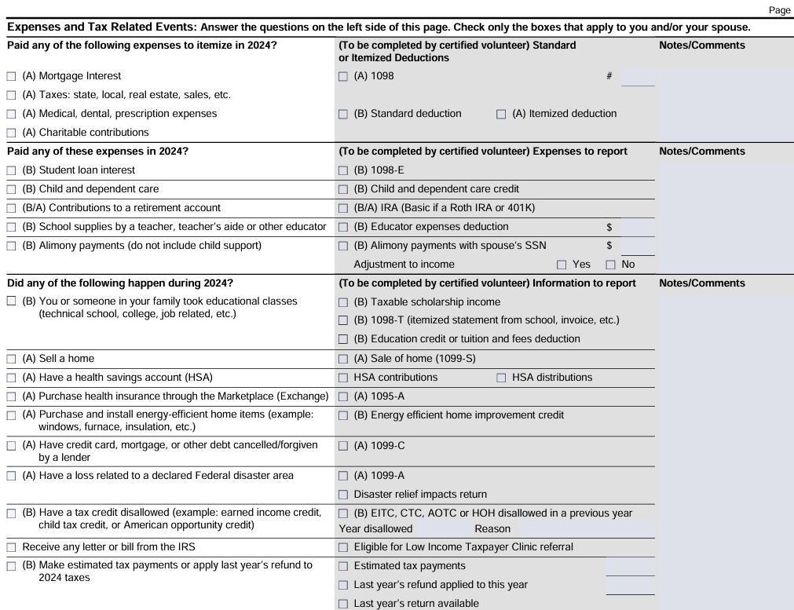
SCOPE?
SCOPE?

Slide 50
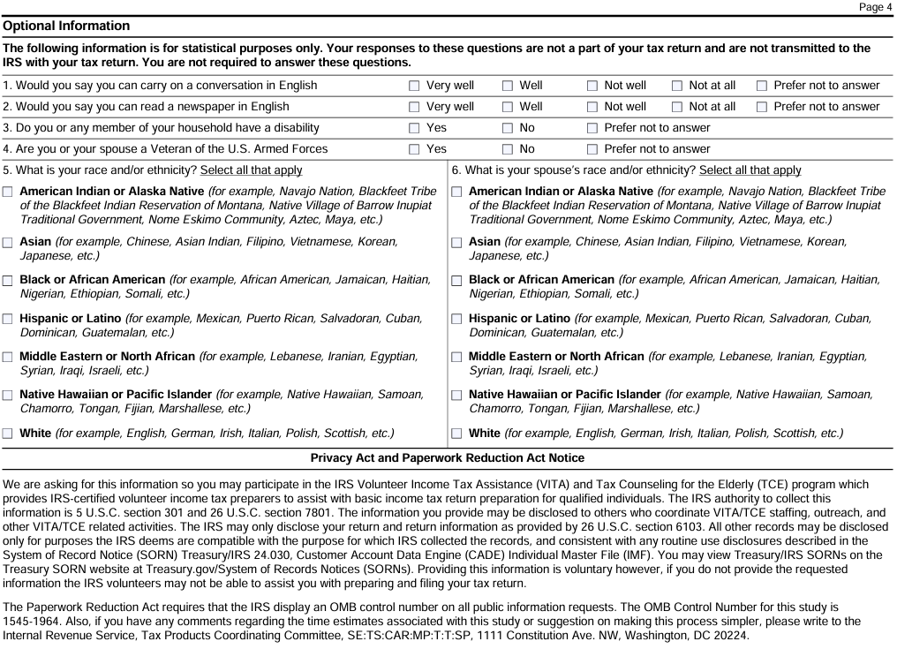
THIS PAGE CAN BE LEFT BLANK.

Slide 51


Slide 52
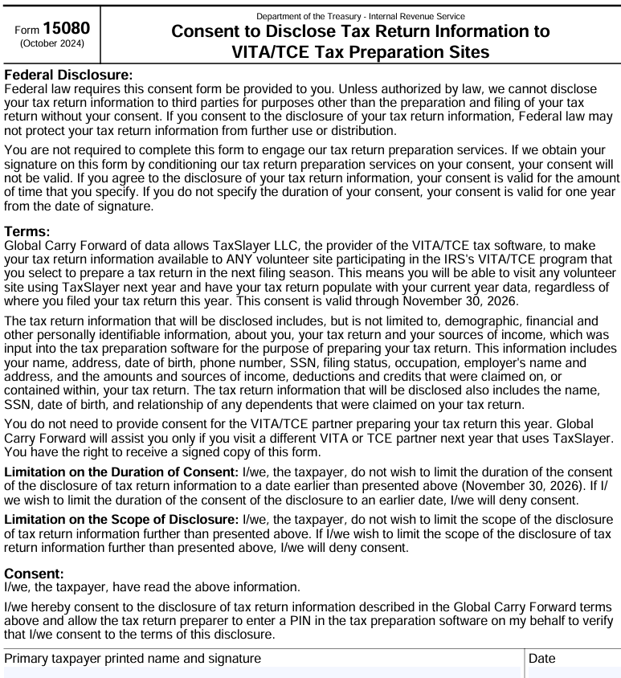

Slide 53
INTAKE SHEET
Pub. 5140 provides the various site requirements that must be met by VITA sites. With respect to the new Intake Sheet, the new version of this publication provides:
  “An interview with the taxpayer using Form 13614-C that includes reviewing entries on Form 13614-C with the taxpayer, ensuring unmarked questions are discussed and marked “No”, “N/A”, have a check mark or other comments if they do not apply.”

Slide 54
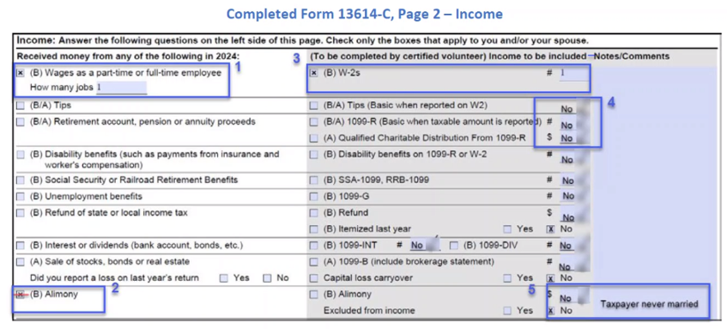

Slide 55
LINK & LEARN
New vendor for 2024 - the website has changed to www.linklearncertification.com.
There is no longer a list of your answers so you have to go back through the questions to be sure you entered everything correctly.
If you miss a question, go to the Review button and it will take you through all the questions and show you the ones you got right and wrong and the correct answers for the ones you got wrong.
Be sure to look at Volunteer Tax Alert 2025-1 before taking the test to address errors in the test book.

Slide 56
FORM 1099-K
This form is used to report payments received by taxpayers from third party settlement organizations including payment apps, credit card processors, and online marketplaces.
The form will be used to report payments to the taxpayer from gig economy companies such as Uber and DoorDash, marketplaces such as Amazon and eBay, and other companies that facilitate cash transfers such as PayPal and Venmo.
We have seen this form most frequently in the past from gig economy companies such as Uber where they are reporting credit card charges received on behalf of their drivers.

Slide 57
FORM 1099-K
Prior to 2022, a Form 1099-K was issued only if the taxpayer received payments totaling at least $20,000 and had at least 200 transactions.
For 2022, Congress reduced that limit to $600 with no minimum number of transactions. However, the IRS delayed implementation of these new reporting requirements until the 2024 tax year.

Slide 58
FORM 1099-K
For 2024, the dollar limit will fall from $20,000 to $5,000 with no transaction limit.
On November 26, 2024, the IRS announced a further transition period for 2025 for 1099-K reporting. For 2025, the dollar limit will fall from $5,000 to $2,500 with no transaction limit.
For 2026, the $600 limit will apply with no transaction threshold, assuming there are no further delays or changes to the law.

Slide 59
FORM 1099-K
Not reporting a Form 1099-K is NOT an option. Either the taxpayer should get the form rescinded by the issuer or you should report the amount on the tax return.
The following discusses how to report income shown on a Form 1099-K.

Slide 60
FORM 1099-K
Situations where a 1099-K should be issued:
  You received any payments with payment cards, including credit cards, debit cards, and gift cards.
  You received payments over $600 ($5,000 for 2024 and $2,500 for 2025) with a Payment App or Online Marketplace. This would include payment for a personal item you sold, services you provide, or property you rent through payment apps or online marketplaces, including auction sites, car sharing or ride-hailing, ticket exchange, and crowdfunding platforms.

Slide 61
FORM 1099-K
Situations where a 1099-K should not be issued:
  You should not receive a 1099-K for any gifts or reimbursement of personal expenses from family or friends. The IRS advises taxpayers to notify the payment app that the transaction is non-business when possible to avoid the issuance of the 1099-K.

Slide 62
FORM 1099-K
Six possible scenarios to explore:
An incorrectly issued 1099-K.
A 1099-K issued for the sale of personal use property.
A 1099-K issued for the sale of business property.
A 1099-K issued for the sale of investment property.
A 1099-K issued for services.
A 1099-K issued for rent.

Slide 63
FORM 1099-K
If the Form 1099-K Was Received in Error
Contact the issuer immediately and try to get a corrected 1099-K showing no gross receipts.
If the taxpayer cannot get a corrected 1099-K, you must report the 1099-K on the taxpayer’s return.
Follow the rules below for reporting the transaction.

Slide 64
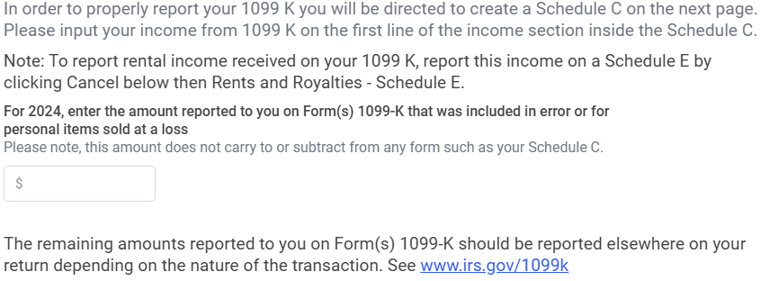
FORM 1099-K
Reporting an Incorrectly-Issued Form 1099-K
TaxSlayer has a new input page for Form 1099-K.
Services Income
Rental Income
Incorrect 1099-K or Loss on Personal Item Sale
Other
The only time you need to go to the 1099-K menu.

Slide 65
FORM 1099-K
Reporting an Incorrectly-Issued Form 1099-K
In the case of an incorrectly-issued 1099-K, hopefully you will be able to enter the amount shown in Box 1a of the 1099-K in the box provided by TaxSlayer (as shown above), and TaxSlayer should make the required entries required on Schedule 1 of Form 1040.
However, last time I checked, the software is not yet working to do anything with any amounts entered in the box.

Slide 66
FORM 1099-K
Reporting an Incorrectly-Issued Form 1099-K
If TaxSlayer is not working properly-
First, enter the amount reported on the 1099-K as “Other Income” and state “1099-K Received in Error”.
Second, under Deductions/ Adjustments to Income/Other Adjustments/Adjustments Not Listed Above enter the description “Erroneous 1099-K” and the same number as above. This will appear as a negative Other Income amount and will have the effect of reversing the income.

Slide 67
FORM 1099-K
Reporting the Sale of Personal Use Property
If the 1099-K was properly reported, the transaction must be reported on the tax return. There are separate rules for reporting the sales of personal items versus selling other goods, renting property, or providing services.
  A personal item is something the taxpayer owned for personal use such as a car, furniture, clothing, jewelry, etc. where the taxpayer did not purchase with the intent of selling it at a profit.
  How you report the sale depends upon whether it was a sale at a loss or a gain.

Slide 68
FORM 1099-K
Reporting Personal Item Sold at a Loss
  The loss is not deductible for tax purposes. Such losses do not normally need to be reported on a tax return except for a sale of personal use real estate where the taxpayer receives a Form 1099-S.
  However, Form 1099-K reporting will require losses on sales of personal use items to be reported on the return.

Slide 69
FORM 1099-K
Reporting Personal Item Sold at a Loss
The new box in TaxSlayer should be where such a loss would be reported. Just enter the amount shown in Box 1a of the 1099-K received for the sale of a personal item at a loss, and TaxSlayer should make the appropriate entries on Schedule 1.

Slide 70
FORM 1099-K
Reporting Personal Item Sold at a Loss if TaxSlayer is Not Functioning Correctly
The easiest way to report the loss is on Schedule 1. Two entries are required. First, enter the amount reported on the 1099-K as “Other Income” and state “Loss on Personal Item” (TaxSlayer is very limited in the characters allowed so this is about all that will fit). This number will appear on Schedule 1, Line 8z.

Slide 71
FORM 1099-K
Reporting Personal Item Sold at a Loss
Second, under Deductions/Adjustments to Income/Other Adjustments/ Adjustments Not Listed Above enter the description “Personal Item Loss” (the characters are even more restricted here) and the same number as above. This adjustment will appear on Schedule 1, Line 24z.

Slide 72
FORM 1099-K
Example – TP sells her car on Autotrader for $10,000. The sales price was less than what she paid for the car, so she has a loss.
In TaxSlayer go to Income/Other Income/Income Not Reported Elsewhere, Select Other income from the dropdown list, type in “Loss on Personal Item”, and enter 10000.
Go to Deductions/Adjustments to Income/Other Adjustments/Adjustments Not Listed Above enter the description “Personal Item Loss”, and enter 10000.

Slide 73
FORM 1099-K
Reporting Personal Item Sold at a Gain
  The gain is taxable income and must be reported on the tax return.
  The sale would be reported as a capital gain on Schedule D.
  However, there is a scope issue for VITA with such transactions. Capital gains transactions are only in scope if they are sales of stocks, bonds, mutual funds, or personal residences.

Slide 74
FORM 1099-K
Example – Taxpayer buys tickets to a Taylor Swift concert and resells one of the tickets he can’t use at a profit. If the Taxpayer is not in the business of buying and selling tickets, this would be reported on Schedule D which would make the return out of scope for VITA.

Slide 75
FORM 1099-K
Reporting Sales of Items other than Personal Items
This could include buying and selling items on a site such as eBay, selling tickets on Ticketmaster, StubHub, etc. where you bought the tickets intending to resell it at a profit, or selling items produced from a hobby.
If property is sold when the taxpayer is not engaged in the activity “for profit”, such as through a hobby, the transaction is Out of Scope for VITA.

Slide 76
FORM 1099-K
Hobby Income –
  “A hobby is any activity that a person pursues because they enjoy it and with no intention of making a profit. People operate a business with the intention of making a profit. Many people engage in hobby activities that turn into a source of income.”

Slide 77
FORM 1099-K
The IRS has a list of factors to consider in determining whether there is a profit motive:
The taxpayer carries out activity in a businesslike manner and maintains complete and accurate books and records.
The taxpayer puts time and effort into the activity to show they intend to make it profitable.
The taxpayer depends on income from the activity for their livelihood.
The taxpayer has personal motives for carrying out the activity such as general enjoyment or relaxation.
The taxpayer has enough income from other sources to fund the activity
Losses are due to circumstances beyond the taxpayer's control or are normal for the startup phase of their type of business.
There is a change to methods of operation to improve profitability.
Taxpayer and their advisor have the knowledge needed to carry out the activity as a successful business.
The taxpayer was successful in making a profit in similar activities in the past.
Activity makes a profit in some years and how much profit it makes.
The taxpayer can expect to make a future profit from the appreciation of the assets used in the activity.
IRS Tax Tip 2022-57

Slide 78
FORM 1099-K
Reporting a Sale of Goods Other than Personal Items
Sales of inventory or items held as stock in trade are business income reported on Schedule C rather than as a capital transaction reported on Schedule D.
So long as the total expenses, including the cost of the items sold, is less than $35,000, the return should be in scope. The cost of the items sold should be reported as “Supplies” under General Expenses.
Don’t forget that if the sale is reported as business income, the net income will be subject to Self-Employment Tax.

Slide 79
FORM 1099-K
Reporting a Sale of Goods Other than Personal Items
Sales of investment property not used in a trade or business are capital transactions reported on Schedule D.
Much like with hobby income, distinguishing between investment activities and business activities is not always simple.
Factors such as the frequency, extent, and regularity of the activity are indicators of an investment activity vs. a business activity.

Slide 80
FORM 1099-K
Reporting a Sale of Goods Other than Personal Items
Similar to the discussion under personal use item sales, there is a significant scope problem for sales of investment property that should be reported on Schedule D.
Schedule D is out of scope for sales of non-business assets other than stocks, bonds, mutual funds, or a personal residence. Thus, if a sale is from investment property that is not held as part of a business activity of the taxpayer, the return will be out of scope unless the sale is a sale of stocks, bonds, mutual funds, or a personal residence.

Slide 81
FORM 1099-K
Reporting Income from Services
The 1099-K reporting for service income will be reported the same as income we report for such activities as Uber drivers. The amount reported on the 1099-K is reported on the Schedule C in TaxSlayer as Gross receipts in the Income section just as we do for cash income not reported on a Form 1099-NEC.

Slide 82
FORM 1099-K
Reporting Income from Services – TaxSlayer Tip
TaxSlayer has a new 1099-K menu item as we discussed above. For service income that needs to be reported on Schedule C, do not enter anything on the 1099-K page of TaxSlayer as this is only for incorrectly reported income or gross receipts from the sale of a personal item at a loss.

Slide 83
FORM 1099-K
Reporting Income from Services – TaxSlayer Tip
Instead, if there is a Form 1099-NEC, start with it and once the Schedule C is created from the 1099-NEC, add the income reported in Box 1a of Form 1099-K plus any other cash income not reported on the 1099-NEC or 1099-K as Gross receipts in the Income section of the Schedule C.

Slide 84
FORM 1099-K
Reporting Income from Services – TaxSlayer Tip
If there is no 1099-NEC, go straight to the Schedule C income menu item in TaxSlayer. There you will enter as Gross receipts any income reported in Box 1a of a 1099-K plus any other cash income not shown on the 1099-K.

Slide 85
FORM 1099-K
Reporting Income from Rental Activities
These activities are out of scope for VITA other than the limited exception for the rental of personal residences by Military servicemembers (and then only if you have Military Certification).
Any such income would be reported on Schedule E.

Slide 86
MEDICAID WAIVER PAYMENTS
Form W-2 has a new code (II) for Box 12 for showing Medicaid Waiver Payments (MWP) that are exempt from tax. This should greatly simplify MWP reporting when the MWP is reported on a Form W-2.
Hopefully, TaxSlayer will treat this like Combat Pay for EIC and CTC purposes, but the Code has not been added yet.

Slide 87
FIRST-TIME HOMEBUYERS CREDIT
2024 is the last year for repayments of the First-Time Homebuyers Credit
HALLELUJAH!!

Slide 88
FORM CHANGES
New Form 1099-DA – Digital Asset Proceeds from Broker Transactions. This form will be used to report the sale of digital assets, such as cryptocurrency, where the digital asset was held in a brokerage account.
This form is OUT OF SCOPE for VITA. If you see a 1099-DA or a brokerage statement that includes a 1099-DA, the return is out of scope.

Slide 89
FORM CHANGES
Form 8888 – Allocation of Refund. This form has been revised to remove the ability to purchase U.S. Savings Bonds with a refund. Now this form will be used only for splitting a refund among various bank accounts or receiving a portion of a refund through direct deposit and another portion by check.

Slide 90
INFLATION ADJUSTMENTS

Slide 91
STANDARD DEDUCTION
MFJ/QSS – goes from $27,700 to $29,200.
Single/MFS – goes from $13,850 to $14,600.
Head of Household – goes from $20,800 to $21,900.
Aged/Blind Adjustment – increases $100 to $1,950 if unmarried and not a surviving spouse, and increases $50 to $1,550 for all others.

Slide 92
OTHER CHANGES
Child Tax Credit – Refundable limit increases from $1,600 to $1,700.
Gross income limit for Qualifying Relative test increases from $4,700 to $5,050.
EIC – Maximum credit increases from $7,430 with 3 or more kids to $7,830.
Annual Exclusion for Gifts – increases from $17,000 to $18,000.
Maximum IRA deduction increases by $500 to $7,000 ($8,000 if age 50 or older).

Slide 93
OTHER CHANGES
Business use of a car – increases to 67¢/mile, and medical and moving decrease to 21¢/mile. Charitable miles are unchanged at 14¢/mile.
HSA Contribution Limit – increases to $8,300 for family plans and $4,150 for self-only plans (increased by $1,000 if 55 or older).
Kiddie Tax Unearned Income Threshold – increases from $2,500 to $2,600.

Slide 94
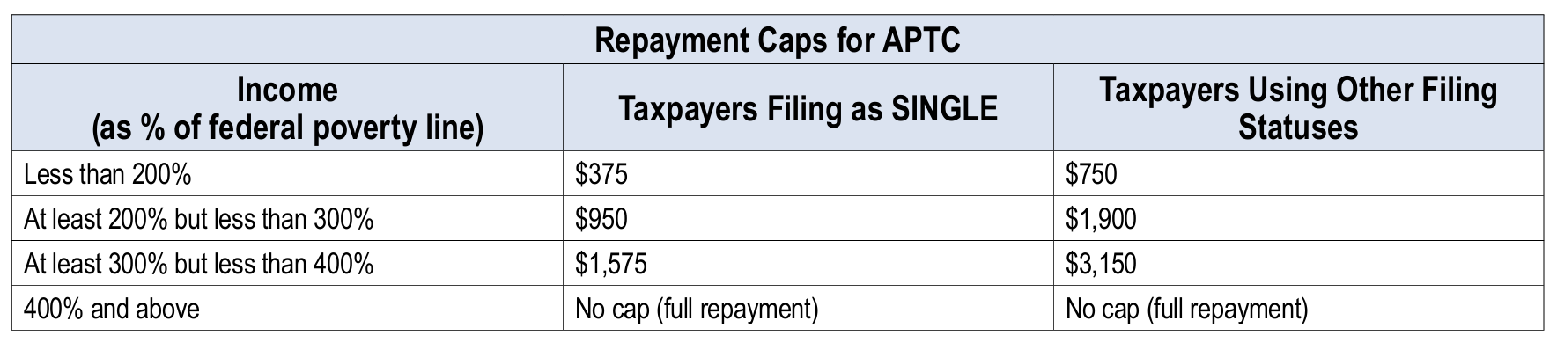
OTHER CHANGES
Repayment limits for the Premium Tax Credit

Slide 95
NC CHANGES

Slide 96
NC TAX RATE
The NC tax rate falls to 4.50% for 2024 and will fall to 4.25% for 2025.
After 2025, the rate will fall to at least 3.99% but could fall further if certain collection thresholds are met.

Slide 97
DIRECT FILE
For the 2024 tax year, NC will now participate in the IRS’s Direct File program.
Thus, a NC taxpayer who utilizes Direct File will now be able to complete the NC return as well.
The software will transfer the Federal information to another software program that will complete the NC return.

Slide 98
DIRECT FILE
Who can use Direct File?
  Types of income – W-2, 1099-INT, 1099-G unemployment compensation, SSA-1099 Social Security income, and new for 2024, 1099-R retirement income.
  Income not supported – everything else, including 1099-DIV and self-employment income.

Slide 99
DIRECT FILE
What credits can be claimed using Direct File?
  The credits covered by Direct File significantly expand for 2024 and will now include EITC, CTC, Other Dependent Credit, Child & Dependent Care Credit, Premium Tax Credit, Credit for the Elderly or Disabled, and the Retirement Savings Credit.
  Education credits are not included.

Slide 100
DIRECT FILE
What states are covered by Direct File?
  For the 2024 tax year, 24 states will be covered by Direct File, including NC (but not SC).
You must set up an account using ID.me to use Direct File. This is a major stumbling block for many of our clients.

Slide 101
DISASTER DECLARATIONS

Slide 102
IMPACT OF DISASTER DECLARATION
Following Hurricane Helene, President Biden declared all of NC and SC as Federal Disaster Areas. The IRS subsequently announced the impact of this declaration on certain Federal tax return payment and filing obligations.
This relief postpones various tax filing and payments that were scheduled to have occurred beginning on September 25, 2024, through May 1, 2025.

Slide 103
DISASTER DECLARATION
This impacts ALL taxpayers in NC and SC without regard to whether they were personally impacted by Hurricane Helene.
This has the effect of delaying certain tax filings and payments until May 1, 2025.

Slide 104
DISASTER DECLARATION
Among the tax filings delayed, the 2024 Federal tax return otherwise due on April 15 can now be filed by May 1, 2025, without penalty.
Among the tax payments impacted, any remaining tax due with the 2024 tax return will now be due May 1, 2025, rather than April 15.

Slide 105
DISASTER DECLARATION
In addition, the 2024 quarterly estimated tax payment due January 15, 2025, and the 2025 quarterly estimated tax payment due April 15, 2025, will now both be due May 1, 2025.
If a taxpayer’s address of record with the IRS is in NC or SC, the relief is supposed to be automatic. For new residents, relief can be obtained by calling 1-866-562-5227 or by calling the phone number provided on any tax notice proposing to apply a penalty in one of these situations.

Slide 106
DISASTER DECLARATION
NC has similarly acted to eliminate the imposition of penalties for filing 2024 NC tax returns until May 1, 2025.
In addition, no penalty will be assessed for the failure to pay any tax due with respect to the 2024 NC tax return if paid by May 1, 2025.
However, due to a quirk in NC law, interest will still be charged on any late payment of tax, including estimated tax, except as noted below.

Slide 107
DISASTER DECLARATION
The NC Legislature passed a disaster relief law following Helene that waives the accrual of interest on income tax payments due between September 25, 2024, and May 1, 2025, for certain counties.
This will include interest relief for the January and April estimated tax payments and the April 15 due date for 2024 taxes.

Slide 108
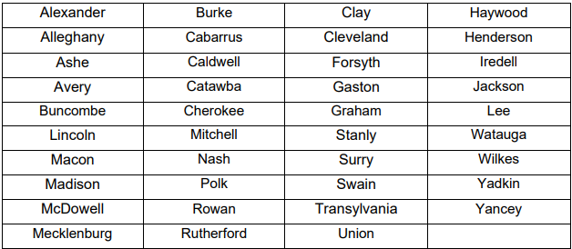
DISASTER DECLARATION
The interest relief applies to individuals resident in or located in the following NC counties:

Slide 109
DISASTER DECLARATION
SCDOR has issued similar relief for all residents of SC. All penalties and interest will be waived for these returns and payments.
2024 tax returns due April 15, 2025, will now be due May 1, 2025.
Quarterly estimated tax payments due January 15, 2025, or April 15, 2025, are now due May 1, 2025.
The balance due on 2024 returns due April 15, 2025, is extended to May 1, 2025.

Slide 110
CASUALTY LOSSES
Unfortunately, this is an issue that those of you in the western part of the state will face this year as we in the eastern part of the state did with Hurricane Florence in 2018.
Casualty losses are OUT OF SCOPE for VITA.
These rules are extremely complex.

Slide 111
CASUALTY LOSSES
Any casualty loss claimed on a tax return is computed only after reduction by any insurance proceeds received and any governmental or charitable assistance through FEMA or other agencies.
If there is a reasonable prospect of recovery for a reimbursement claim (such as through FEMA), the disaster with respect to that loss isn’t treated as occurring until the claim is resolved.

Slide 112
CASUALTY LOSSES
In the case of Federally-declared disasters such as Helene, the taxpayer has an option of claiming the casualty loss on an amended return for the year prior to the disaster year.
If the taxpayer either wants to claim the casualty loss in the prior year, has a claim pending at year end where there was a reasonable prospect of recovery, or does not have the information needed to claim the casualty loss on their originally-filed 2024 tax return, you may still be able to prepare their 2024 tax return not claiming the casualty loss. The loss would later be claimed on an amended return that would be out of scope.

Slide 113
CASUALTY LOSSES
Under the general rules, a casualty loss is first reduced by $100 and then by 10% of the taxpayer’s AGI.
Under these rules, a casualty loss is an itemized deduction so it would take a significant uncompensated loss to exceed the 10% of AGI threshold and the Standard Deduction amounts.

Slide 114
CASUALTY LOSSES
Last week, the Senate passed a bill to change these rules for all major disasters declared by the President since 2020 (“Qualified Disaster Losses”), which would include Hurricane Helene. The House previously passed the bill, and the President has probably signed by now.
Under these rules, a Qualified Disaster Loss is deductible to the extent the unreimbursed loss exceeds $500 and is deductible, like the standard deduction, without regard to whether the taxpayer can itemize.

Slide 115
CASUALTY LOSSES
A similar set of special rules applied for major disasters that occurred during 2020, so the new law extends this treatment for losses occurring during the years 2021 through 2024.
See Pub. 547 for a discussion of Qualified Disaster Losses. See also Form 4684 and its instructions for further guidance.

Slide 116
DISASTER ASSISTANCE
Payments to a taxpayer that qualify as a gift or as a “Qualified Disaster Relief Payment” are generally excludable from income.
Amounts received from individuals such as family or friends, or from a charitable organization are excludable as a gift so long as they are received from “detached and disinterested generosity.”

Slide 117
QUALIFIED DISASTER RELIEF
Qualified disaster relief payments include payments you receive (regardless of the source) for the following expenses.
Reasonable and necessary personal, family, living, or funeral expenses incurred as a result of a federally declared disaster.
Reasonable and necessary expenses incurred for the repair or rehabilitation of a personal residence due to a federally declared disaster. (A personal residence can be a rented residence or one you own.)
Reasonable and necessary expenses incurred for the repair or replacement of the contents of a personal residence due to a federally declared disaster.
Qualified disaster relief payments also include amounts paid to individuals affected by the disaster by a federal, state, or local government in connection with a federally declared disaster. These payments must be made from a governmental fund, be based on individual or family needs, and not be compensation for services. Payments to businesses generally don’t qualify.

Slide 118
IRS RESOURCES
The IRS has a number of resources to aid taxpayers located in disaster areas. Go to IRS.gov and enter “disaster” in the search bar at the upper right corner and then click on “Disaster Assistance and Emergency Relief for Individuals and Businesses” to get started.

Slide 119
TAXSLAYER CHANGES

Slide 120
TS ENHANCEMENTS
There are a number of very positive enhancements to TaxSlayer. These include the following:
  Federal Electronic Forms Report under Management Reports – allows you to see all of the Federal schedules and forms in every return and thus you can search for all the returns that include a specific form.

Slide 121
TS ENHANCEMENTS
  Capital Gains and Losses – they put back the adjustment code letters which had been removed last year (such as Code W for Wash Sales).
  Form 1095-A now includes column totals.
  TaxSlayer will now give you a warning if a change to the return affects a Direct Deposit amount previously entered.

Slide 122
TS ENHANCEMENTS
  In the Simplified Method Worksheet, TaxSlayer now computes the age(s) of the taxpayer (and spouse if it’s a joint and survivor annuity) as of the annuity starting date which was previously a great opportunity for mistakes. I would still recommend using the Bogart Pension Exclusion Calculator if the taxpayer retired on disability but otherwise the TaxSlayer worksheet should be acceptable.

Slide 123
TS ENHANCEMENTS
There are three enhancements to discuss in detail.
First, there is now an MFJ vs. MFS Comparison Tool. It’s located under Miscellaneous Forms in the Federal section.
  This will allow you to show taxpayers the difference between filing MFJ vs. MFS.

Slide 124
TS ENHANCEMENTS
  You must set up the return as an MFJ return in TaxSlayer. Once completed, you go to the Comparison Tool and it will show the difference between filing MFJ and MFS. You must be careful to properly designate which spouse earned each item of income for this to work properly.
  The program asks the question whether the spouses lived together at any time during the year, and if they did, taxes 85% of any Social Security.

Slide 125
TS ENHANCEMENTS
  If an MFS return is preferred, you would have to delete the spouse’s information, change the filing status (which deletes the state return), create a new state return for the taxpayer shown on the MFS return, and then create a new MFS return for the spouse.
  As an alternative, there is a Bogart calculator (www.cotaxaide.org/tools) that has an MFJ/MFS Comparison tool.

Slide 126
TS ENHANCEMENTS
Second, they have substantially improved the Prior Year Comparison Tool. You access this Tool on the Summary Print Page.
The enhancements include:
  Substantially more detail so many more line items are included to allow you to determine the significant areas of change.

Slide 127
TS ENHANCEMENTS
  The Tool can now look back to the two prior years rather than just one.
  You can now manually input prior year data that is not in TaxSlayer.
  You can print the Comparison using a Print button on the same page.

Slide 128
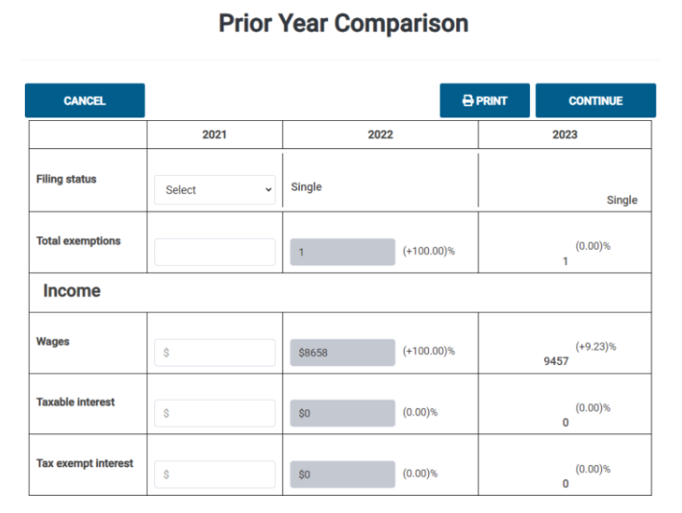

Slide 129
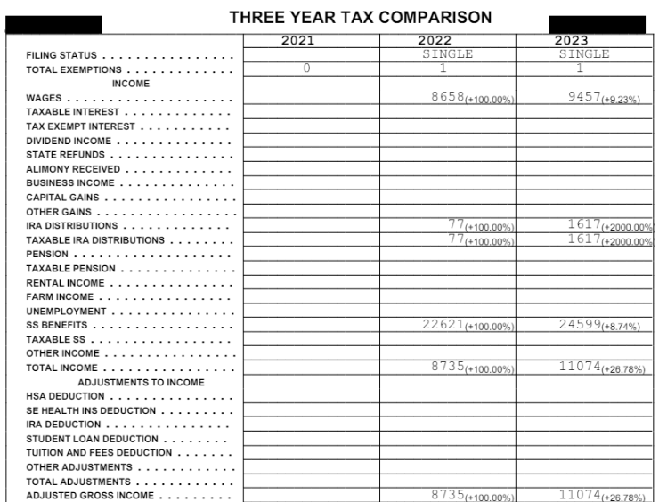

Slide 130
TS ENHANCEMENTS
Third, there is now a 1040 Estimated Payments Calculator located under Federal/Payments & Estimates/Vouchers for 202_ Estimated Tax Payments.
  If you want a 2025 estimate, it populates the 2024 data from the 2024 tax return and then allows you to enter any changes for 2025. You will have to estimate items such as tax credits.

Slide 131
TS ENHANCEMENTS
  It will then provide an estimate of the total tax due net of any estimated withholdings and credits, and then provides ¼ of that number for the quarterly estimated tax amount.
  Note that this is an estimate of the total Federal tax due which would typically be greater than the amount needed to avoid an Estimated Tax Penalty.

Slide 132
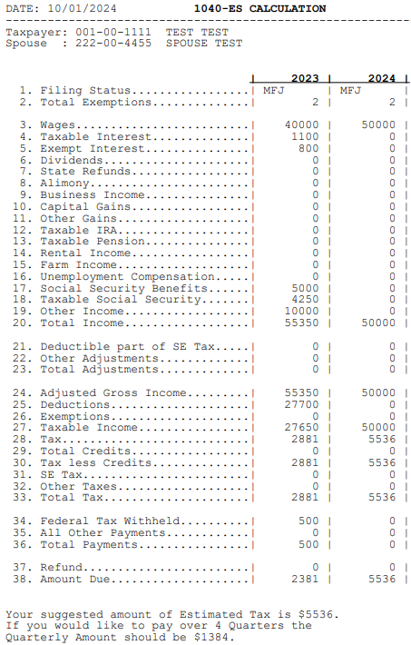

Slide 133
REJECTS

Slide 134
REJECTS
I am sure for most sites, your two most frequent rejects are for the following:
  ACA insurance with no Form 8962 included
  IP PIN

Slide 135
ACA REJECT
If anyone on the taxpayer’s return (taxpayer, spouse, or dependent claimed on the return) had ACA coverage for even one month during 2024, Form 8962 must be included in the return to reconcile any Premium Tax Credit.

Slide 136
ACA REJECT
Many taxpayers have no idea what ACA is and fail to answer the question on the Intake Sheet correctly.
Ways to help catch the presence of ACA
  Check the question on the Intake Sheet or see if they have a Form 1095-A.
  Ask how they obtained their insurance – Medicare, Medicaid, TriCare, employer (current or former for retirees), or on their own.

Slide 137
ACA REJECT
Ways to help catch the presence of ACA
  If there is employer insurance, you normally should expect to see Code DD in Box 12 of the W-2.
  If they acquired the insurance on their own, ACA is a likely option.
  If they acquired the insurance on their own, ask if they pay any monthly premiums. If not, it is almost certain to be ACA insurance.

Slide 138
ACA REJECT
Ways to help catch the presence of ACA
  Even if they pay some premium, if it is relatively inexpensive, that’s also a clue.
  Use a variety of terms when asking about ACA, including insurance obtained through the Marketplace or Obamacare.
  When asking about insurance sources, be sure to confirm whether it was the same all year.

Slide 139
ACA REJECT
Ways to help catch the presence of ACA
  Check the prior year return for ACA.
  Watch out for TaxSlayer warnings.
  If you suspect the taxpayer has ACA, have them call the Marketplace at 1-800-318-2596 to check.

Slide 140
ACA REJECT
If they had ACA, you must have Form 1095-A to complete the return.
How to obtain Form 1095-A:
  If they have an online account with the Marketplace, they can retrieve the 1095-A.
  If not, they can call 1-800-318-2596 to have one sent to them.

Slide 141
ACA REJECT
How to obtain Form 1095-A:
  If you and the taxpayer can call the Marketplace together, we have had great success with having the Marketplace representative read the appropriate numbers off the 1095-A to us once the taxpayer has authorized us to speak with the Marketplace. This really helps near the end of the season.

Slide 142
IDENTITY PIN
Another frequent cause of rejects is the failure to include an Identity Protection PIN (IP PIN) issued to the taxpayer or someone else on the return.
Ways to help catch the presence of an IP PIN
  Check the question on the Intake Sheet.

Slide 143
IDENTITY PIN
Ways to help catch the presence of an IP PIN
  Ask if anyone has ever tried to file a return using their SSN.
  Ask if they have ever received a letter from the IRS and, if yes, probe to see if it might be an IP PIN letter.
  Check the prior year return or TaxSlayer warnings.

Slide 144
IDENTITY PIN
An IP PIN is only good for the calendar year the PIN is issued and should be included on any return, including prior year returns, electronically filed during that calendar year.
If a taxpayer has an IP PIN one year, it is highly likely they will have one the next.

Slide 145
IDENTITY PIN
If the taxpayer moved during the year, it is likely they will not receive the letter showing the new IP PIN.
If there is an IP PIN, how can you retrieve it?
  If the taxpayer has an online IRS account, they can retrieve the PIN online.

Slide 146
IDENTITY PIN
If there is an IP PIN, how can you retrieve it?
  If the taxpayer does not have an online IRS account, have the taxpayer call 1-800-908-4490 to have a new letter issued. However, this takes time (supposedly mailed within 21 days) and won’t work towards the end of the season.

Slide 147
IDENTITY PIN
If you don’t have the IP PIN, your only choice is to paper file the Federal return. Note that you can still e-file the NC return using the state only feature in the e-file section of TaxSlayer.

Slide 148
NEW USE FOR IP PIN
The IRS announced a new program to assist with situations where a dependent has already been claimed on another return, another frequent cause of rejects.
This would include a situation where a dependent claims him/herself on a previously-filed return and the parents want to file claiming the child.

Slide 149
NEW USE FOR IP PIN
For the upcoming filing season, if the primary taxpayer on a tax return has an IP PIN and that IP PIN is entered on an e-filed return, the return will be accepted by the IRS even though a dependent listed on the return has already been claimed by another taxpayer.
This does not apply to tax years prior to 2024.

Slide 150
NEW USE FOR IP PIN
This allows the IRS to accept the return and begin the process of reconciling the dependent issue rather than waiting for a paper return to be filed and processed by the IRS.
While this doesn’t mean it will result in a refund right away, it should significantly speed up the resolution process meaning the affected taxpayer should be able to get a refund much faster than under the current system.

Slide 151
NEW USE FOR IP PIN
Of course, this only works if the primary taxpayer can get an IP PIN.
There are basically three ways to get an IP PIN:
  Create an online account with the IRS and then go to Profile to request an IP PIN (which is issued immediately). You can now choose to get a PIN for one year or for the current and all future years until cancelled.

Slide 152
NEW USE FOR IP PIN
  Make an appointment with an IRS office. Once your identity is confirmed, you are supposed to receive your IP PIN by mail within 3 weeks.
  File Form 15227 requesting an IP PIN. Once you get a call back to verify your identity, it is supposed to take 4 to 6 weeks to receive your IP PIN by mail.

Slide 153
NEW USE FOR IP PIN
While the online account is preferable, it requires the taxpayer to go through the ID.me process.
This is not a simple process.
Multiple forms of identity verification are required (including a government-issued photo ID), and proof of a current address is required. Taxpayers who have moved in the recent past may have trouble getting through the process.
Video calls or selfies are required as part of the process.

Slide 154
NEW USE FOR IP PIN
See the following site for more information about obtaining an IP PIN: https://www.irs.gov/identity-theft-fraud-scams/get-an-identity-protection-pin
For more information on establishing an online account - https://www.irs.gov/privacy-disclosure/how-to-register-for-irs-online-self-help-tools#:~:text=(updated%20Oct.%2031%2C%202023,a%20live%20ID.me%20agent

Slide 155
EDUCATION

Slide 156
EDUCATION
This topic was discussed in detail in last year’s training. I encourage you to go back and review those materials for more detail on scholarship income and education credits.
As this is always the most requested topic every year, I will focus on what you need to do as a preparer rather than all the rules around education discussed last year.

Slide 157
EDUCATION – POTENTIAL ERRORS
Education is one of the more challenging issues we face in properly preparing returns. Potential errors include:
Failure to optimize when it saves the taxpayers significant dollars.
Failure to include scholarship income on the student’s return if the student has a filing obligation.
Allowing a student to complete their return in isolation from the parents’ return.

Slide 158
EDUCATION – POTENTIAL ERRORS
Errors include:
Claiming AOC when the student either doesn’t qualify or when it doesn’t make sense, such as a high school student taking college courses.
Claiming AOC when the student is not at least half-time.
Putting scholarship income on the parents’ return when optimizing.

Slide 159
EDUCATION – POTENTIAL ERRORS
Errors include:
Optimizing restricted scholarships.
Creating Kiddie Tax issues for the student.
Including in qualified expenses for the LLC books that were not required to be purchased from the school.
Including expenses in QEE that don’t qualify such as parking fees or student activity fees that are not a requirement of enrollment.

Slide 160
EDUCATION – POTENTIAL ERRORS
Errors include:
Doing education credits before you have completed the rest of the return.
Putting in a note to the Quality Reviewer that you don’t know how to do the education credit so please fix.
BOTTOM LINE – WHEN IN DOUBT, GET HELP!

Slide 161
WHY THIS MATTERS
A simple example to show why we focus on education.
Beth is a full-time college student and has a Form 1098-T showing $4,000 in Box 1 for education expenses and $4,000 in Box 5 for scholarships.
If we take this at face, we would do nothing on Beth’s return or her parents’ return as the expenses and scholarships offset one another leaving no education credit for the parents and no scholarship income for the student.

Slide 162
WHY THIS MATTERS
But if we do the right thing, we will stop and analyze whether we could optimize the credit. Assuming we can optimize the AOC here, we would create $4,000 of scholarship income on Beth’s return, which wouldn’t even have to be reported if she has less than $9,850 of other income and thus would have no tax cost. And we would generate $4,000 of qualified expenses for the AOC on the parents’ return which would generate an AOC of as much as $2,500.

Slide 163
WHY THIS MATTERS
By taking the time to think through the education options, we have created a $2,500 tax benefit for the parents at typically no cost (or minimal cost) to the student versus no benefit if we don’t take the time to understand this issue.

Slide 164
IS THIS LEGAL?
Every year I get asked whether optimizing education credits by choosing to include scholarship income on a student’s tax return in order to generate an education credit is legitimate.
The answer is ABSOLUTELY YES!
The 4012 (p. J-11) and Pub. 970 (p. 16-17 & 27 & 28) both discuss the optimization opportunity.

Slide 165
IS THIS LEGAL?
Here is language from Pub. 970:
  Coordination with Pell grants and other scholarships. You may be able to increase your American opportunity credit when the student (you, your spouse, or your dependent) includes certain scholarships or fellowship grants in the student's gross income. Your credit may increase only if the amount of the student's qualified education expenses minus the total amount of scholarships and fellowship grants is less than $4,000. If this situation applies, consider including some or all of the scholarship or fellowship grant in the student's income in order to treat the included amount as paying nonqualified expenses instead of qualified education expenses. Nonqualified expenses are expenses such as room and board that aren't qualified education expenses such as tuition and related fees. (emphasis added)

Slide 166
EDUCATION
Whenever you see a Form 1098-T or the taxpayer answers YES to the question on page 3 of the Intake Sheet concerning someone in the family taking education classes, you MUST think about both scholarship income to the student and the ability to claim an education credit. Ignoring a 1098-T is not an option.

Slide 167
EDUCATION
Remember –
  Scholarship Income, if any, is ALWAYS the income of the student without regard to who claims any education credit.
  The education credit is claimed by the student if no one else is claiming the student and is otherwise claimed by the taxpayer claiming a Child Tax Credit or Other Dependent Credit for the student.

Slide 168
Determine if Student Qualifies for AOC or LLC
DO THE REST OF THE RETURN BEFORE STARTING ON EDUCATION
AOC
LLC
Determine QEE
Determine QEE
Is QEE minus Scholarship ≥$4,000?
Is QEE > Scholarship?
YES
NO
YES
NO
Enter $4,000 as QEE for AOC
Are all Scholarships Restricted?
Difference is QEE for LLC
Difference is Scholarship Income
YES
NO
Is QEE ≥ Scholarship?
Go to AOC Workbook
NOTE: If the amount of QEE for the LLC is significant and there are also significant scholarship amounts, consider trying to optimize using the Bogart Education Calculator.
YES
NO
QEE minus Scholarship is QEE for AOC
Scholarship minus QEE is Scholarship Income

Slide 169
TOOLS
AOC Workbook – available in Excel or Open Office versions on the training website. Works for most situations where the student qualifies for the AOC.
Bogart Education Calculator – www.cotaxaide.org/tools. Works for both the AOC and LLC.
Neither tool considers the impact of state taxes or the phaseout for higher income taxpayers.

Slide 170
MISCELLANEOUS TOPICS

Slide 171
SPORTS BETTING
Online sports gambling became legal in NC in 2024.
The amount of sports betting in NC exceeded $4.7 billion just from March through November!
Should we anticipate seeing a lot more W-2G’s this year???

Slide 172
SPORTS BETTING
Here is a summary of the W-2G filing thresholds for gambling activities:
  Won $1,200 (not reduced by the wager) or more playing bingo or slots.
  Netted $1,500 or more from keno.
  Exceeded $5,000 in winnings from a poker tournament.
  Obtained $600 or more in any other gambling endeavor, such as sports betting, and the payout was at least 300 times the amount you put on the line.

Slide 173
SPORTS BETTING
In addition, if the amount won from sports betting (minus the amount of the wager) exceeds $5,000, reporting is required, as well as Federal withholding at a 24% rate.
Note that if the winnings are transferred through a service like PayPal, they may also get a 1099-K.
So, it’s possible we will see an increase. Whether taxpayers willingly admit they have gambling income when they didn’t receive a W-2G is another matter.

Slide 174
SPORTS BETTING - LOSSES
Gambling losses are an itemized deduction that cannot exceed the amount of gambling winnings. If the taxpayer doesn’t itemize, there is NO tax benefit from gambling losses.
NC does not conform to the Federal rules on gambling losses and does not allow any deduction, even if the Federal return does. TaxSlayer automatically makes this adjustment to NC itemized deductions. There is talk that NC may change the rule to allow gambling losses.

Slide 175
QUALIFIED CHARITABLE DISTRIBUTIONS
I have been asked to try to explain QCDs in a simple way, as taxpayers, much like with the optimization of education credits, think it’s too good to believe or they just don’t understand it.
The concept behind QCDs is to give taxpayers the same tax benefit as they would receive if they were able to itemize and claim a charitable contribution.
Here is what Google Gemini says when I asked it to explain QCDs in simple language.

Slide 176
QUALIFIED CHARITABLE DISTRIBUTIONS
Think of a Qualified Charitable Distribution (QCD) as a tax-friendly way to donate from your retirement savings.
If you're 70½ or older and have an IRA, you usually have to take money out of it every year. This is called a Required Minimum Distribution (RMD). When you take this money out, you usually have to pay taxes on it.
A QCD is a special type of withdrawal where you donate a part of your RMD directly to a charity. Instead of paying taxes on that money, you can skip it. This can help you save money on taxes and support the causes you care about.
Here's a simple way to remember it:
  You must be 70½ or older.
  The money goes directly from your IRA to the charity.
  You can donate up to $105,000 per year.
  You don't have to pay taxes on the money you donate.
By using a QCD, you can help a charity and save money on taxes at the same time.

Slide 177
QUALIFIED CHARITABLE DISTRIBUTIONS
Here is an example to prove the point.
  Taxpayer normally gives $6,000 a year to charity and she has an RMD requirement to distribute $10,000 annually. Assuming the taxpayer is at a 20% combined Federal and state tax rate, she will pay $2,000 in tax on the $10,000 RMD. She would not receive any tax benefit from the charitable contribution if she doesn’t itemize.

Slide 178
QUALIFIED CHARITABLE DISTRIBUTIONS
  Instead, she directs the IRA administrator to send $6,000 from her IRA to the charity and receives the remaining $4,000 in RMD. She will pay tax of $800 on the RMD, creating a tax savings of $1,200 by using the QCD.

Slide 179
BAILEY & MILITARY EXEMPTIONS
I have been asked to talk about Bailey and the exemption for certain Military pensions in NC (once again).
I discussed this topic in detail in last year’s presentation which is available on the Reinvestment Partners website and taxvolunteers.com/vita website, so I’ll only provide a summary here.
See taxvolunteers.com/vita for a great checklist of these rules under the NC Resources tab.

Slide 180
BAILEY
NC does not tax certain Federal and NC state and locality retirement plan distributions.
Requirements-
  The participant was vested in the plan as of August 12, 1989. For most plans this means the participant had to have begun service prior to August 12, 1984. There are special vesting rules for contributory plans like the Thrift Savings Plan.

Slide 181
BAILEY
Requirements (cont.)-
  The plan must be a “Qualifying Plan” which are most Federal and NC employer-provided state retirement plans. These include the NC Teachers’ and State Employees’ Retirement Plan, the NC Local Government Employees’ Retirement Plan, the Federal Civil Service Retirement System, the Federal Employees’ Retirement System, the Thrift Savings Plans, and the Military Retirement System.

Slide 182
BAILEY
Requirements (cont.)-
  The distribution must be a “Qualifying Distribution”. These include retirement distributions, distributions after termination of employment, distributions to a beneficiary, and distributions to a former spouse under a court order.

Slide 183
MILITARY RETIREMENT
Since 2021, NC does not tax certain retirement benefits paid to retired members of the Military and their survivors.
Requirements –
  The participant must have had at least 20 years of service in the Uniformed Services or have been medically retired.

Slide 184
MILITARY RETIREMENT
  The distribution must be a normal retirement payment, a disability retirement payment, or a payment to a beneficiary under the Survivor Benefit Plan (if the participant had 20 years of service or was medically retired).
  Payments to survivors under plans other than the Survivor Benefit Plan, such as the Thrift Savings Plan, do not qualify.

Slide 185
MILITARY RETIREMENT
These payments will most often appear on a Form 1099-R issued by DFAS.
If you see a DFAS 1099-R, always ask about this exemption.
The exemption does not apply to civilian employees, only active-duty members of the Uniformed Services.

Slide 186
MILITARY RETIREMENT
My understanding is that SC is much simpler – all Military retirement pay is not taxed in SC starting in 2022.
This includes amounts paid to a surviving spouse.
But I am not an expert on SC taxation.

Slide 187
TAX REFORM

Slide 188
TAX REFORM
2025 is the last year for the bulk of the 2017 tax reform provisions. If Congress does not act, the law will revert in most cases back to where we were in 2017.

Slide 189
TAX REFORM
Here is a list of the major changes that would occur if Congress fails to act:
Increase in tax rates across all income groups
Substantial reduction in the standard deduction, which equates to substantially more taxpayers using itemized deductions
Reintroduction of personal exemptions
Significant reduction in Child Tax Credit to $1,000 per child

Slide 190
TAX REFORM
Here is a list of the major changes that would occur if Congress fails to act:
Eliminates the Other Dependent Credit
Eliminates the $10,000 cap on State and Local taxes for itemized deduction purposes
Reinstates miscellaneous itemized deductions
Eliminates the QBI deduction for Schedule Cs and certain dividends

Slide 191
PRESIDENT-ELECT TRUMP
President-Elect Trump suggested a number of tax reform ideas during his campaign which will be considered as part of tax reform.
He proposes permanently extending the various changes made to individual taxation as discussed above, including lower tax rates, higher standard deductions, higher child tax credit, etc.

Slide 192
PRESIDENT-ELECT TRUMP
The President has suggested that several income items be tax-exempt, including Social Security, tips, and overtime pay. In addition, he proposed to change the law so that US citizens living abroad would no longer be subject to US taxation.
Making tips and overtime nontaxable could lead to lower EIC payments for many lower-income taxpayers.
How these items will be treated for Social Security and Medicare taxes is unknown and could negatively impact future Social Security benefits if excluded.

Slide 193
PRESIDENT-ELECT TRUMP
He has also suggested that auto loan interest would qualify as an itemized deduction (which will have minimal impact for our client base) and that State and Local Taxes would no longer be subject to the $10,000 limit which alone would cost more than $1 trillion over the next 10 years. I would be surprised to see a Republican Congress totally remove this limit but instead a $15,000 or $20,000 limit is likely.

Slide 194
PRESIDENT-ELECT TRUMP
The revenue impact of these proposals is substantial (estimated at $8.3 trillion through 2034). Just extending the current tax law with no other changes would cost more than $4 trillion.
And in the case of the repeal of taxes on Social Security benefits, this would have the effect of causing the Social Security Trust Fund to be insolvent more than one year earlier than currently projected (early 2032 rather than late 2033) and would make Medicare insolvent 6 years earlier (as early as 2030).

Slide 195
PRESIDENT-ELECT TRUMP
To offset a portion of this cost, President-Elect Trump has proposed eliminating all of President Biden’s green energy credits (including the energy credit for home improvements) and imposing significant new tariffs on imported goods. This would reduce the net cost to around $3.5 trillion through 2034.
Obviously, all of these changes will require the approval of Congress.

Slide 196
PRESIDENT-ELECT TRUMP
With Republican control of the Senate and House, passage of a new bill is easier, but still will face challenges in the Senate due to the limitations of the filibuster rule (which generally requires 60 votes for passage) and limitations of the Budget Reconciliation process which can allow passage with only a majority vote but has substantial restrictions on provisions that create a deficit after 10 years.

Slide 197
PRESIDENT-ELECT TRUMP
Obviously, we will have plenty to discuss for training next year!
Bill Hawkins
hawkinsbill79@gmail.com

